Slide 1
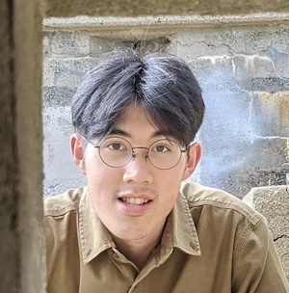
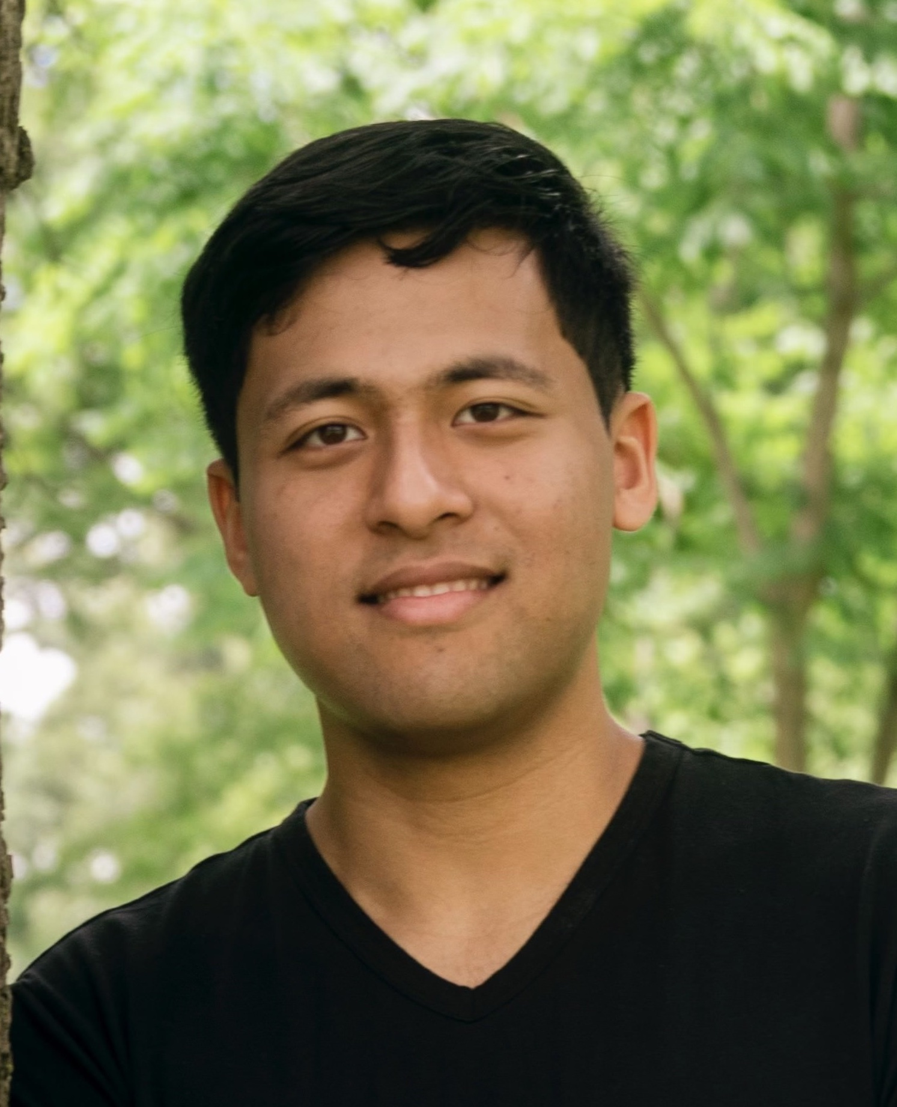
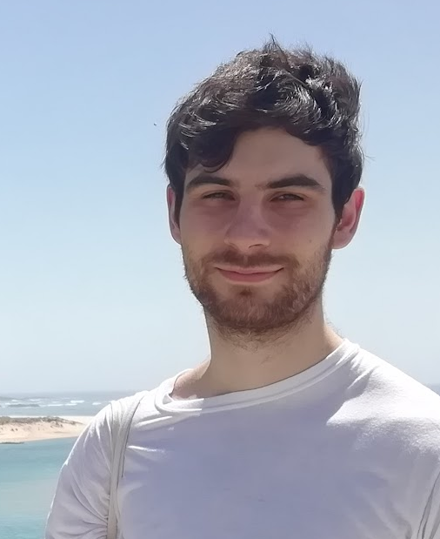
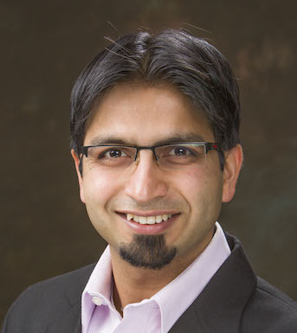
Maximum Flow and Minimum-Cost Flow in Almost Linear Time
Rasmus Kyng (ETH Zurich)
Swiss TCS Winter School
Jan 30th, 2023
Joint work with
Li Chen
GaTech
Yang Liu
Stanford
Richard Peng
UWaterloo
Max Probst Gutenberg
ETH Zurich
Sushant Sachdeva
UToronto

Slide 2
Links
rasmuskyng.com/winterschool2023
Problem sets
Course notes with some background, including basic convex optimization

Slide 3
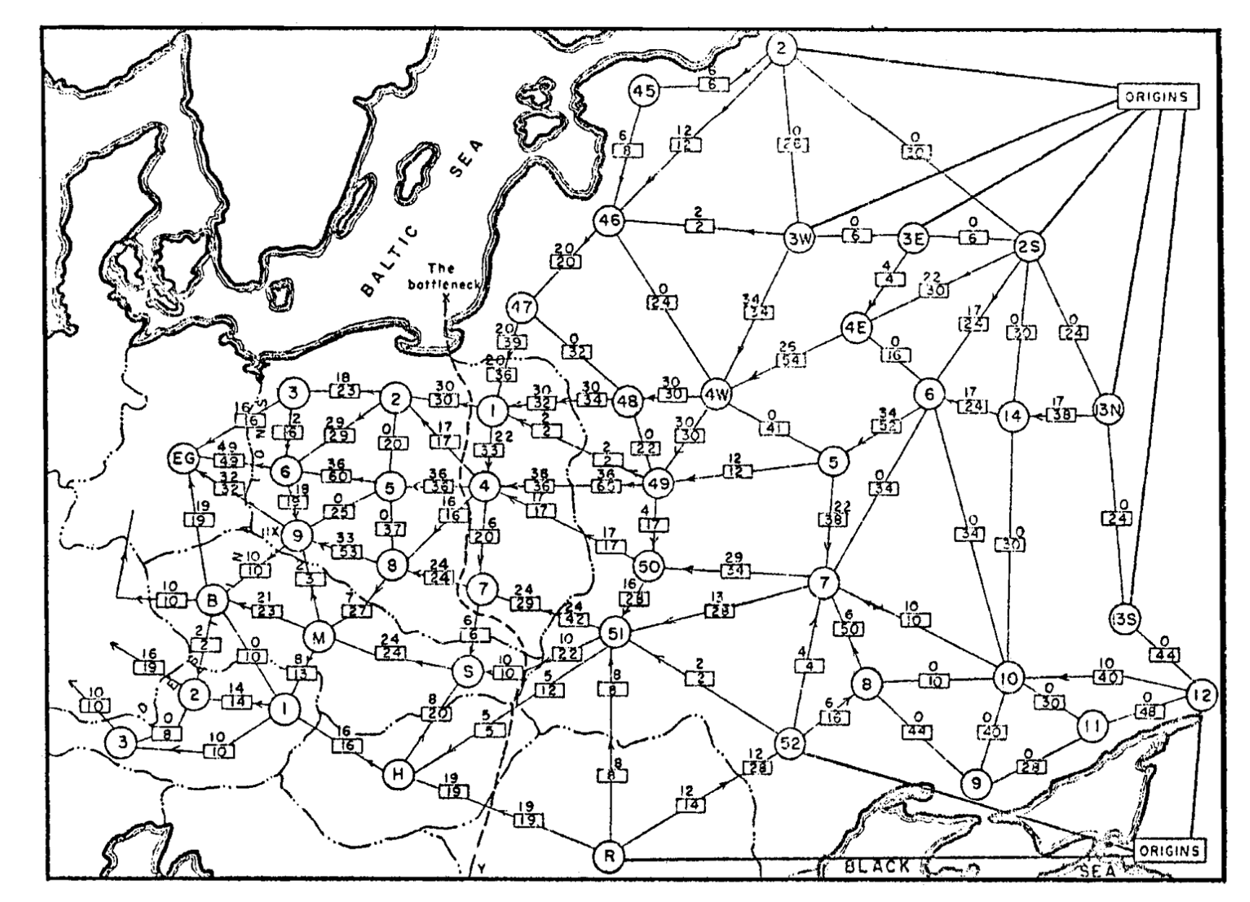


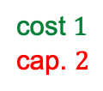
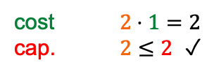


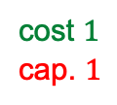

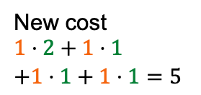

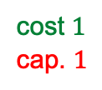

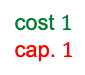





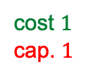
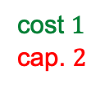



Apples on Trains?
Some cities have a surplus of apples, others a deficit.
How can we most cheaply send the surplus apples to cities with a deficit?
city = vertex
cost $1$
cap. $2$
train route = edge
cost $2⋅1=2$
cap. $2≤2$ $✓$
flow $2$
Train routes are directed and have
a cost (fuel spent per ton of apples) and
a capacity (tonnes apples per day)
$$+2$$
cost $2$
cap. $2$
$$+2$$
cost $2$
cap. $2$
Cost
$$2⋅2+2⋅1=6$$
New cost
$1⋅2+1⋅1$
$+1⋅1+1⋅1=5$
cost $1$
cap. $1$
$$2$$
Is this optimal?
cost $1$
cap. $1$
$$1$$
$$1$$
$$2$$
cost $1$
cap. $2$
No.
$$1$$
cost $1$
cap. $2$
$$1$$
cost $1$
cap. $1$
$$−2$$
cost $1$
cap. $1$
$$−2$$

Slide 4


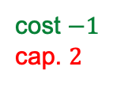



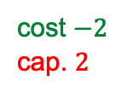


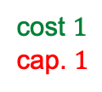









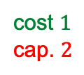







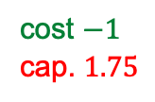
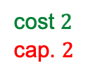
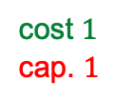
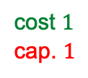



Improving our Solution?
Network with “undo” edges?
cost $1$
cap. $2$
cost $1$
cap. $2−1.75=0.25$
“the residual network w.r.t. to the given flow”
flow $1.75$
cost $−1$
cap. $1.75$
$$+2$$
cost $2$
cap. $2$
cost $−2$
cap. $2$
$$+2$$
$$2$$
purple cycle unit cost is
$1⋅(−2)+1⋅(−1)$ $+ 1 ⋅ 1 +1 ⋅ 1=−1$
cost $1$
cap. $1$
cost $1$
cap. $1$
$$1$$
cost $1$
cap. $2$
$$1$$
$$2$$
$$1$$
$$1$$
cost $−1$
cap. $2$
cost $1$
cap. $1$
$$−2$$
cost $1$
cap. $1$
$$−2$$
$$2$$
$$1$$
$$1$$
$$1$$
$$+$$
$$1$$
$$=$$
$$2$$
$$1$$
$$1$$
$$1$$
$$1$$
$$6$$
$$−1$$
$$5$$

Slide 5
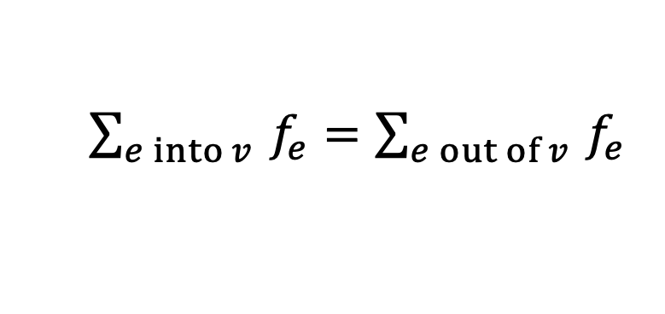
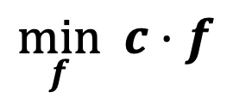
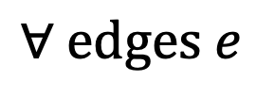
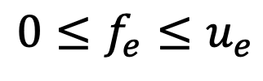
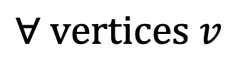
Linear Program for Min-Cost Flow
$$\min_{f} c⋅f$$
min-cost flow
$$∀ edges e$$
$$0≤f_{e}≤u_{e}$$
direction and capacity constraints
$$∀ vertices v$$
$\sum_{e into v }{f_{e}}=\sum_{e out of v }{f_{e}}$
Net flow constraints

Slide 6
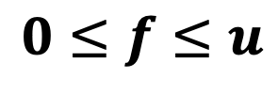


Linear Program for Min-Cost Flow
$$\min_{f} c⋅f$$
min-cost flow
$$0≤f≤u$$
direction and capacity constraints
$$Bf=0$$
Net flow constraints
[Chen-K-Liu-Peng-Probst Gutenberg-Sachdeva]
Can solve min-cost flow in $m^{1+o\left(1\right)}$ time

Slide 7
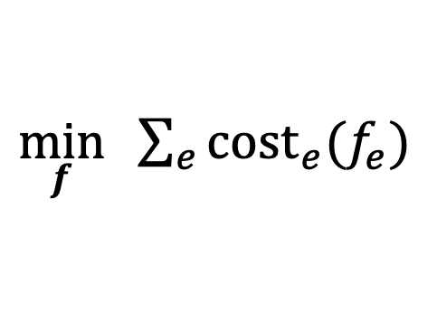
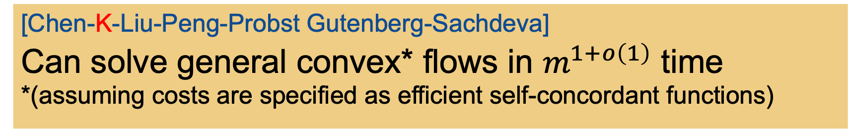
Linear Program for Min-Cost Flow
$\min_{f} \sum_{e}{{cost}_{e}(f_{e})}$
min-cost flow
$$0≤f≤u$$
direction and capacity constraints
$$Bf=0$$
Net flow constraints
[Chen-K-Liu-Peng-Probst Gutenberg-Sachdeva]
Can solve general convex* flows in $m^{1+o\left(1\right)}$ time
*(assuming costs are specified as efficient self-concordant functions)

Slide 8

Applications: Almost-Linear time Algorithms
(Min-cost) Bi-partite matching
Min-cost flow
Negative weight shortest paths
Worker assignment
Optimal Transport
Directed flows with vertex capacities / costs
Undirected vertex connectivity
Flow diffusion
…
Matrix Scaling
Isotonic Regression
Weighted $p$-norm Flows
Entropic-regularized Optimal Transport
…

Slide 9

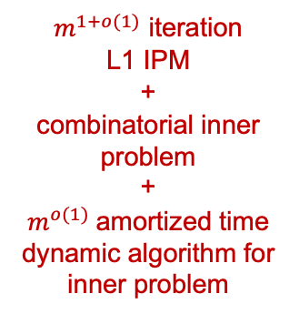
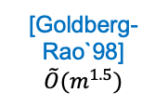

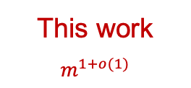
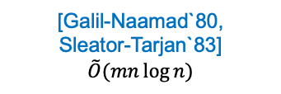
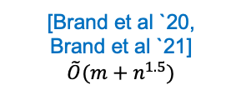


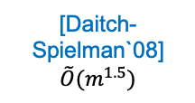


Comparison to Previous Works on Maximum Flow and Min-Cost Flow
$m$ edges, $n$ vertices
Combinatorial
Era
Continuous
Era
[Ford-Fulkerson`54]
$$\tilde{O}(m^{2}U)$$
[Galil-Naamad`80,
Sleator-Tarjan`83]
$$\tilde{O}(mn\log{n})$$
[Goldberg-Rao`98]
$$\tilde{O}(m^{1.5})$$
[Daitch-Spielman`08]
$$\tilde{O}(m^{1.5})$$
[Madry`13]
$$\tilde{O}(m^{1.43}U^{0.14})$$
[Lee-Sidford`14]
$$\tilde{O}(mn^{0.5})$$
[Kathuria Liu Sidford`20]
$$m^{1.33+o(1)}U^{0.33}$$
[Brand et al `20, Brand et al `21]
$$\tilde{O}(m+n^{1.5})$$
[Gao-Liu-Peng`21, Brand et al `21]
$$\tilde{O}(m^{1.48})$$
This work
$$m^{1+o(1)}$$
Combinatorial outer and inner algorithms
$m^{1+o(1)}$ iteration
L1 IPM
+
combinatorial inner problem
+
$m^{o(1)}$amortized time dynamic algorithm for inner problem
Numerical outer algorithm (L2 IPM)
+ numerical inner algorithm ($ℓ_{2},ℓ_{p}$ flows)
Improved outer loop
Improved inner loop via dynamic algorithms

Slide 10
Key Ingredient I: L1 Interior Point Method (IPM)
Outer Algorithm

Slide 11

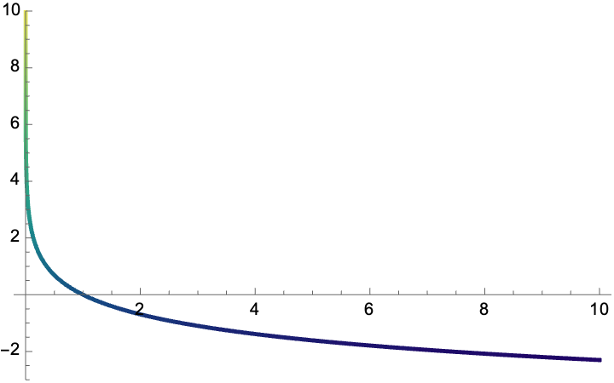









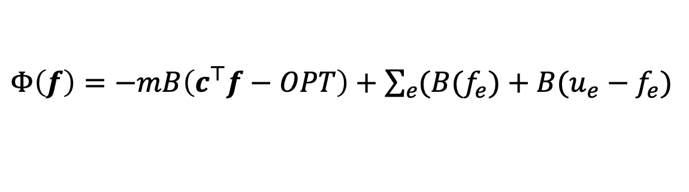



Interior Point Methods for Flow
Karmarkar ’84 Interior Point Method (IPM)
Renegar ’88 Path-Following IPM
$f_{1}≤4$
$$B(f)$$
Guarantee $f≥0$?
$f_{2}≥0$
$$Φ(f)$$
$f_{2}≤6$
$B\left(f\right)→∞$ as $f→0$
$f$
$f_{1}≥0$
${(f}_{1}^{∗},f_{2}^{∗})=(0 , 6)$
Minimize ${−6f}_{1}+f_{2}$
$Φ\left(f\right)=−mB\left(c^{⊤}f−OPT\right)+\sum_{e}{(B(f_{e})+B(u_{e}−f_{e})}$
Improves objective
Keep it “far” from hard constraints
$−αB(value gap of f)$

Slide 12



Interior Point Methods for Flow
Karmarkar ’84 Interior Point Method (IPM)
Renegar ’88 Path-Following IPM
$$Φ(f)$$
$f^{(0)}$
$f^{(1)}$
$$δ$$
$−αB(value gap of f)$

Slide 13


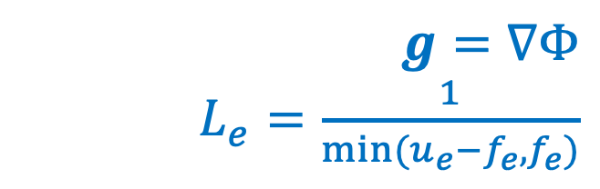

Interior Point Methods for Flow
Karmarkar ’84 Interior Point Method (IPM)
Renegar ’88 Path-Following IPM
$$Φ(f)$$
$$f$$
$f+δ$ ?
$g=∇Φ$
$L_{e}=\frac{1}{\min{(u_{e}−f_{e},f_{e})}}$
$$Φ\left(f+δ\right)≤Φ\left(f\right)\text{+}g^{⊤}δ+{\left\|Lδ\right\|}_{2}^{2}$$
2nd order Taylor expansion
Symmetrized residual capacity
$−αB(value gap of f)$

Slide 14
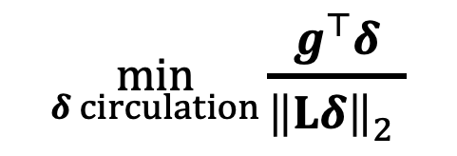
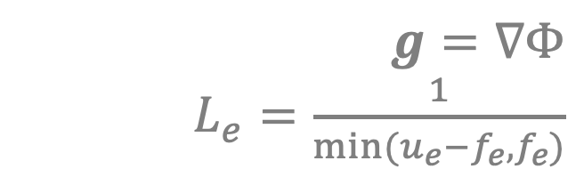



Interior Point Methods for Flow
Karmarkar ’84 Interior Point Method (IPM)
Renegar ’88 Path-Following IPM
Electrical flows!
$$\min_{δ circulation}{\frac{g^{⊤}δ}{{\left\|Lδ\right\|}_{2}^{}}}$$
$$Φ(f)$$
$$f$$
$$−g$$
$f+δ$ ?
$$Φ\left(f+δ\right)≤Φ\left(f\right)\text{+}g^{⊤}δ+{\left\|Lδ\right\|}_{2}^{2}$$
$g=∇Φ$
$L_{e}=\frac{1}{\min{(u_{e}−f_{e},f_{e})}}$
minimize over circulations $δ$: $Bδ=0$
$−αB(value gap of f)$

Slide 15
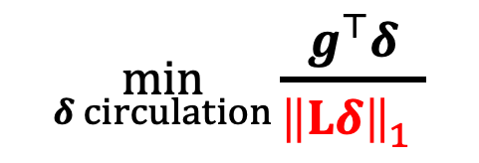

Interior Point Methods for Flow
Karmarkar ’84 Interior Point Method (IPM)
Renegar ’88 Path-Following IPM
Min-Ratio Cycles!
$$\min_{δ circulation}{\frac{g^{⊤}δ}{{\left\|Lδ\right\|}_{1}^{}}}$$
$$Φ(f)$$
$$f$$
$$−g$$
$f+δ$ ?
$$Φ\left(f+δ\right)≤Φ\left(f\right)\text{+}g^{⊤}δ+{\left\|Lδ\right\|}_{1}^{2}$$
$g=∇Φ$
$L_{e}=\frac{1}{\min{(u_{e}−f_{e},f_{e})}}$
minimize over circulations $δ$: $Bδ=0$
$−αB(value gap of f)$

Slide 16

Interior Point Methods for Flow
Karmarkar ’84 Interior Point Method (IPM)
Renegar ’88 Path-Following IPM
Min-Ratio Cycles!
$$\min_{δ circulation}{\frac{g^{⊤}δ}{{\left\|Lδ\right\|}_{1}^{}}}$$
$$Φ(f)$$
$$f$$
$$−g$$
$f+δ$ ?
Exercise: min-ratio circulation is
always realized by a simple cycle
$$Φ\left(f+δ\right)≤Φ\left(f\right)\text{+}g^{⊤}δ+{\left\|Lδ\right\|}_{1}^{2}$$
$g=∇Φ$
$L_{e}=\frac{1}{\min{(u_{e}−f_{e},f_{e})}}$
minimize over circulations $δ$: $Bδ=0$
$−αB(value gap of f)$

Slide 17
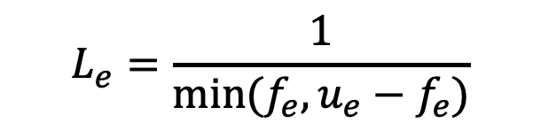


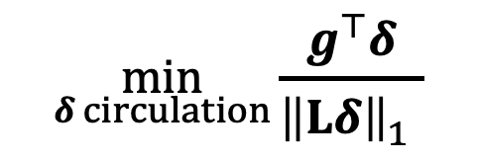

Min-Ratio Cycle
$$\min_{δ circulation}{\frac{g^{⊤}δ}{{\left\|Lδ\right\|}_{1}^{}}}$$
$$L_{e}=\frac{1}{min(f_{e},u_{e}−f_{e})}$$
$$δ$$
$$−g$$
undirectified residual capacity
cost $1$
cap. $2$
cost $1$
cap. $2−1.75=0.25$
flow $1.75$
cost $−1$
cap. $1.75$

Slide 18




Min-Ratio Cycle
$$\min_{δ circulation}{\frac{g^{⊤}δ}{{\left\|Lδ\right\|}_{1}^{}}}$$
$$L_{e}=\frac{1}{min(f_{e},u_{e}−f_{e})}$$
$$δ$$
$$−g$$
undirectified residual capacity
cost $1$
cap. $2$
cost $1$
cap. $2−1.75=0.25$
flow $1.75$
Directed cost $±1$
Undirected length $\frac{1}{0.25}$
cost $−1$
cap. $1.75$
cap. $0.25$
$\max_{e}{|{L_{e}δ}_{e}| }≤1⇒$ $f+δ$feasible
$${\left\|Lδ\right\|}_{∞}^{}$$
${\left\|Lδ\right\|}_{1}^{}≤0.1⇒$ $f+δ$feasible and $g$ and $L$ change very little

Slide 19

Our L1 IPM
[Chen-K-Liu-Peng-Probst Gutenberg-Sachdeva]
There is an IPM for min-cost flow such that
$m^{1+o(1)}$ iterations, each subproblem a min-ratio cycle $\min_{Bδ=0}{\frac{g^{⊤}δ}{{\left\|Lδ\right\|}_{1}^{}}}$
A $m^{o(1)}$-approximate solution suffices at each iteration
At most $m^{1+o(1)}$ total changes to $g_{e},L_{e}$ over all edges $e$
For each min-ratio cycle problem, $f^{⋆}−f$ is a good solution
Notes:
The algorithm, we called L1 IPM is as follows
It runs in almost linear number of iterations
Each iteration solves a min ratio cycle
We show that almost-constant approx suffices at each iteration
The gradient and lengths are stable.
Throughout the algorithm, there are m to the 1 plus o(1) total changes to them.
At each iteration, f star minus f makes enough progress.
f star is the optimal flow.
So, our approx cycle also makes enough progress

Slide 20
Key Ingredient II: Min-ratio Cycle Data-Structure
Inner Algorithm
Notes:
Now I will discuss the second key ingredient.
It is a data structure for dynamic min ratio cycle
But for now, I’ll show you a static min ratio cycle algorithm

Slide 21



Warm-up: A Single Approximate Min-Ratio Cycle using Random Trees
Goal: Approximately solve $\min_{Bδ=0}{\frac{g^{⊤}δ}{{\left\|Lδ\right\|}_{1}^{}}}$
Algorithm:
Sample a random “low-stretch spanning tree” $\text{T}$ [Alon-Karp-Peleg-West ‘95, Elkin-Emek-Spielman-Teng ‘05, Abraham-Bartal-Neiman ‘09]
Return the best “tree cycle” in $\text{T}$ (one off-tree edge + tree path)
$\tilde{O}(m)$ time
$\tilde{O}(m)$ time
Notes:
So the goal is to find an approximate min ratio cycle
first, we sample a low stretch spanning tree
this takes m polylog time
Then, we output the best tree cycle in T
A tree cycle is one off-tree edge + the tree path
They are also called fundamental cycles
We denote them by cycle of e
This step takes also m polylog time

Slide 22





Warm-up: A Single Approximate Min-Ratio Cycle using Random Trees
$$e$$
$$𝔼_{T}\left[L\text{(}tree cycle of e\text{)}\right]≤ Õ\left(1\right) L_{e}$$
min-ratio cycle $δ^{∗}$
By Markov’s inequality, with probability 1/2
$$𝔼_{T}\left[\sum_{\begin{aligned}e∈δ^{∗} \\ \end{aligned}}{L\text{(}tree cycle of e\text{)}}\right]≤Õ\left(1\right)\sum_{e∈δ^{∗}}{L_{e}}$$
$$\sum_{e∈δ^{∗}}{gradient of tree cycle of e} =\sum_{e∈δ^{∗}}{gradient of e}$$

Slide 23

Min-ratio cycle data-structure
[Chen-K-Liu-Peng-Probst Gutenberg-Sachdeva]
A randomized data-structure that maintains $m^{o(1)}$ “low-stretch” trees
and supports in $m^{o(1)}$ amortized time w.h.p.
Update $g_{e},L_{e}$ for an edge e
Return a $m^{o(1)}$-approximate min-ratio cycle
Route flow along such a cycle
Notes:
So here is the data structure statement
we have a randomized data structure that maintains a few low stretch trees
and supports the following operations in almost constant amortized time with high probability
one update g and L for an edge
two return an approx min ratio cycle
three send flow along the cycle
Now we can write down the overall algorithm

Slide 24

Overall Algorithm
A data-structure maintains a few trees $\left\{T_{i}\right\}$
For $t←1$,…,${ m}^{1+o(1)}$ iterations
Identify a circulation $δ$ approximately minimizing $\frac{g^{⊤}δ}{{\left\|Lδ\right\|}_{1}}$, Update $f^{(t)}←f^{(t−1)}+αδ$
Update (lazy) gradients $g$ and lengths $L$
Update trees
Output final flow $f^{(final)}$
Notes:
using the data structure
our overall algorithm looks like this
the data structure maintains a few trees
for an almost linear number of iterations
we update gradients and lengths
we update trees accordingly
we query for an approx min ratio cycle delta
then, we send flow along delta
We output the final flow as solution

Slide 25

Dynamic Min Ratio Cycle
“Partial Tree Building” Partial Tree on a subset of vertices/edges $\sim 0.99 m$ Recurse on the rest $\sim 0.01 m$
“Partial Tree Maintenance” Maintain partial tree through $0.01 m$ updates, then rebuild Pass edge update to the recursive DS on the next level
Challenges: Recursion should reduce #vertices and #edges Maintain the smaller graph under edge updates/vertex splits
Notes:
Now I’ll show you more about the data structure
The previous tree algorithm is not easy to handle updates
Instead of building the whole tree at once, we build a partial tree on a large subset of vertices and edges, say, 0.99m of them
For the rest of 0.01 m, we recursively build the tree on them
This approach can be maintained dynamically
In particular, we maintain the partial tree through 0.01 m updates and then rebuild the whole thing
When an edge update comes, we add both endpoints to the next level graph
And we pass the update to the data structure next level
There are two challenges to implement the approach
One is the recursion should reduce number of vertices and edges
Two is the dynamic maintenance of the next level graph under edge updates and vertex splits
I’ll talk about them in the next slide

Slide 26


















Min-Ratio Data Structure Layers
$$G_{0}$$
$$G_{1}$$
$δ^{∗}$
$$G_{2}$$
$δ^{∗}$
depth $d$
$δ^{∗}$
$$⋯$$
$$G_{d}$$
$m$ edges
$m/K$ edges
$m/K^{d}$ edges
$−1$ OPT
$−1/β$ OPT
$−1/β^{d}$ OPT
$1$ update
$R$ updates
$R^{d}$ updates
Notes:
SAY normal IPMs cannot work with distortion >> 1
SAY recourse R << deg() very hard with existing methods

Slide 27






Min-Ratio Data Structure
Rooted forest $F$
$≈$“partial tree”
vertex
sparsification
“roots”
$=$vertices of $G_{1}$
$$G_{0}$$
“core graph”
$≈m$ edges
$≈m$ vertices
$≈m$ edges
$≈m/K$ vertices

Slide 28


Min-Ratio Data Structure
vertex
sparsification
edge
sparsification
“sparsified
core graph”
$$G_{0}$$
“core graph”
$=G_{1}$
$≈m$ edges
$≈m$ vertices
$≈m$ edges
$≈m/K$ vertices
$≈m/K$ edges
$≈m/K$ vertices

Slide 29

Core Graphs – Dynamically?!
Graph $G$
Forest $F$
Roots
edge changed in G
remove it from forest!
Core graph

Slide 30
Core Graphs – Dynamically?!
Graph $G$
Forest $F$
Roots
edge changed in G
remove it from forest!
Core graph

Slide 31
Edge Sparsification via Spanners
Core graph

Slide 32

Edge Sparsification via Spanners
Core graph
Spanner
Edge
embedding
length $m^{o(1)}$

Slide 33
Dynamic Spanner
Core graph
Vertex split!
Spanner
Edge
embedding

Slide 34
Dynamic Spanner
Core graph
Spanner
Edge
embedding

Slide 35





Edge Sparsification and Spanner Cycles
Circulation $δ^{∗}$
$δ^{∗}$ embedded into $S$
$δ^{∗}$
$δ^{∗}$
Core graph
Spanner $S$
Edge
embedding
Spanner
cycles
Lemma
Either some spanner cycle is a good min-ratio cycle
OR
Challenge
We maintain explicit embeddings
of all edges into spanner
$δ^{∗}$ embedded into $S$ is still a good min-ratio cycle

Slide 36



Adaptivity Issue
Our DS does not work for all update/query sequences
gradients $g_{e}$ and lengths $L_{e}$ affected by DS output non-oblivious adversary
White-box analysis of DS and IPM
Gradient/lengths updates reveal which edge becomes important
$f^{∗}−f$ is a good enough direction
Min-Ratio DS
$$G$$
Update cycle $δ$
Notes:
We encountered the so-called adaptivity issue

Slide 37

Data Structure Ideas Summary
A single tree can find the first good cycle
Recursive partial tree building and maintenance
Core graph for vertex reduction
Contract forest components
Dynamic $→$ vertex splits
Spanner for edge reduction
Dynamic $→$ maintain via “spanner of broken edges”
Use edge embeddings to detect good cycles
New semi-adaptive adversary model
Notes:
We encountered the so-called adaptivity issue

Slide 38

Some immediate open problems
Deterministic?
$m^{1+o(1)}$-time to $m polylog(m)$–time? Simple and practical?
Static Spanner with Embedding Find a sparse subgraph $H$ and embed each edge with a $polylog(m)$-length path in $H$?
Bound vertex congestion by roughly max-degree
Can we improve k-commodity flow?
General graph matching in almost-linear time?

Slide 39
Thank you for listening! Questions? arxiv.org/abs/2203.00671
Co-authors
Li Chen
GaTech
Yang Liu
Stanford
Richard Peng
UWaterloo
Max Probst Gutenberg
ETH Zurich
Sushant Sachdeva
UToronto

Slide 40

Comparison to Previous Works on Maximum Flow and Min-Cost Flow
[Ford-Fulkerson`54]
$$\tilde{O}(m^{2}U)$$
[Galil-Naamad`80,
Sleator-Tarjan`83]
$$\tilde{O}(mn\log{n})$$
[Goldberg-Rao`98]
$$\tilde{O}(m^{1.5})$$
[Daitch-Spielman`08]
$$\tilde{O}(m^{1.5})$$
[Madry`13]
$$\tilde{O}(m^{1.43}U^{0.14})$$
[Lee-Sidford`14]
$$\tilde{O}(mn^{0.5})$$
[Kathuria Liu Sidford`20]
$$m^{1.33+o(1)}U^{0.33}$$
[Brand et al `20, Brand et al `21]
$$\tilde{O}(m+n^{1.5})$$
[Gao-Liu-Peng`21, Brand et al `21]
$$\tilde{O}(m^{1.48})$$
This work
$$m^{1+o(1)}$$
Combinatorial outer and inner algorithms
$m^{1+o(1)}$ iteration
L1 IPM
+
combinatorial inner problem
+
$m^{o(1)}$amortized time dynamic algorithm for inner problem
Numerical outer algorithm (L2 IPM), $Ω\left(m^{0.33}U^{1/7}\right)$ or $Ω\left(n^{0.5}\right)$ iterations
+ numerical inner algorithm ($ℓ_{2},ℓ_{p}$ flows), $Ω\left(m^{0.98}\right)$-time
Improved outer loop
Improved inner loop via dynamic algorithms

