Slide 1
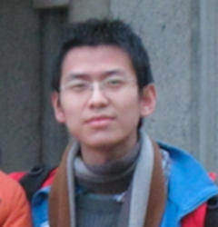
A matrix Chernoff bound for strongly Rayleigh distributions and spectral sparsifiers from a few random spanning trees
Speaker | Rasmus Kyng | Harvard University
Joint work | with Zhao Song | UT Austin
 |  | October 2018

Slide 2
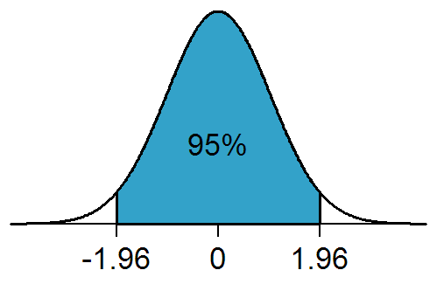

Concentration of scalar random variables
Independent random $X_{i}∈ℝ$
$X=\sum_{i}{X_{i}}$
Is $X≈𝔼X$with high probability?

Slide 3
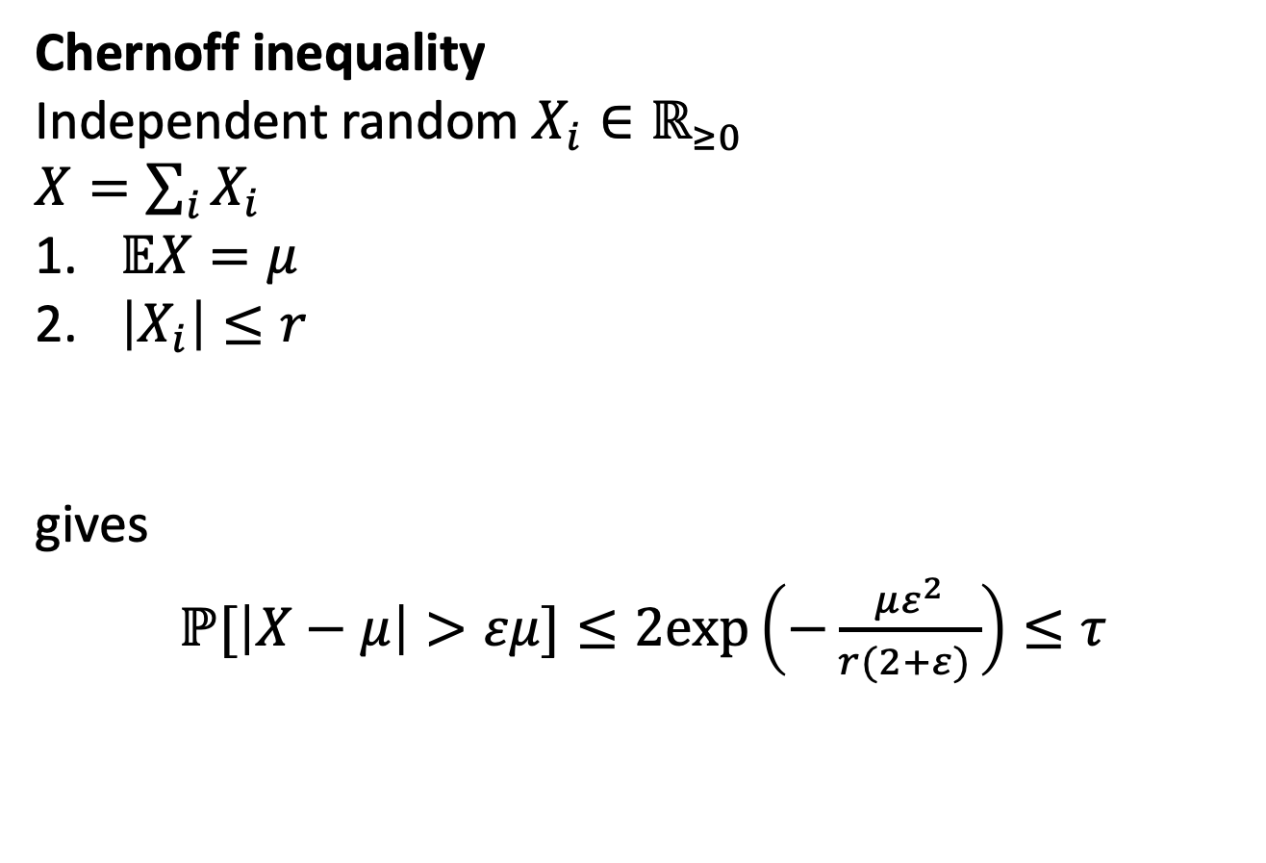
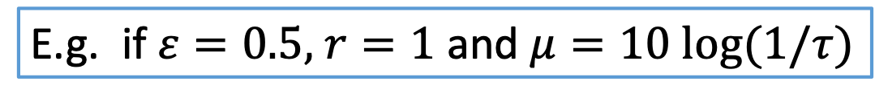
Concentration of scalar random variables
Chernoff inequality
Independent random $X_{i}∈ℝ_{≥0}$
$X=\sum_{i}{X_{i}}$
$𝔼X=μ$
$\left|X_{i}\right|≤r$
gives
$ℙ[\left|X−μ\right|>εμ]≤2exp\left(−\frac{με^{2}}{r(2+ε) }\right)≤τ$
E.g. if $ε=0.5,$ $r=1$ and $μ=10 log(1/τ)$

Slide 4

Concentration of random matrices
Independent random $X_{i}∈ℝ^{d×d}$
$X=\sum_{i}{X_{i}}$
Is $X≈𝔼X$ with high probability?

Slide 5
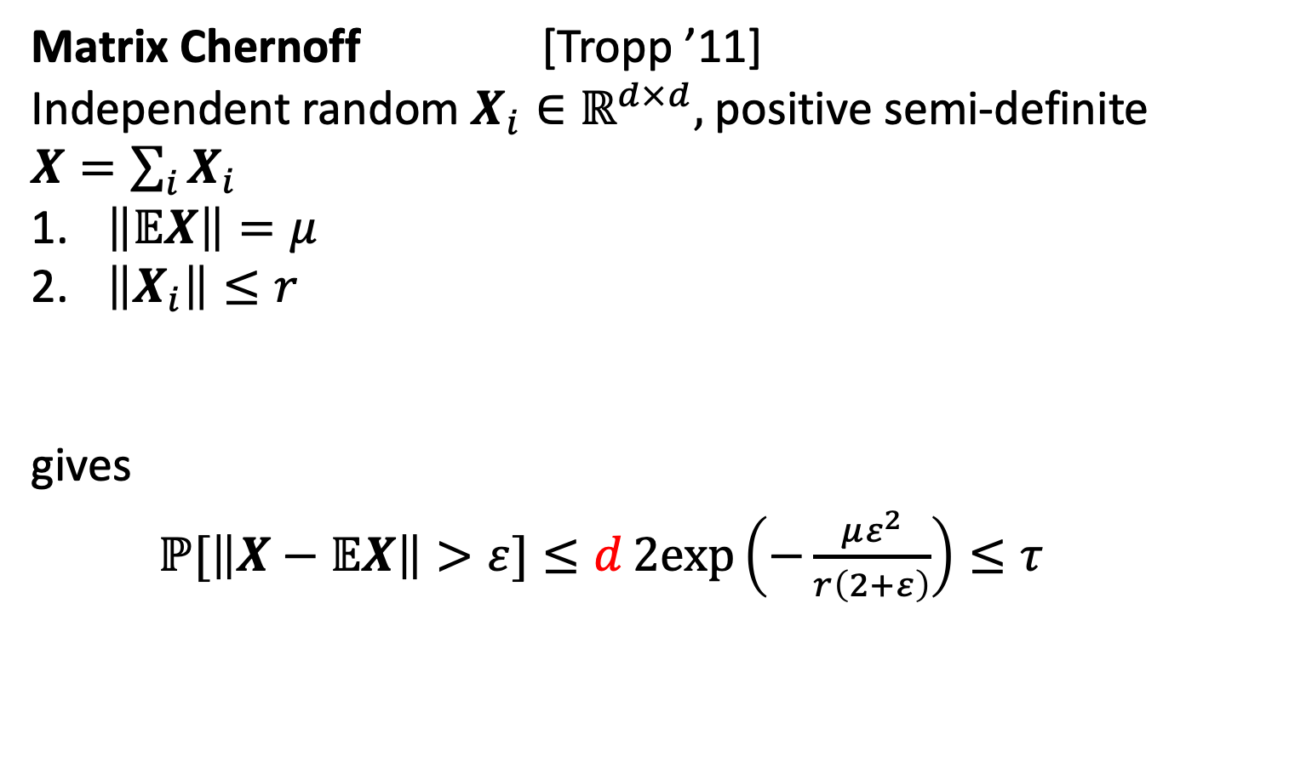
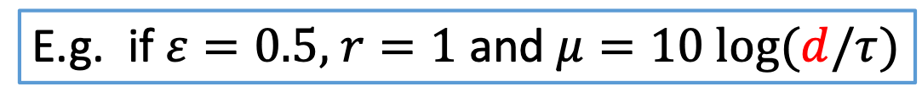
Concentration of random matrices
Matrix Chernoff [Tropp ’11]
Independent random $X_{i}∈ℝ^{d×d},$ positive semi-definite
$X=\sum_{i}{X_{i}}$
$\left\|𝔼X\right\|=μ$
$\left\|X_{i}\right\|≤r$
gives
$ℙ[\left\|X−𝔼X\right\|>ε]≤d2exp\left(−\frac{με^{2}}{r\left(2+ε\right)}\right)≤τ$
E.g. if $ε=0.5,$ $r=1$ and $μ=10 log(d/τ)$
[Rudelson ‘99, Ahlswede-Winter ’02]

Slide 6
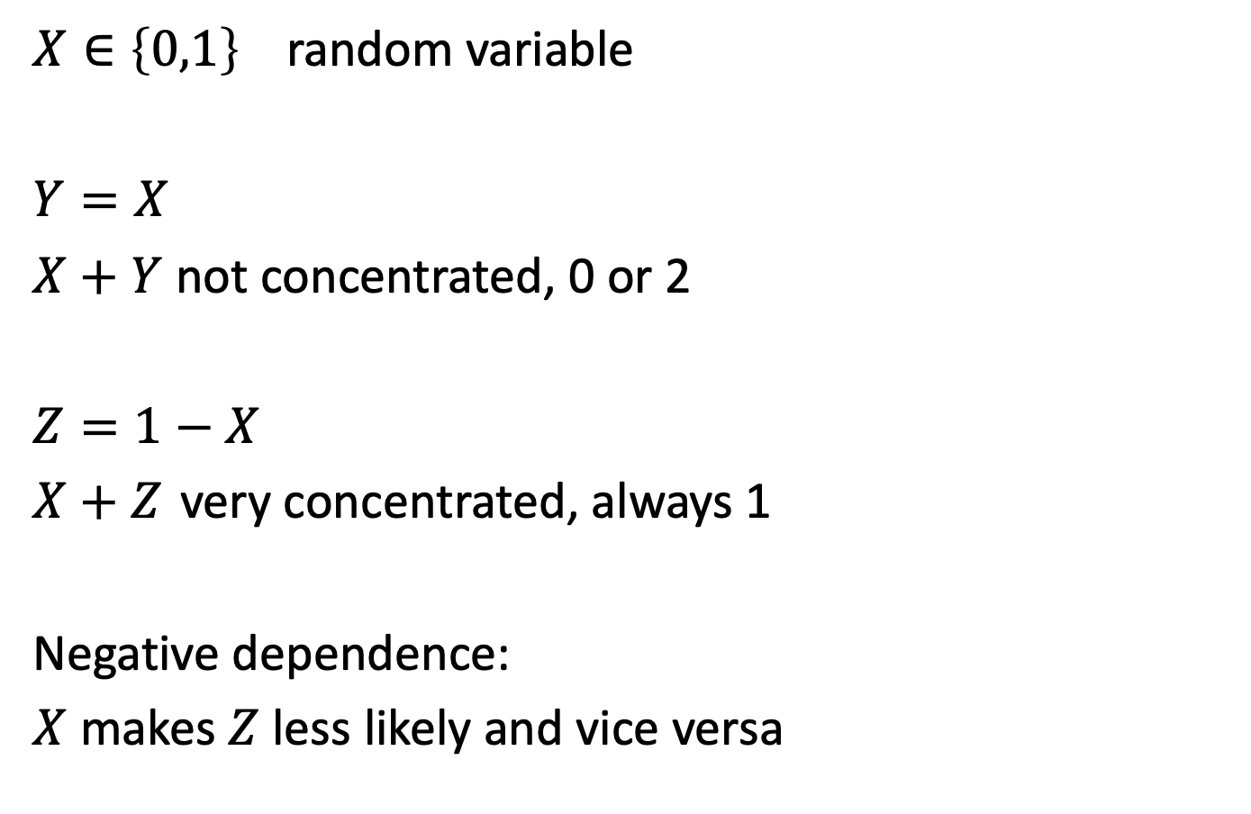
What if variables are not independent?
$X∈{\left\{0,1\right\}}^{ }$ random variable
$Y=X$
$X+Y$ not concentrated, 0 or 2
$Z=1−X$
$X+Z$ very concentrated, always 1
Negative dependence:
$X$ makes $Z$ less likely and vice versa

Slide 7
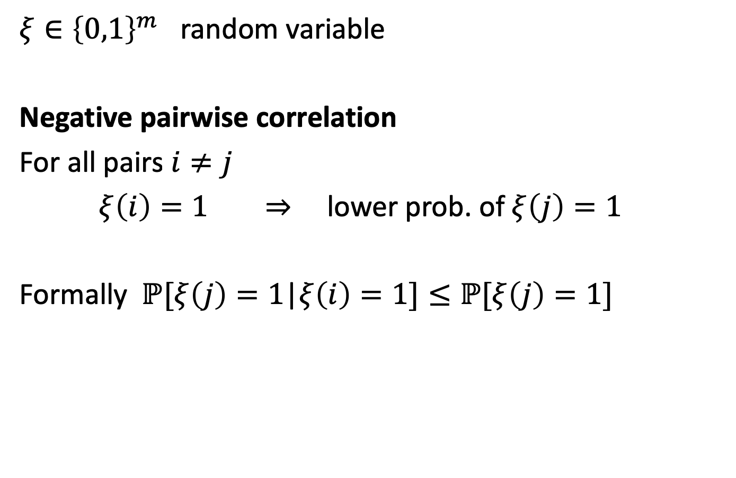
What if variables are not independent?
$ξ∈{\left\{0,1\right\}}^{m}$ random variable
Negative pairwise correlation
For all pairs $i≠j$
$ξ\left(i\right)=1$ $⇒$ lower prob. of$ξ\left(j\right)=1$
Formally $ℙ[ξ\left(j\right)=1$|$ξ\left(i\right)=1]≤ℙ[ξ\left(j\right)=1\text{]}$

Slide 8
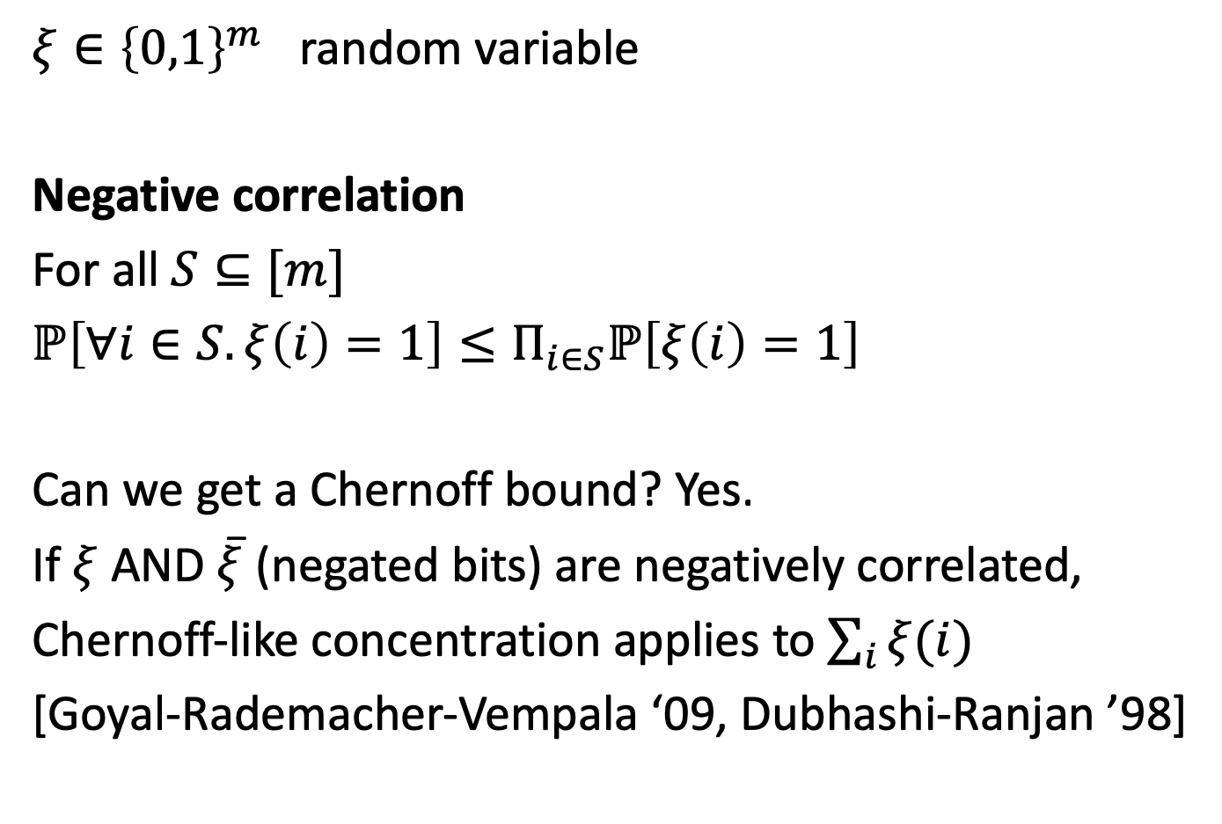
What if variables are not independent?
$ξ∈{\left\{0,1\right\}}^{m}$ random variable
Negative correlation
For all $S⊆[m]$
$ℙ\left[∀i∈S.ξ\left(i\right)=1\right]≤Π_{i∈S}ℙ\left[ξ\left(i\right)=1\right]$
Can we get a Chernoff bound? Yes.
If $ξ$ AND $\overline{ξ}$ (negated bits) are negatively correlated,
Chernoff-like concentration applies to $\sum_{i}{ξ(i)}$
[Goyal-Rademacher-Vempala ‘09, Dubhashi-Ranjan ’98]

Slide 9
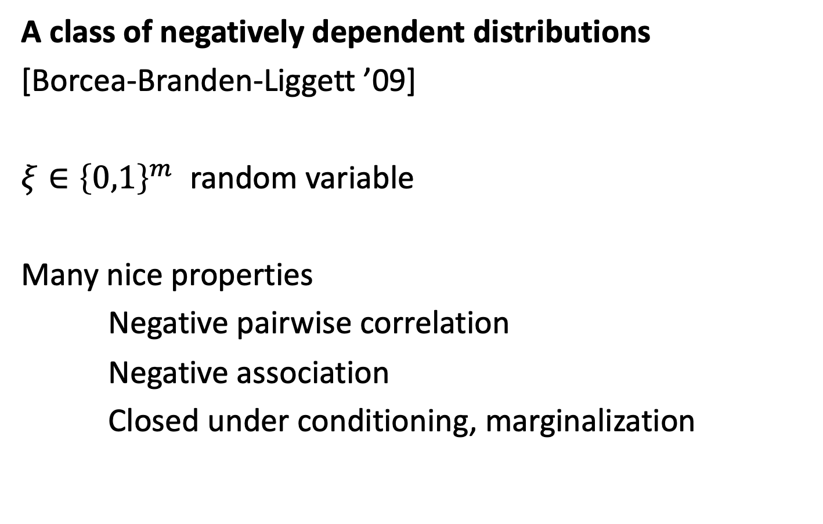
Strongly Rayleigh distributions
A class of negatively dependent distributions
[Borcea-Branden-Liggett ’09]
$ξ∈{\left\{0,1\right\}}^{m}$ random variable
Many nice properties
Negative pairwise correlation
Negative association
Closed under conditioning, marginalization

Slide 10
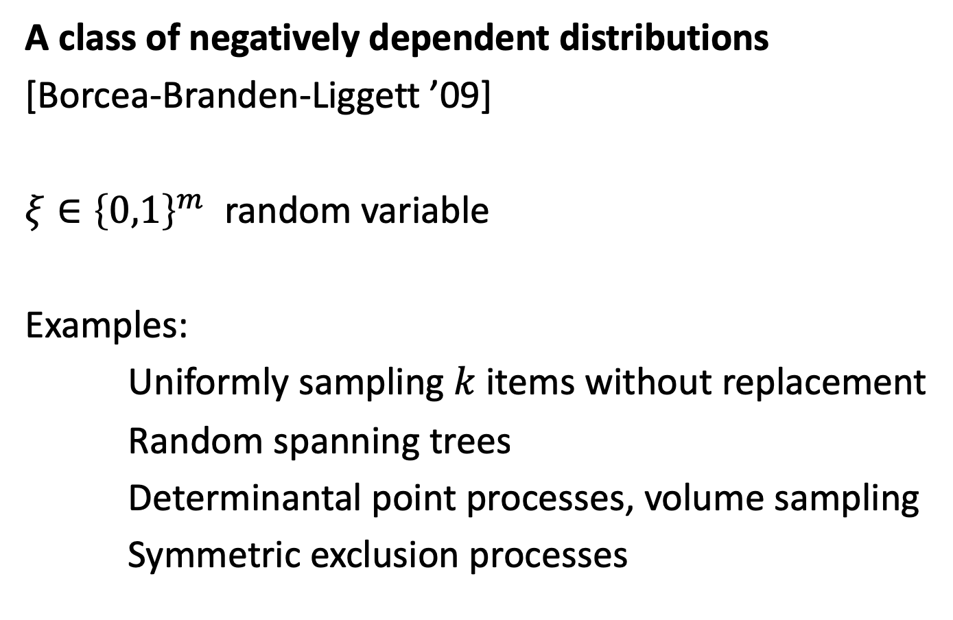
Strongly Rayleigh distributions
A class of negatively dependent distributions
[Borcea-Branden-Liggett ’09]
$ξ∈{\left\{0,1\right\}}^{m}$ random variable
Examples:
Uniformly sampling $k$ items without replacement
Random spanning trees
Determinantal point processes, volume sampling
Symmetric exclusion processes

Slide 11
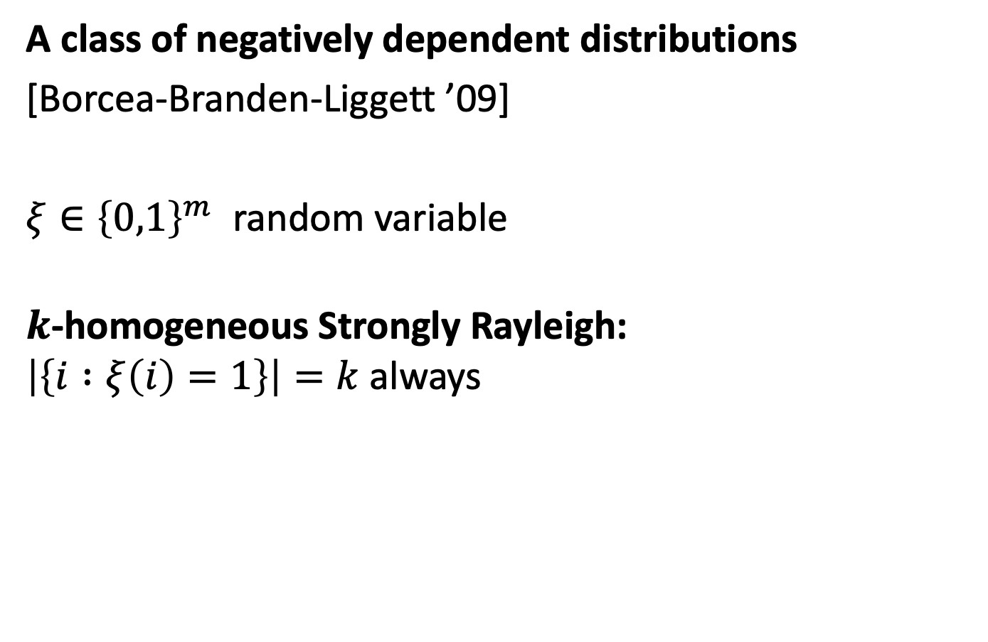
Strongly Rayleigh distributions
A class of negatively dependent distributions
[Borcea-Branden-Liggett ’09]
$ξ∈{\left\{0,1\right\}}^{m}$ random variable
$k$-homogeneous Strongly Rayleigh:
$\left|\left\{i :ξ\left(i\right)=1\right\}\right|=k$ always

Slide 12
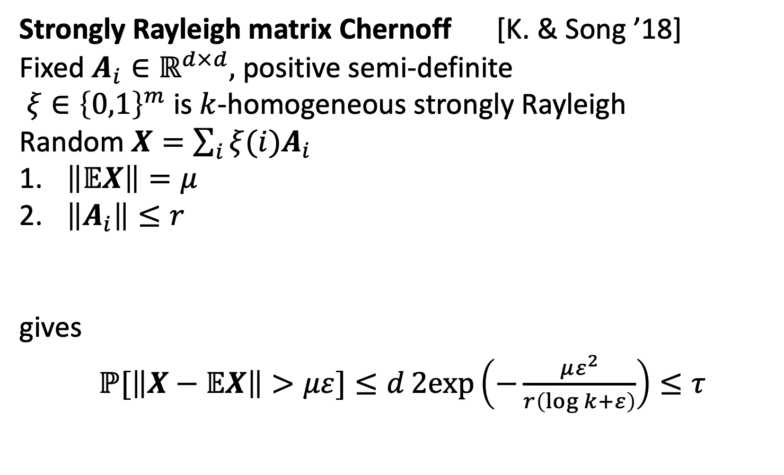
Concentration of random matrices
Strongly Rayleigh matrix Chernoff [K. & Song ’18]
Fixed $A_{i}∈ℝ^{d×d},$ positive semi-definite
$ξ∈{\left\{0,1\right\}}^{m}$ is $k$-homogeneous strongly Rayleigh
Random $X=\sum_{i}{{ξ(i)A}_{i}}$
$\left\|𝔼X\right\|=μ$
$\left\|A_{i}\right\|≤r$
gives
$ℙ[\left\|X−𝔼X\right\|>με]≤d2exp\left(−\frac{με^{2}}{r\left(\log{k}+ε\right)}\right)≤τ$
E.g. if $ε=0.5,$ $r=1$ and $μ=10 log\left(d/τ\right)log⁡(k)$
Scalar version: Peres-Pemantle ‘14

Slide 13
Concentration of random matrices
Strongly Rayleigh matrix Chernoff [K. & Song ’18]
Fixed $A_{i}∈ℝ^{d×d},$ positive semi-definite
$ξ∈{\left\{0,1\right\}}^{m}$ is $k$-homogeneous strongly Rayleigh
Random $X=\sum_{i}{{ξ(i)A}_{i}}$
$\left\|𝔼X\right\|=μ$
$\left\|A_{i}\right\|≤r$
gives
$ℙ[\left\|X−𝔼X\right\|>με]≤d2exp\left(−\frac{με^{2}}{r\left(\log{k}+ε\right)}\right)≤τ$
E.g. if $ε=log⁡(k),$ $r=1$ and $μ=10 log\left(d/τ\right)$
Scalar version: Peres-Pemantle ‘14

Slide 14
An application:
Graph approximation using random spanning trees

Slide 15
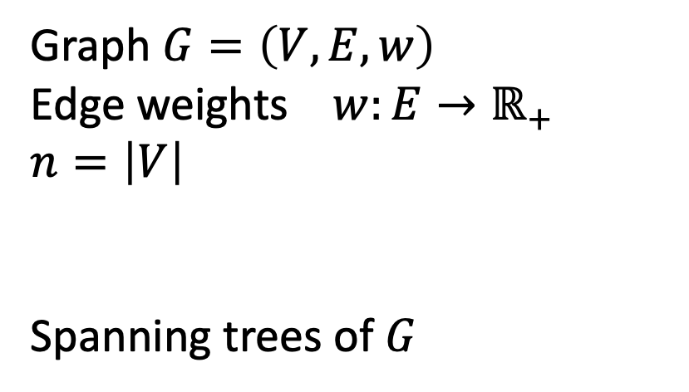
Spanning trees of a graph
Graph $G=\left(V,E,w\right)$
Edge weights $w:E→ℝ_{+}$
$n=\left|V\right|$
Spanning trees of $G$

Slide 16
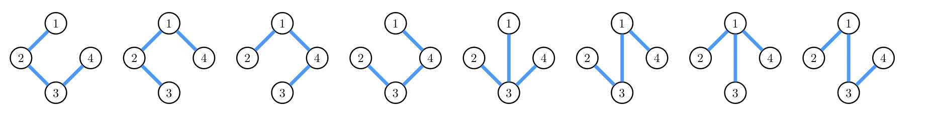

Random spanning trees
Graph $G$
Tree distribution
Pick a random tree?

Slide 17
Random spanning trees
Does the sum of a few random spanning trees
resemble the graph?
E.g. is the weight across each cut similar?
Starter question:
Are the edge weights similar in expectation?

Slide 18

Random spanning trees
Graph $G$
Tree distribution
Pick a random tree

Slide 19

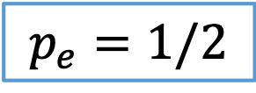
Random spanning trees
Graph $G$
Tree distribution
Pick a random tree
$p_{e}:$ probability of edge present
$$p_{e}=1/2$$

Slide 20
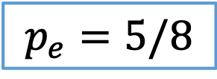
Random spanning trees
Graph $G$
Tree distribution
Pick a random tree
$p_{e}:$ probability of edge present
$$p_{e}=5/8$$

Slide 21


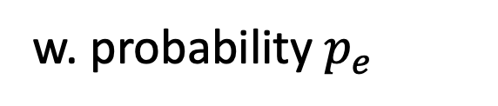
Random spanning trees
Getting the expectation right:
$𝔼w_{T}\left(e\right)=p_{e}⋅\frac{1}{p_{e}}w_{G}\left(e\right)=$ $w_{G}\left(e\right)$
$$w_{T}(e)=\left\{\begin{aligned}\frac{1}{p_{e}}w_{G}(e) \\ \frac{1}{p_{e}}0\end{aligned}\right.$$
w. probability $p_{e}$
o.w.

Slide 22






Reweighted random spanning trees
Original weights
Tree weights
$$1$$
$$1$$
$$8/5$$
$$1$$
$$2$$
$$1$$
$$1$$
$$8/5$$

Slide 23


Reweighted random spanning trees
Original weights
Tree weights
$$1$$
$$1$$
$$8/5$$
$$8/5$$
$$1$$
$$1$$
$$1$$
$$8/5$$

Slide 24






Reweighted random spanning trees
Original weights
Tree weights
$$1$$
$$1$$
$$1/p_{e}$$
$$1$$
$$1$$
$$1$$
$$𝔼$$
$$=$$
$$1$$
$$1$$
$$1$$
random
tree
$$1$$
$$1$$

Slide 25
Reweighted random spanning trees
Original weights
Tree weights
$$1$$
$$1$$
$$1/p_{e}$$
$$1$$
$$1$$
$$1$$
$$𝔼$$
$$=$$
$$1$$
$$1$$
$$1$$
random
tree
$$1$$
$$1$$
The average weight over trees equals the original weight
Does the tree “behave like” the original graph?

Slide 26
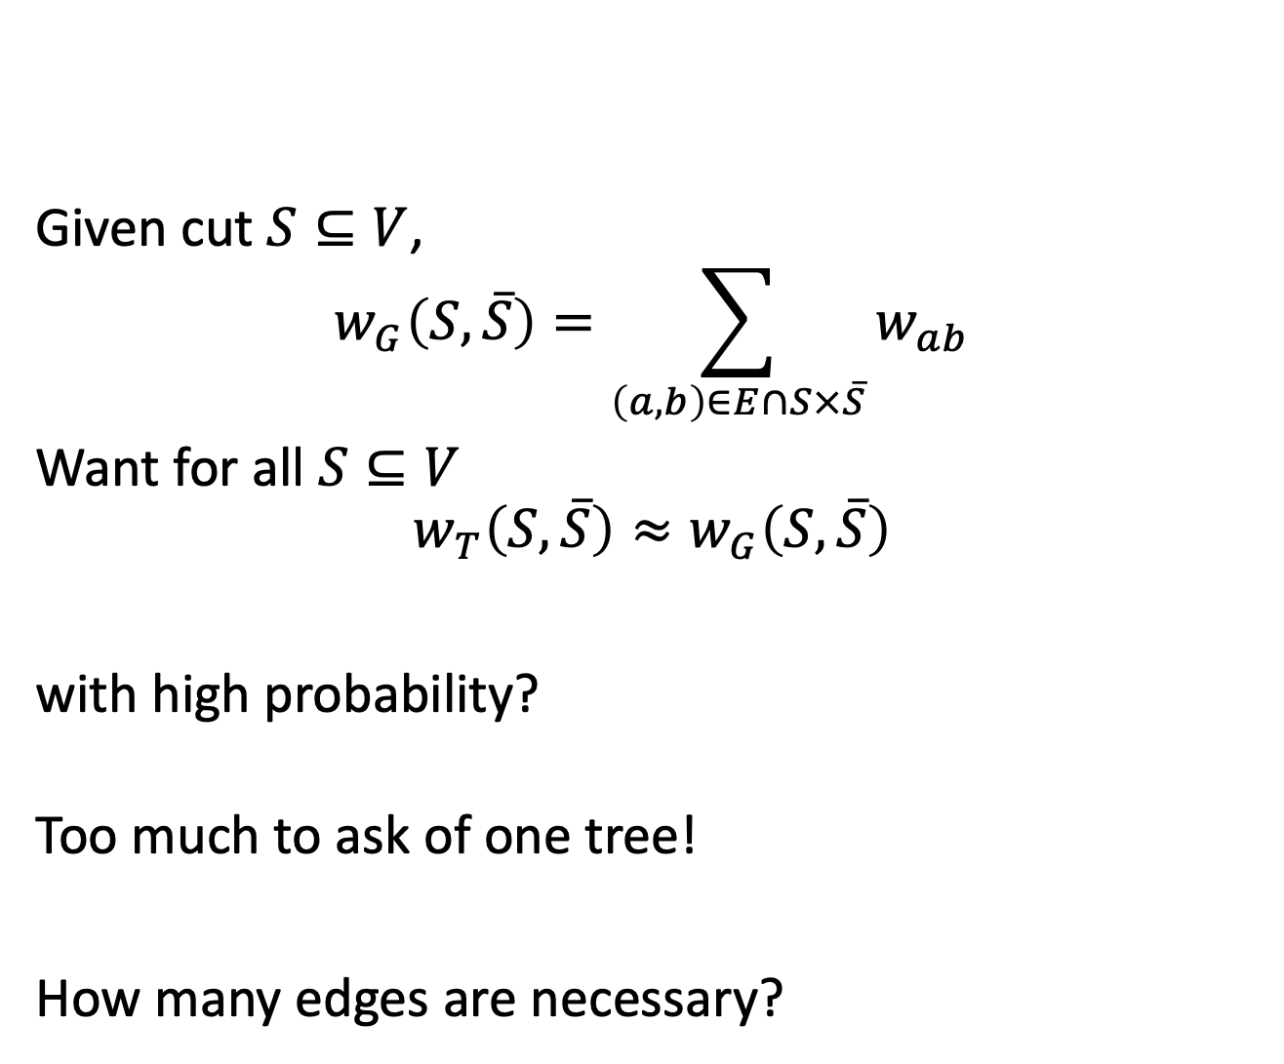
Preserving cuts?
Given cut $S⊆V$,
$$w_{G}\left(S,\overline{S}\right)=\sum_{\left(a,b\right)∈E∩S×\overline{S}}{w_{ab}}$$
Want for all $S⊆V$
$$w_{T}\left(S,\overline{S}\right)≈w_{G}\left(S,\overline{S}\right)$$
with high probability?
Too much to ask of one tree!
How many edges are necessary?

Slide 27

Independent edge samples
$G$ graph
Flip a coin for each edge to decide if present
$H$ random graph, independent edges

Slide 28
Independent edge samples
$G$ graph
Flip a coin for each edge to decide if present
$H$ random graph, independent edges

Slide 29




Independent edge samples
$$H$$
Getting the expectation right:
$𝔼w_{H}\left(e\right)=p_{e}⋅\frac{1}{p_{e}}w_{G}\left(e\right)=$ $w_{G}\left(e\right)$
$$G$$
$$w_{H}(e)=\left\{\begin{aligned}\frac{1}{p_{e}}w_{G}(e) \\ \frac{1}{p_{e}}0\end{aligned}\right.$$
w. probability $p_{e}$
o.w.

Slide 30
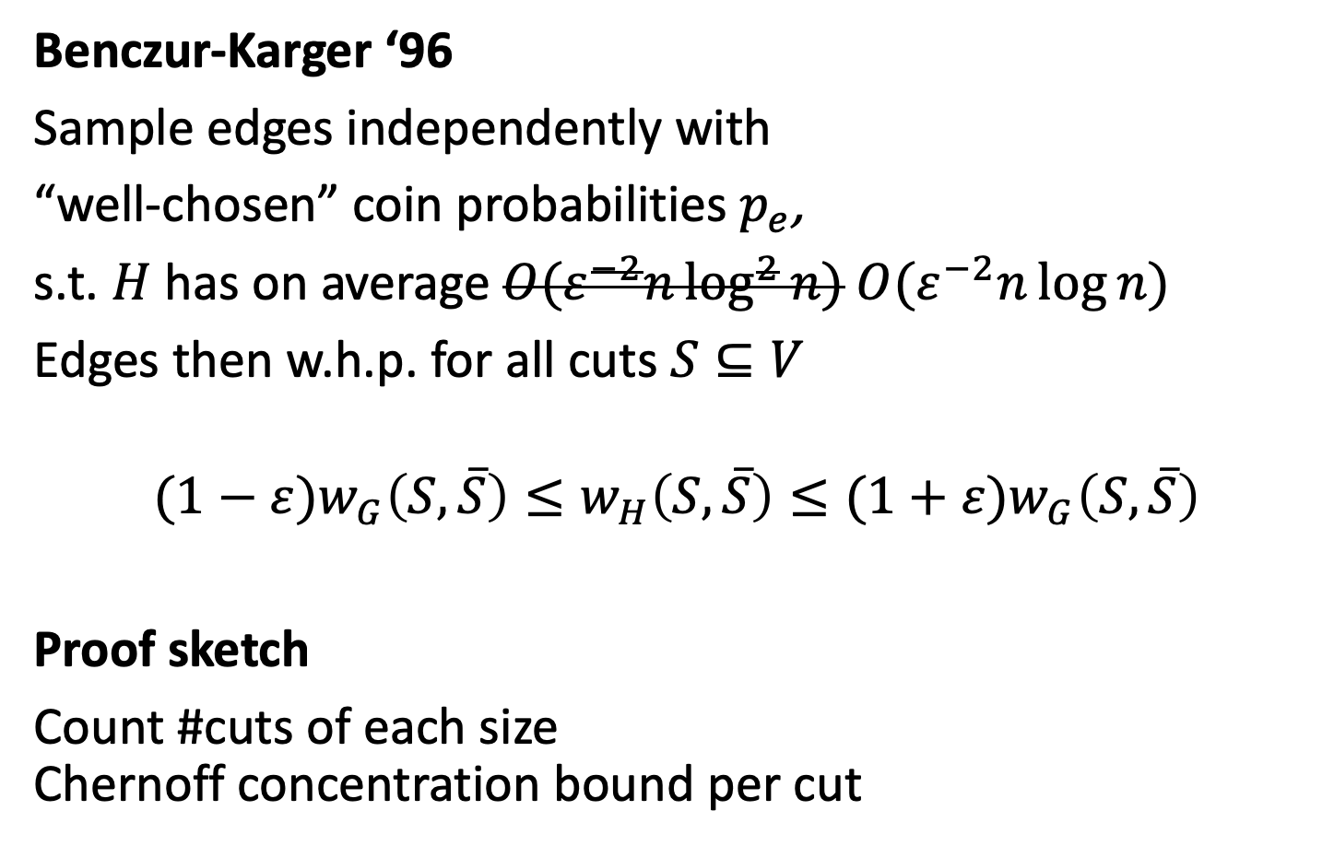
Preserving cuts?
Benczur-Karger ‘96
Sample edges independently with
“well-chosen” coin probabilities $p_{e}$,
s.t. $H$ has on average $O(ε^{−2}n\log^{2}{n}) O(ε^{−2}n\log{n})$
Edges then w.h.p. for all cuts $S⊆V$
$$(1−ε)w_{G}\left(S,\overline{S}\right)≤w_{H}\left(S,\overline{S}\right)≤(1+ε)w_{G}\left(S,\overline{S}\right)$$
Proof sketch
Count #cuts of each size
Chernoff concentration bound per cut

Slide 31
Reweighted random tree
Original weights
Tree weights
$$1$$
$$1$$
$$1/p_{e}$$
$$1$$
$$1$$
$$1$$
$$𝔼$$
$$=$$
$$1$$
$$1$$
$$1$$
random
tree
$$1$$
$$1$$
The average weight over trees equals the original weight
Does the tree “behave like” the original graph?

Slide 32















Combining trees
Maybe it’s better if we average a few trees?
$$8/5$$
$$8/5$$
$$8/5$$
$$8/5$$
$$8/5$$
$$\frac{1}{2}$$
$$2$$
$$+$$
$$=$$
$$1$$
$$8/5$$
$$8/5$$
$$4/5$$
$$4/5$$
$$1$$
$$1$$
$$≈$$
$$1$$
??
$$1$$
$$1$$

Slide 33
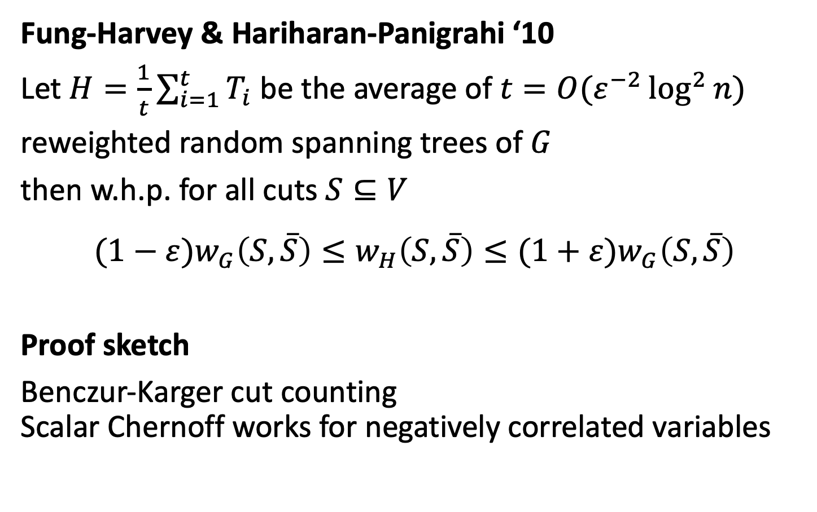
Preserving cuts?
Fung-Harvey & Hariharan-Panigrahi ‘10
Let $H=\frac{1}{t}\sum_{i=1}^{t}{T_{i}}$ be the average of $t=O(ε^{−2}\log^{2}{n})$
reweighted random spanning trees of $G$
then w.h.p. for all cuts $S⊆V$
$$(1−ε)w_{G}\left(S,\overline{S}\right)≤w_{H}\left(S,\overline{S}\right)≤(1+ε)w_{G}\left(S,\overline{S}\right)$$
Proof sketch
Benczur-Karger cut counting
Scalar Chernoff works for negatively correlated variables

Slide 34
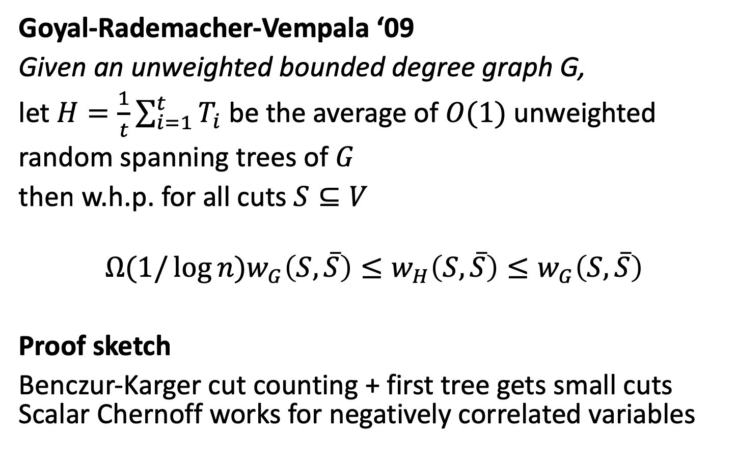
Preserving cuts?
Goyal-Rademacher-Vempala ‘09
Given an unweighted bounded degree graph G,
let $H=\frac{1}{t}\sum_{i=1}^{t}{T_{i}}$ be the average of $O(1)$ unweighted
random spanning trees of $G$
then w.h.p. for all cuts $S⊆V$
$$Ω(1/\log{n})w_{G}\left(S,\overline{S}\right)≤w_{H}\left(S,\overline{S}\right)≤w_{G}\left(S,\overline{S}\right)$$
Proof sketch
Benczur-Karger cut counting + first tree gets small cuts
Scalar Chernoff works for negatively correlated variables

Slide 35
Preserving more than cuts:
Matrices and quadratic forms

Slide 36
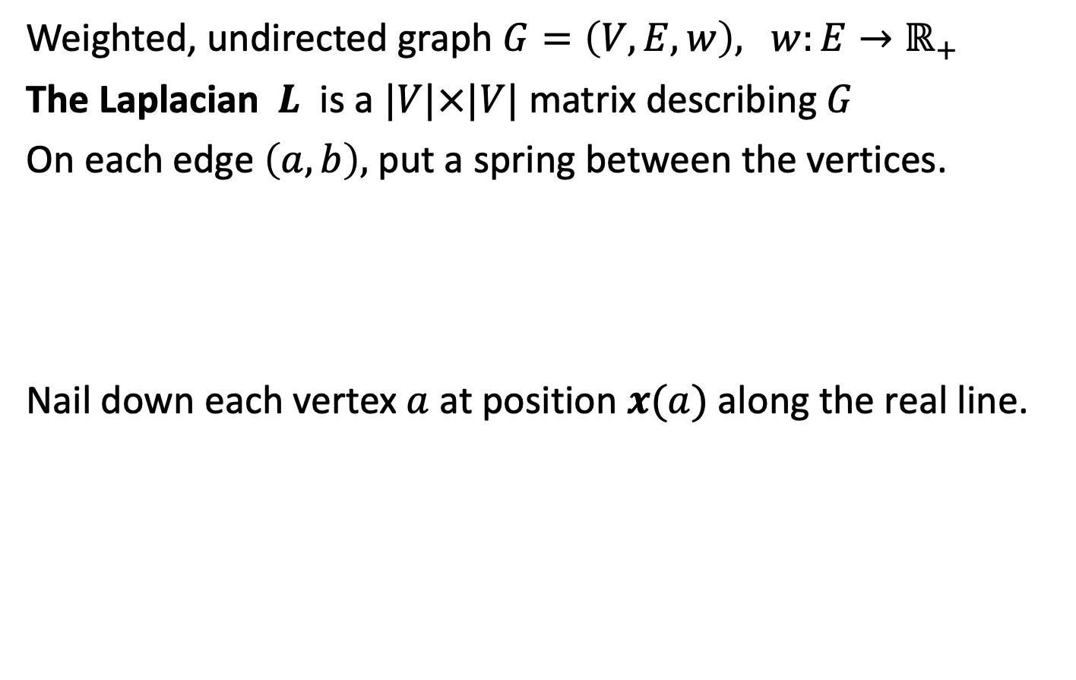



Laplacians: It’s springs!
Weighted, undirected graph $G=\left(V,E,w\right)$, $w:E→ℝ_{+}$
The Laplacian $L$ is a $|V|×|V|$ matrix describing $G$
On each edge $\left(a,b\right),$ put a spring between the vertices.
Nail down each vertex $a$ at position $x(a)$ along the real line.
$$x\left(a\right)$$
$$x\left(b\right)$$
$$x\left(c\right)$$

Slide 37
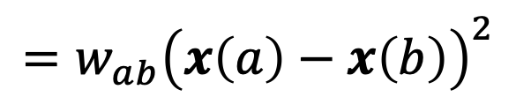

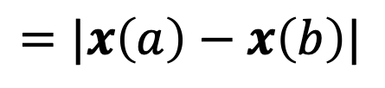



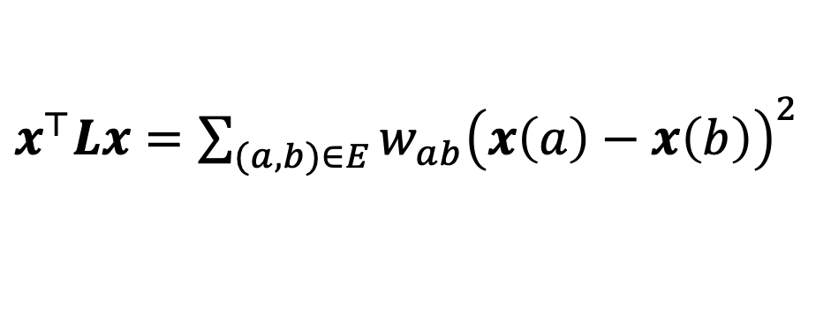
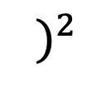
Laplacians: It’s springs!
Length
Energy $=$ spring const. length
$$x\left(a\right)$$
$$x\left(b\right)$$
$$=|x\left(a\right)−x\left(b\right)|$$
$$⋅($$
$${ )}^{2}$$
$$={w_{ab}\left(x\left(a\right)−x\left(b\right)\right)}^{2}$$
$x^{⊤}Lx=\sum_{(a,b)∈E}{{w_{ab}\left(x\left(a\right)−x\left(b\right)\right)}^{2}}$

Slide 38

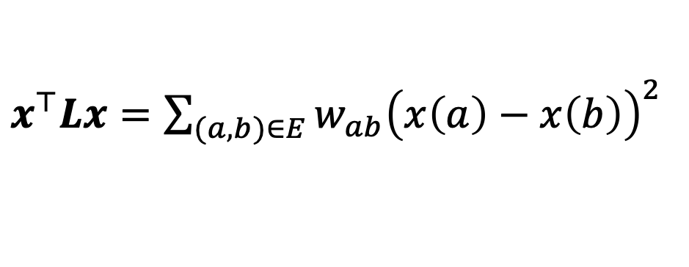


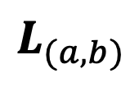
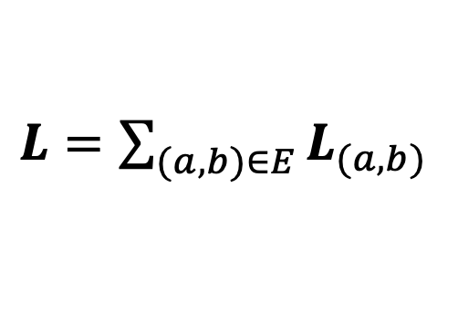

Laplacians
$x^{⊤}Lx=\sum_{(a,b)∈E}{{w_{ab}\left(x\left(a\right)−x\left(b\right)\right)}^{2}}$
$$b$$
$$a$$
$=$ $\sum_{(a,b)∈E}{{x^{⊤}L}_{(a,b)}x}$
$$c$$
$L=\sum_{(a,b)∈E}{L_{(a,b)}}$
“baby Laplacian” per edge
$$L_{(a,b)}$$

Slide 39



Laplacian of a graph
$$1$$
$$1$$
$$2$$

Slide 40
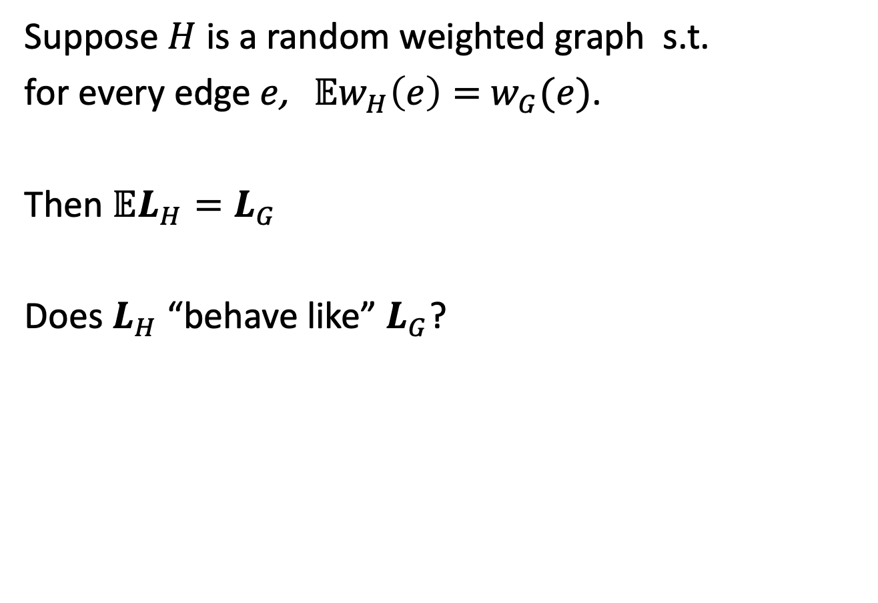
Preserving matrices?
Suppose $H$ is a random weighted graph s.t.
for every edge $e$, $𝔼w_{H}\left(e\right)=$ $w_{G}(e)$.
Then $𝔼L_{H}=L_{G}$
Does $L_{H}$ “behave like” $L_{G}$?

Slide 41
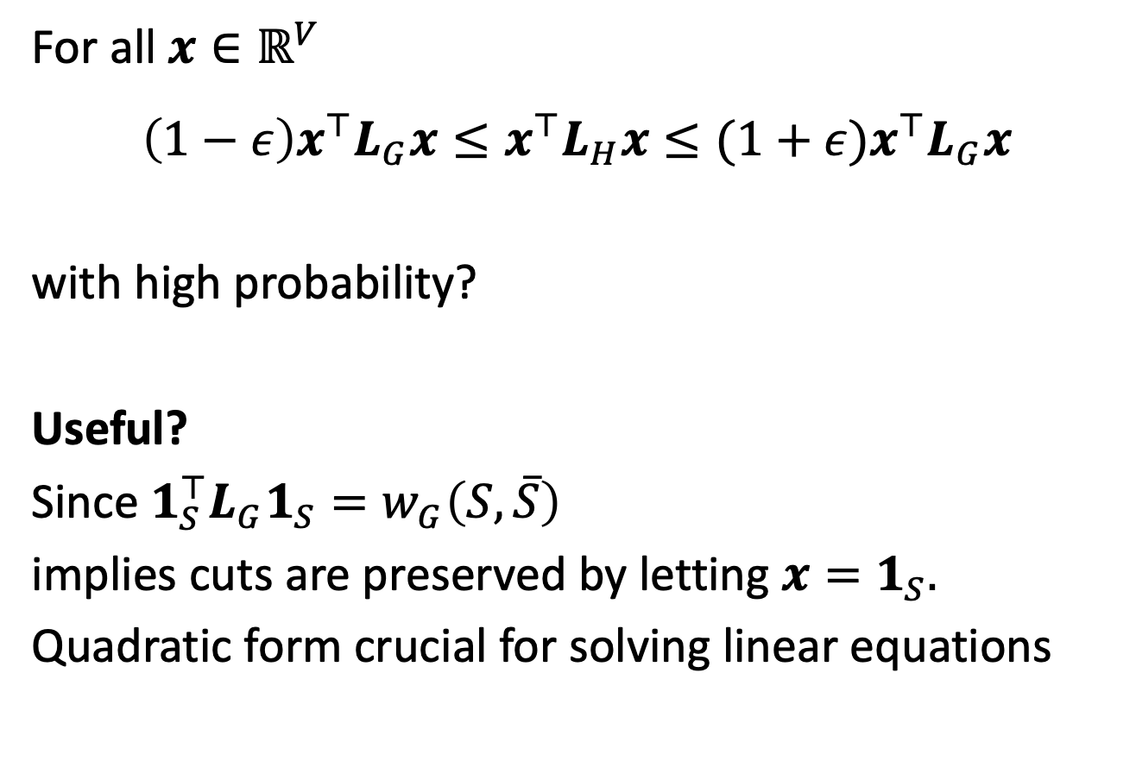
Preserving quadratic forms?
For all $x∈ℝ^{V}$
$$\left(1−ε\right)x^{⊤}L_{G}x≤x^{⊤}L_{H}x≤(1+ε)x^{⊤}L_{G}x$$
with high probability?
Useful?
Since $1_{S}^{⊤}L_{G}1_{S}=w_{G}\left(S,\overline{S}\right)$
implies cuts are preserved by letting $x=1_{S}.$
Quadratic form crucial for solving linear equations

Slide 42
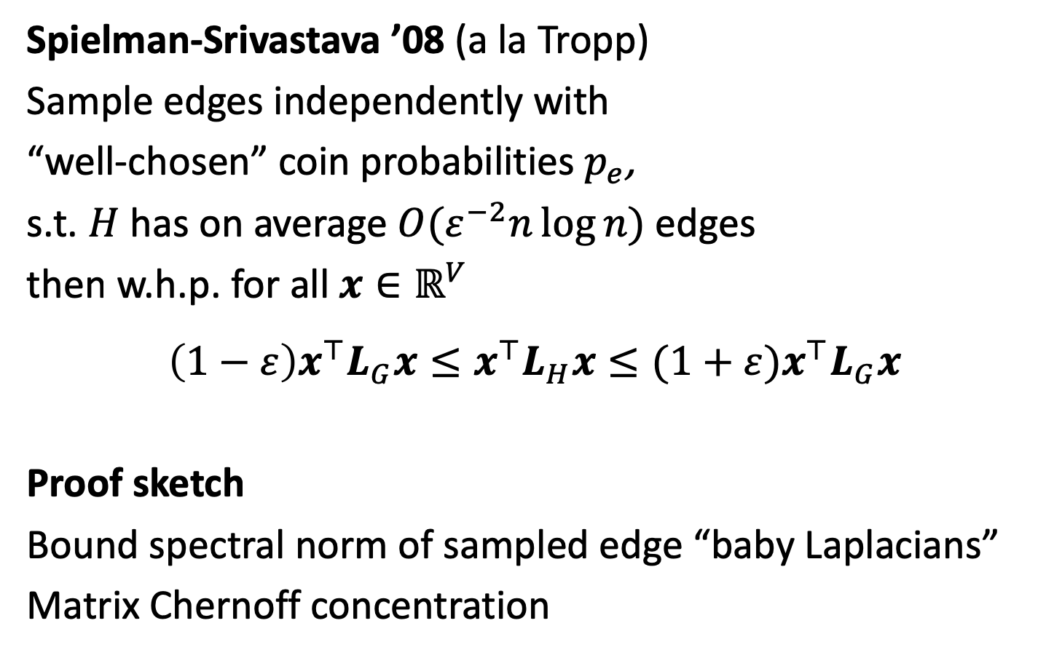
Preserving quadratic forms?
Spielman-Srivastava ’08 (a la Tropp)
Sample edges independently with
“well-chosen” coin probabilities $p_{e}$,
s.t. $H$ has on average $O(ε^{−2}n\log{n})$ edges
then w.h.p. for all $x∈ℝ^{V}$
$$\left(1−ε\right)x^{⊤}L_{G}x≤x^{⊤}L_{H}x≤(1+ε)x^{⊤}L_{G}x$$
Proof sketch
Bound spectral norm of sampled edge “baby Laplacians”
Matrix Chernoff concentration

Slide 43
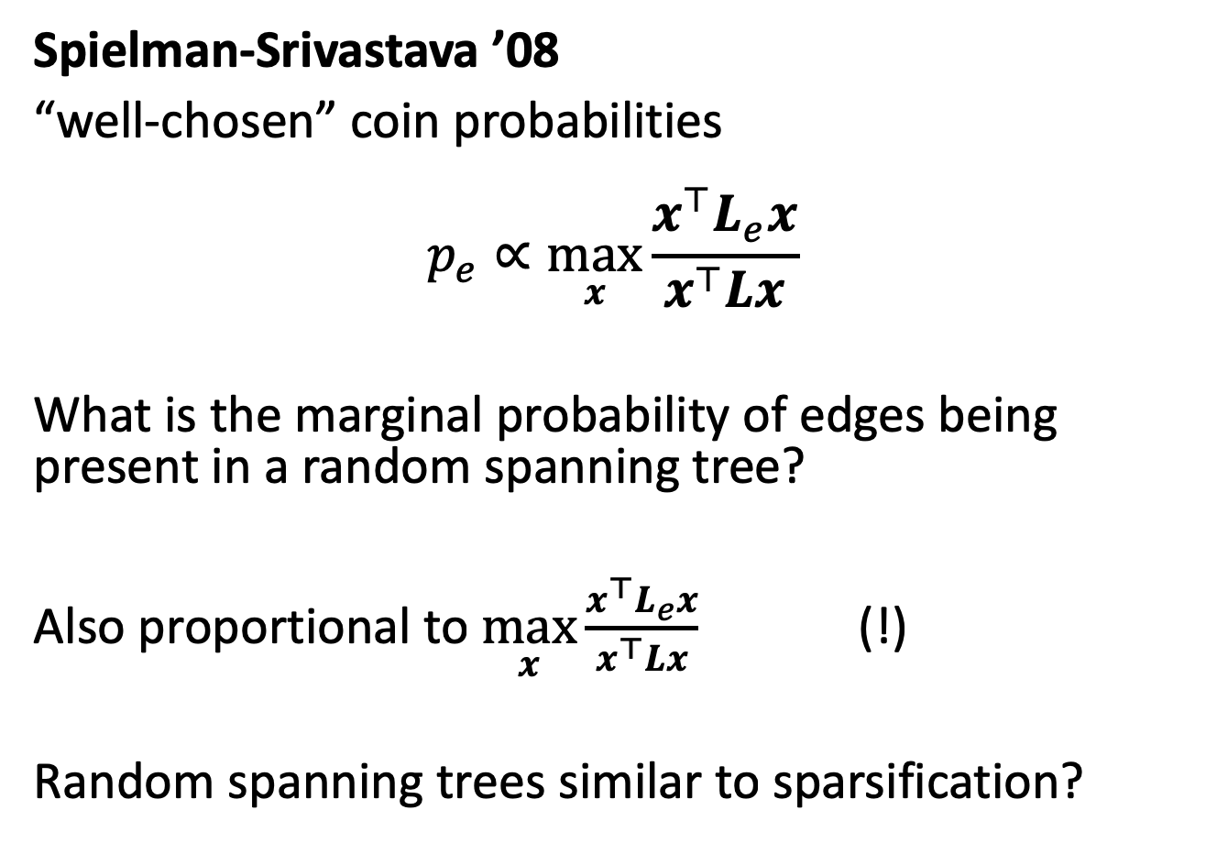
What sampling probabilities?
Spielman-Srivastava ’08
“well-chosen” coin probabilities
$$p_{e}∝\max_{x}{\frac{x^{⊤}L_{e}x}{x^{⊤}Lx}}$$
What is the marginal probability of edges being present in a random spanning tree?
Also proportional to $\max_{x}{\frac{x^{⊤}L_{e}x}{x^{⊤}Lx}}$ (!)
Random spanning trees similar to sparsification?

Slide 44
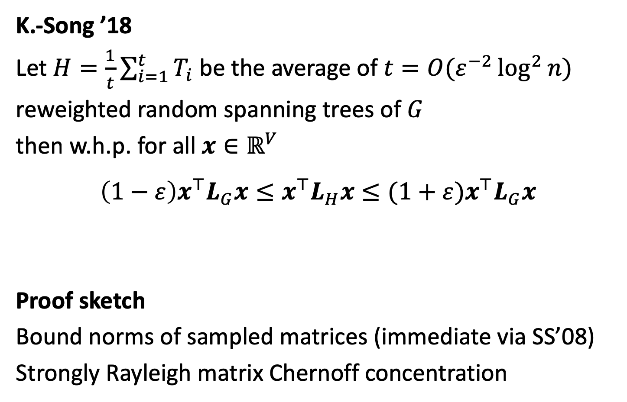
Preserving quadratic forms?
K.-Song ’18
Let $H=\frac{1}{t}\sum_{i=1}^{t}{T_{i}}$ be the average of $t=O(ε^{−2}\log^{2}{n})$
reweighted random spanning trees of $G$
then w.h.p. for all $x∈ℝ^{V}$
$$\left(1−ε\right)x^{⊤}L_{G}x≤x^{⊤}L_{H}x≤(1+ε)x^{⊤}L_{G}x$$
Proof sketch
Bound norms of sampled matrices (immediate via SS’08)
Strongly Rayleigh matrix Chernoff concentration

Slide 45
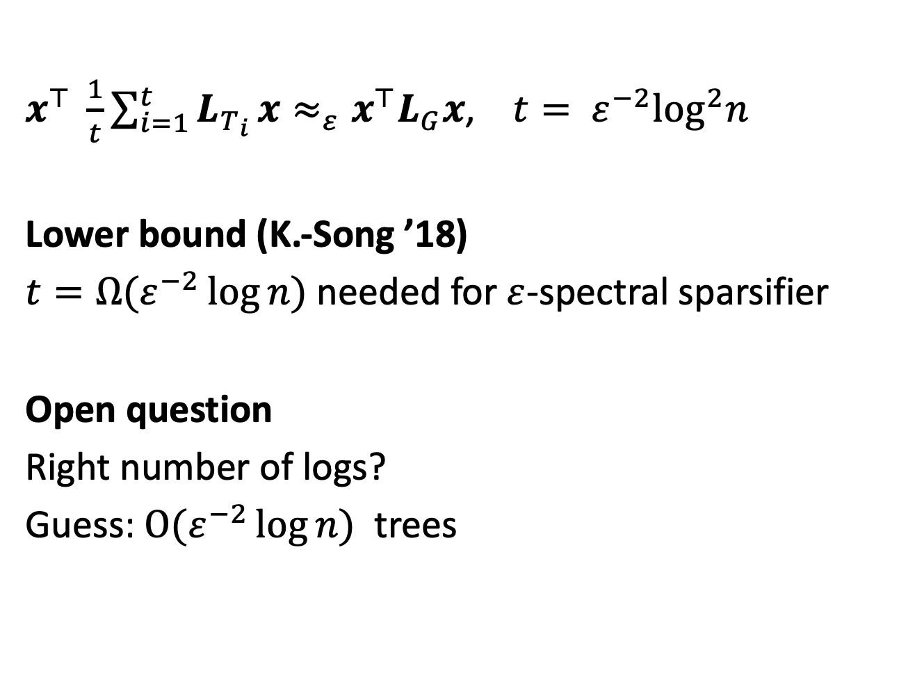
Random spanning trees
$x^{⊤} \frac{1}{t}\sum_{i=1}^{t}{L_{T_{i}}}x≈_{ε}x^{⊤}L_{G}x\text{ , }t= ε^{−2}\log^{2}n$
Lower bound (K.-Song ’18)
$t=Ω(ε^{−2}\log{n})$ needed for $ε$-spectral sparsifier
Open question
Right number of logs?
Guess: $O(ε^{−2}\log{n})$ trees

Slide 46
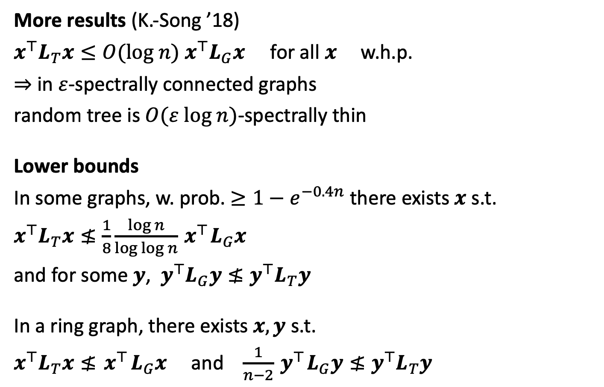
Random spanning trees
More results (K.-Song ’18)
$x^{⊤}L_{T}x≤O(log n){ x}^{⊤}L_{G}x$ for all $x$ w.h.p.
$⇒$ in $ε$-spectrally connected graphs
random tree is $O(ε log n)$-spectrally thin
Lower bounds
In some graphs, w. prob. $≥1−e^{−0.4n}$there exists $x$ s.t.
$x^{⊤}L_{T}x≰\frac{1}{8}\frac{log n}{log\log{n}}{ x}^{⊤}L_{G}x$
and for some $y$, $y^{⊤}L_{G}y≰y^{⊤}L_{T}y$
In a ring graph, there exists $x, y$ s.t.
$x^{⊤}L_{T}x≰{ x}^{⊤}L_{G}x$ and $\frac{1}{n−2}{ y}^{⊤}L_{G}y≰y^{⊤}L_{T}y$

Slide 47
Proving the strongly Rayleigh matrix Chernoff bound

Slide 48

An illustrative case
$x^{⊤}L_{T}x≤O(log n){ x}^{⊤}L_{G}x$ for all $x$ w.h.p.

Slide 49

Loewner order
$A≼B$ iff for all $x$ $x^{⊤}Ax≤x^{⊤}Bx$
$x^{⊤}L_{T}x≤O(log n){ x}^{⊤}L_{G}x$ for all $x$
$L_{T}≼O(log n)L_{G}$

Slide 50
Proof strategy?
Convert problem to Doob martingales
Matrix martingale concentration
Control effect of conditioning via coupling
Norm bound from coupling
Variance bound: coupling symmetry + shrinking marginals

Slide 51


What is a martingale?
A sequence of random variables $Y_{0},…,Y_{k}$ s.t.
$𝔼\left[Y_{i} | Y_{0},…,Y_{i−1}\right]=Y_{i−1}$
Many concentration bounds for independent random variables can be generalized to the martingale case,
to show $Y_{k}≈Y_{0}$ w.h.p.

Slide 52

Concentration of martingales
Why do martingales exhibit concentration?
Each difference is zero mean,
conditional on previous outcomes
$𝔼\left[Y_{i}−Y_{i−1} | Y_{0},…,Y_{i−1}\right]=0$
If each difference $Y_{i}−Y_{i−1}$ is small, then
$Y_{k}−Y_{0}=\sum_{i}{Y_{i}−Y_{i−1}}≈0$

Slide 53


Doob martingales
NOT indep.
Random variables $γ_{1},…,γ_{k}$
Goal: Prove concentration for $f(γ_{1},…,γ_{k})$
where $f$ is ``stable” under small changes to $γ_{1},…,γ_{k}$
$f\left(γ_{1},…,γ_{k}\right)≈𝔼f\left(γ_{1},…,γ_{k}\right)$ ?
Also need $γ_{1},…,γ_{k}$ stable under conditioning

Slide 54


Doob martingales
Pick random outcome $γ_{1},…,γ_{k}$ from distribution
$Y_{0}=𝔼\left[f(γ_{1},…,γ_{k})\right]$
$Y_{1}=𝔼\left[f\left(γ_{1},…,γ_{k}\right)|γ_{1}\right]$
$Y_{2}=𝔼\left[f\left(γ_{1},…,γ_{k}\right)|γ_{1},γ_{2}\right]$
$⋮$
$Y_{k}=𝔼\left[f\left(γ_{1},…,γ_{k}\right)|γ_{1},γ_{2},…,γ_{k}\right]=f\left(γ_{1},…,γ_{k}\right)$
$𝔼Y_{1}{=𝔼}_{γ_{1}}\left[𝔼\left[f\left(γ_{1},…,γ_{k}\right)|γ_{1}\right]\right]=𝔼\left[f(γ_{1},…,γ_{k})\right]=Y_{0}$
$𝔼\left[Y_{i}−Y_{i−1}|prev. steps\right]=0$
Show $Y_{k}≈Y_{0},$ i.e. $f\left(γ_{1},…,γ_{k}\right)≈𝔼f\left(γ_{1},…,γ_{k}\right)$
Martingale!
Despite $γ_{1},…,γ_{k}$
NOT independent

Slide 55

Our Doob martingale
Reveal one edge of tree at a time
Let $γ_{i}$ denote the index of the $i$th edge of the tree
Pick random tree as $T=γ_{1}, γ_{2}, …,γ_{n−1}$
$L_{T}=f\left(γ_{1}, γ_{2}, …,γ_{n−1}\right)$
$Y_{0}=𝔼\left[L_{T} \right]$
$Y_{1}=𝔼\left[L_{T}|γ_{1}\right]$
$⋮$
$Y_{n−1}=𝔼\left[L_{T}|γ_{1},γ_{2},…,γ_{n−1}\right]\text{=}L_{T}$
$𝔼\left[Y_{i}−Y_{i−1}|prev. steps\right]=0$

Slide 56

Our Doob martingale
Want to show
$Y_{n−1}\text{=}{ L}_{T}$ is close to $Y_{0}=𝔼\left[L_{T}\right]$
$Y_{n−1}−Y_{0}=\sum_{i}{Y_{i}−Y_{i−1}}$
Matrix martingale concentration?
Matrix Freedman (Tropp ‘11)
Norm $\left\|Y_{i}−Y_{i−1}\right\|≤1$
Variance $\left\|\sum_{i}{𝔼\left[{{(Y}_{i}−Y_{i−1})}^{2}| prev. steps\right]}\right\|≤O\left(\log{n}\right)$
implies w.h.p
$L_{T}≼O(log n)L_{G}$

Slide 57

Our Doob martingale
Want to show
$Y_{n−1}\text{=}{ L}_{T}$ is close to $Y_{0}=𝔼\left[L_{T}\right]$
$Y_{n−1}−Y_{0}=\sum_{i}{Y_{i}−Y_{i−1}}$
Matrix martingale concentration?
Matrix Freedman (Tropp ‘11)
Norm $\left\|Y_{i}−Y_{i−1}\right\|≤1$
Variance $\left\|\sum_{i}{𝔼\left[{{(Y}_{i}−Y_{i−1})}^{2}| prev. steps\right]}\right\|≤O\left(\log{n}\right)$
implies w.h.p
$L_{T}≼O(log n)L_{G}$
difficult
How can we understand $Y_{42}=𝔼\left[L_{T} |γ_{1},…,γ_{42}\right]$?

Slide 58
How does conditioning change the distribution?
Graph
Tree distribution
All
Conditional
Pick a random tree, conditional on red edge present?

Slide 59
How does conditioning change the distribution?
How similar are the distributions?
Tree distribution
All
Conditional

Slide 60
How does conditioning change the distribution?
How similar are the distributions?
Tree distribution
All
Conditional

Slide 61



How does conditioning change the distribution?
How similar are the distributions?
Tree distribution
All
Cond.
Coupling Pick pair $\left(T,T^{′}\right)$ with marginals as above
$$T$$
$$T′$$

Slide 62
How does conditioning change the distribution?
How similar are the distributions?
Tree distribution
All
Cond.
Coupling Pick pair $\left(T,T^{′}\right)$ with marginals as above
$$T$$
$$T′$$

Slide 63
How does conditioning change the distribution?
How similar are the distributions?
Tree distribution
All
Cond.
Coupling Pick pair $\left(T,T^{′}\right)$ with marginals as above
$$T$$
$$T′$$

Slide 64


How does conditioning change the distribution?
How similar are the distributions?
Tree distribution
All
Cond.
Coupling Pick pair $\left(T,T^{′}\right)$ with marginals as above
$$T$$
$$T′$$
$$−$$
$$=$$

Slide 65
How does conditioning change the distribution?
How similar are the distributions?
Tree distribution
All
Cond.
Coupling Pick pair $\left(T,T^{′}\right)$ with marginals as above
$$T$$
$$T′$$
$$−$$
$$=$$

Slide 66
How does conditioning change the distribution?
How similar are the distributions?
Tree distribution
All
Cond.
Coupling Pick pair $\left(T,T^{′}\right)$ with marginals as above
$$T$$
$$T′$$
$$−$$
$$=$$

Slide 67
How does conditioning change the distribution?
How similar are the distributions?
Tree distribution
All
Cond.
Coupling Pick pair $\left(T,T^{′}\right)$ with marginals as above
$$T$$
$$T′$$
$$−$$
$$=$$

Slide 68
How does conditioning change the distribution?
How similar are the distributions?
Tree distribution
All
Cond.
Coupling Pick pair $\left(T,T^{′}\right)$ with marginals as above
$$T$$
$$T′$$
$$−$$
$$=$$

Slide 69

Coupling table – difference $≤2$

Slide 70

Good couplings
Stochastic covering property
For $k$-homogenous strongly Rayleigh distributions
a coupling of $\left(T,T^{′}\right)$ with difference $≤2$ always exists.
[Borcea-Branden-Liggett ’09]
[Peres-Pemantle ‘14]

Slide 71

Coupling table has more structure
Alice, Bob, Charlie want to form a tree,
by each selecting one edge: $γ_{1}$, $γ_{2}$, $γ_{3}$

Slide 72

Coupling table has more structure
Alice picks $γ_{1}$
How much does this restrict Bob and Charlie?

Slide 73

Coupling table has more structure
Alice picks $γ_{1}$
How much does this restrict Bob and Charlie?
After Bob and Charlie choose their edges,
they enlist Anna to pick an extra edge, ${\tilde{γ}}_{1}$
Anna can choose that edge s.t.
Anna, Bob, & Charlie, obtain original distribution

Slide 74

Coupling table has more structure
Recover the original distribution by adding
a “make-up edge” to conditional distribution
$${\tilde{γ}}_{1}$$

Slide 75


Coupling table has more structure
Recover the original distribution by adding $≤1$
“make-up edge” to conditional distribution
$${\tilde{γ}}_{1}$$

Slide 76

Coupling table has more structure
Recover the original distribution by adding $≤1$
“make-up edge” to conditional distribution
$${\tilde{γ}}_{1}$$

Slide 77


Coupling table has more structure
Recover the original distribution by adding $≤1$
“make-up edge” to conditional distribution
$${\tilde{γ}}_{1}$$

Slide 78




Coupling table has more structure
Alice, Bob, Charlie
Anna, Bob, Charlie
$$γ_{1}$$
$${\tilde{γ}}_{1}$$
“makeup edge”
Conditional distribution
Original distribution (!)
$Y_{1}−Y_{0}$
$=𝔼\left[L_{T}|γ_{1}\right]−𝔼\left[L_{T}\right]$
$=𝔼\left[\text{Alice}\text{ + }\text{Bob}\text{ + }\text{Charlie}|\text{Alice}\right]−𝔼\left[\text{Anna} \text{+ }\text{Bob}\text{ + }\text{Charlie}|\text{Alice}\right]$
$=$ Alice $−$ $𝔼\left[\text{Anna}|\text{Alice}\right]$
$=L_{γ_{1}}−𝔼\left[L_{{\tilde{γ}}_{1}}|γ_{1}\right]$

Slide 79

Coupling table has more structure
Alice, Bob, Charlie
Anna, Bob, Charlie
$$γ_{1}$$
$${\tilde{γ}}_{1}$$
“makeup edge”
Conditional distribution
Original distribution (!)
$Y_{1}−Y_{0}$
$=𝔼\left[L_{T}|γ_{1}\right]−𝔼\left[L_{T}\right]$
$=L_{γ_{1}}−𝔼\left[L_{{\tilde{γ}}_{1}}|γ_{1}\right]$
$\left\|Y_{1}−Y_{0}\right\|≤max\left(\left\|L_{γ_{1}}\right\|,\left\|𝔼\left[L_{{\tilde{γ}}_{1}}|γ_{1}\right]\right\|\right)$
$≤max\left(\left\|L_{γ_{1}}\right\|,𝔼\left[\left\|L_{{\tilde{γ}}_{1}}\right\||γ_{1}\right]\right)$
$≤\max_{e}\left\|L_{e}\right\|≤1$

Slide 80



Coupling table has more structure
Alice, Bob, Charlie
Anna, Bob, Charlie
$$γ_{1}$$
$${\tilde{γ}}_{1}$$
“makeup edge”
Conditional distribution
Original distribution (!)
$𝔼\left[Y_{1}−Y_{0}\right]=0$
$=𝔼\left[L_{γ_{1}}−𝔼\left[L_{{\tilde{γ}}_{1}}|γ_{1}\right]\right]=0$
$𝔼\left[Y_{1}−Y_{0}\right]$
So
$𝔼\left[L_{γ_{1}}\right]=𝔼\left[𝔼\left[L_{{\tilde{γ}}_{1}}|γ_{1}\right]\right]$
Alice
Anna, “makeup edge”
Important symmery

Slide 81



Coupling table has more structure
Alice, Bob, Charlie
Anna, Bob, Charlie
$$γ_{1}$$
$${\tilde{γ}}_{1}$$
“makeup edge”
Conditional distribution
Original distribution (!)
$$𝔼\left[{{(Y}_{1}−Y_{0})}^{2}\right]=𝔼\left[{\left(L_{γ_{1}}−𝔼\left[L_{{\tilde{γ}}_{1}}|γ_{1}\right]\right)}^{2}\right]$$
$=𝔼\left[L_{γ_{1}}^{2}+{𝔼\left[L_{{\tilde{γ}}_{1}}|γ_{1}\right]}^{2}\right]$
$≼𝔼\left[L_{γ_{1}}^{ }+{𝔼\left[L_{{\tilde{γ}}_{1}}|γ_{1}\right]}^{ }\right]$
$≼2𝔼\left[L_{γ_{1}}^{ }\right]$

Slide 82



Coupling table has more structure
$𝔼\left[{{(Y}_{1}−Y_{0})}^{2}\right]≼2𝔼\left[L_{γ_{1}}^{ }\right]$
$𝔼\left[L_{γ_{1}}^{ }\right]=\frac{1}{n−1}𝔼\left[L_{T}^{ }\right]=\frac{1}{n−1}L_{G}$
So $𝔼\left[{{(Y}_{1}−Y_{0})}^{2}\right]≼\frac{2}{n−1}L_{G}$

Slide 83

Later steps
What about $Y_{t}−Y_{t−1}$?
Boils down to bounding $𝔼\left[L_{γ_{t}}^{ }| γ_{1},γ_{2},…,γ_{t−1}\right]$

Slide 84
How does conditioning change the distribution?
Graph
Tree distribution
All
Conditional
Pick a random tree, conditional on red edge present?

Slide 85
How does conditioning change the distribution?
Graph
Tree distribution
All
Conditional
“Shrinking Marginals Lemma”
All other edges become less likely

Slide 86

How does conditioning change the distribution?
Graph
Tree distribution
All
Conditional
“Shrinking Marginals Lemma”
All other edges become less likely
$\frac{5}{8}=0.625$ vs $\frac{3}{5}=0.6$

Slide 87

How does conditioning change the distribution?
Graph
Tree distribution
All
Conditional
“Shrinking Marginals Lemma”
All other edges become less likely
$\frac{4}{8}=0.5$ vs $\frac{2}{5}=0.4$

Slide 88


Later steps
$𝔼\left[\text{remaining} \text{edges}| γ_{1},γ_{2},…,γ_{i−1}\right]$ $≼𝔼\left[L_{T}^{ }\right]=L_{G}$
Shrinking marginals
$𝔼\left[L_{γ_{i}}^{ }| γ_{1},γ_{2},…,γ_{i−1}\right]≼\frac{1}{n−i}L_{G}$
$\sum_{i}{𝔼\left[{{(Y}_{i}−Y_{i−1})}^{2}| prev. steps\right]}≼\sum_{i}{\frac{2}{n−i}L_{G}}=O(\log{n)}L_{G}$

Slide 89

Our Doob martingale
Want to show
$Y_{n−1}\text{=}{ L}_{T}$ is close to $Y_{0}=𝔼\left[L_{T} \right]$
$Y_{n−1}−Y_{0}=\sum_{i}{Y_{i}−Y_{i−1}}$
Matrix Freedman (Tropp ‘11)
Norm $\left\|Y_{i}−Y_{i−1}\right\|≤1$
Variance $\left\|\sum_{i}{𝔼\left[{{(Y}_{i}−Y_{i−1})}^{2}| prev. steps\right]}\right\|≤O\left(\log{n}\right)$
implies
$L_{T}≼O(log n)L_{G}$ w.h.p

Slide 90

Concentration of random matrices
Strongly Rayleigh matrix Chernoff [K. & Song ’18]
Fixed $A_{i}∈ℝ^{d×d},$ positive semi-definite
$ξ∈{\left\{0,1\right\}}^{m}$ is $k$-homogeneous strongly Rayleigh
Random $X=\sum_{i}{{ξ(i)A}_{i}}$
$\left\|𝔼X\right\|=μ$
$\left\|A_{i}\right\|≤r$
gives
$ℙ[\left\|X−𝔼X\right\|>με]≤d2exp\left(−\frac{με^{2}}{r\left(\log{k}+ε\right)}\right)$

Slide 91

Open Questions
Our bound for $k$-homogeneous strongly Rayleigh
$$ℙ[\left\|X−𝔼X\right\|>με]≤d2exp\left(−\frac{με^{2}}{r\left(\log{k}+ε\right)}\right)$$
Remove the $\log{k}$?
Remove homogeneity condition
Find more applications
Show $\log{n}$ sparsifier from $O\left(1\right)$ spanning trees?

Slide 92
Thanks!

