Slide 1
Optimization on Graphs
Speaker | Rasmus Kyng ETH Zurich Dept. of Computer Science inf.ethz.ch

Slide 2



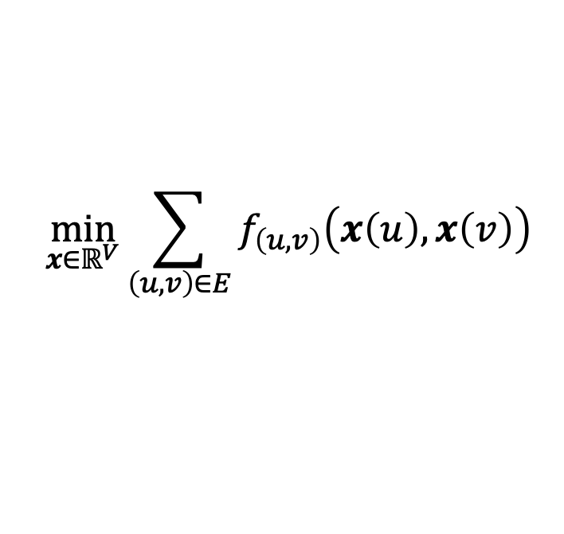
Optimization on Graphs
Edge Constraints
For all $\left(u,v\right)∈E$
$g_{\left(u,v\right)}\left(x\left(u\right),x\left(v\right)\right)≤0$
Graph $G=\left(V,E\right)$
pairwise interactions on
$x\left(u\right),x\left(v\right)$ for $\left(u,v\right)∈E$
( )
$x∈ℝ^{V}$
Objective
$$\min_{\begin{aligned}x∈ℝ^{V} \\ \end{aligned}}{\sum_{\left(u,v\right)∈E}{f_{\left(u,v\right)}\left(x\left(u\right),x\left(v\right)\right)}}$$

Slide 3
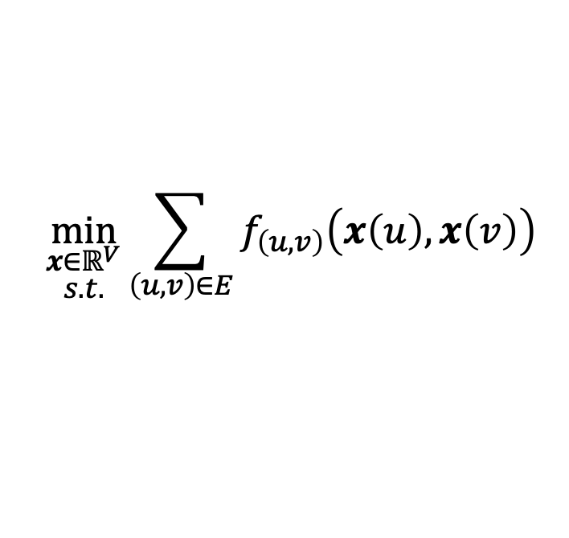
Optimization on Graphs
Edge Constraints
For all $\left(u,v\right)∈E$
$g_{\left(u,v\right)}\left(x\left(u\right),x\left(v\right)\right)≤0$
Graph $G=\left(V,E\right)$
pairwise interactions on
$x\left(u\right),x\left(v\right)$ for $\left(u,v\right)∈E$
( )
$x∈ℝ^{V}$
Objective
$$\min_{\begin{aligned}x∈ℝ^{V} \\ s.t.\end{aligned}}{\sum_{\left(u,v\right)∈E}{f_{\left(u,v\right)}\left(x\left(u\right),x\left(v\right)\right)}}$$
( )

Slide 4
Optimization on Graphs: An Example

Slide 5
Isotonic Regression
Predict child’s height from mother’s height
Model?
Height of child
Height of mother

Slide 6
Isotonic Regression
Predict child’s height from mother’s height
Model? Increasing function?
Height of child
Height of mother

Slide 7
Isotonic Regression
Predict child’s height from mother’s height
Model? Increasing function?
Height of child
Height of mother

Slide 8
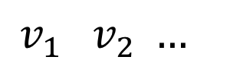
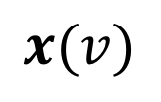

Isotonic Regression
$$x(v)$$
Height of child
$$G=\left(V,E\right)$$
Height of mother
$$v_{1} v_{2} …$$

Slide 9
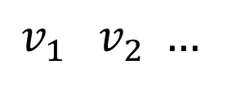
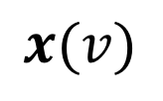
Isotonic Regression
$$x(v)$$
Height of child
$$G=\left(V,E\right)$$
Height of mother
$$v_{1} v_{2} …$$

Slide 10
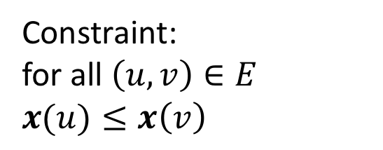

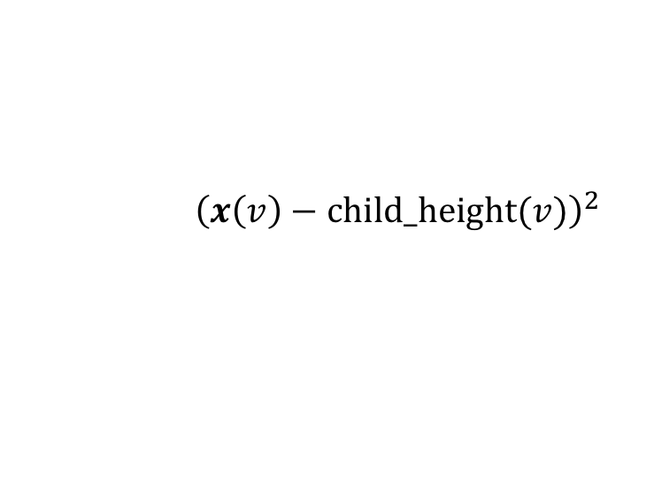
Isotonic Regression
Constraint:
for all $\left(u,v\right)∈E$
$x(u)≤x\left(v\right)$
Cost:
$$\min_{x}{\sum_{v∈V }{{\left(x\left(v\right)−\text{child}\text{_}\text{height}(v)\right)}^{2}}}$$
$$x(v)$$
Height of child
$$G=\left(V,E\right)$$
Height of mother
$$v_{1} v_{2} …$$

Slide 11

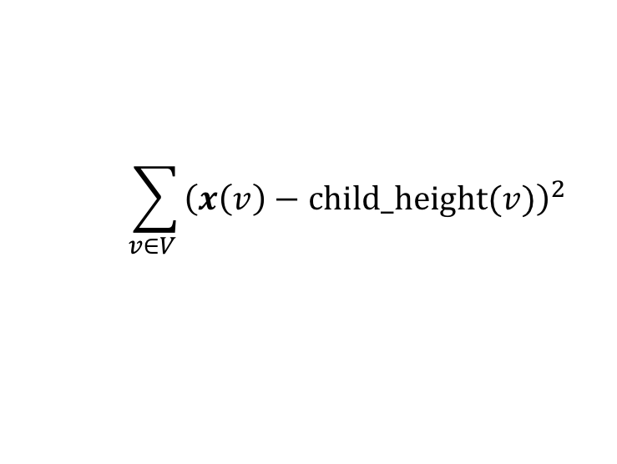
Isotonic Regression
Constraint:
for all $\left(u,v\right)∈E$
$x(u)≤x\left(v\right)$
Cost:
$$\min_{x}{\sum_{v∈V }{{\left(x\left(v\right)−\text{child}\text{_}\text{height}(v)\right)}^{2}}}$$
$$x(v)$$
Height of child
$$G=\left(V,E\right)$$
Height of mother
$$v_{1} v_{2} …$$

Slide 12
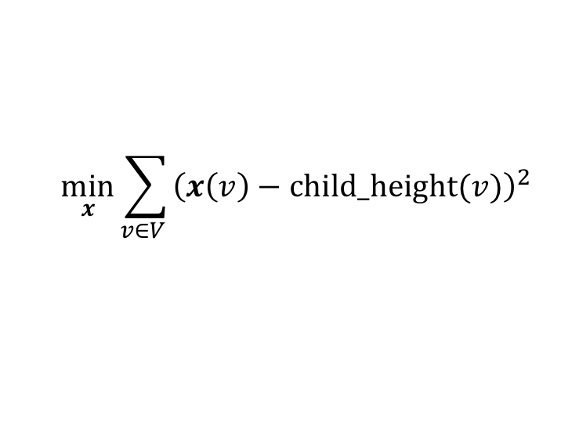
Isotonic Regression
Constraint:
for all $\left(u,v\right)∈E$
$x(u)≤x\left(v\right)$
Cost:
$$\min_{x}{\sum_{v∈V }{{\left(x\left(v\right)−\text{child}\text{_}\text{height}(v)\right)}^{2}}}$$
$$x(v)$$
Height of child
$$G=\left(V,E\right)$$
Height of mother
$$v_{1} v_{2} …$$

Slide 13
Isotonic Regression
Constraint:
for all $\left(u,v\right)∈E$
$x(u)≤x\left(v\right)$
Cost:
$$\min_{x}{\sum_{v∈V }{{\left(x\left(v\right)−\text{child}\text{_}\text{height}(v)\right)}^{2}}}$$
$$x(v)$$
Height of child
$$G=\left(V,E\right)$$
Height of mother
$$v_{1} v_{2} …$$

Slide 14
Isotonic Regression
Constraint:
for all $\left(u,v\right)∈E$
$x(u)≤x\left(v\right)$
Cost:
$$\min_{x}{\sum_{v∈V }{{\left(x\left(v\right)−\text{child}\text{_}\text{height}(v)\right)}^{2}}}$$
$$x(v)$$
Height of child
$$G=\left(V,E\right)$$
Height of mother
$$v_{1} v_{2} …$$

Slide 15

Isotonic Regression
Constraint Graph $G=\left(V,E\right)$
Age of child
Height of mother
Height of child
Height of mother
Height of child

Slide 16
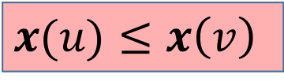

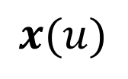
Isotonic Regression
Constraint Graph $G=\left(V,E\right)$
$x\left(v\right)$
$$x(u)$$
Age of child
Height of mother
Height of mother
$x(u)≤x\left(v\right)$
Taller mother AND older child

Slide 17
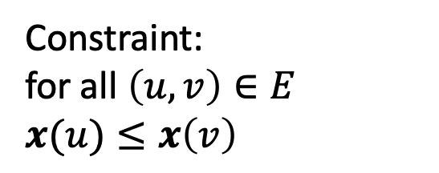
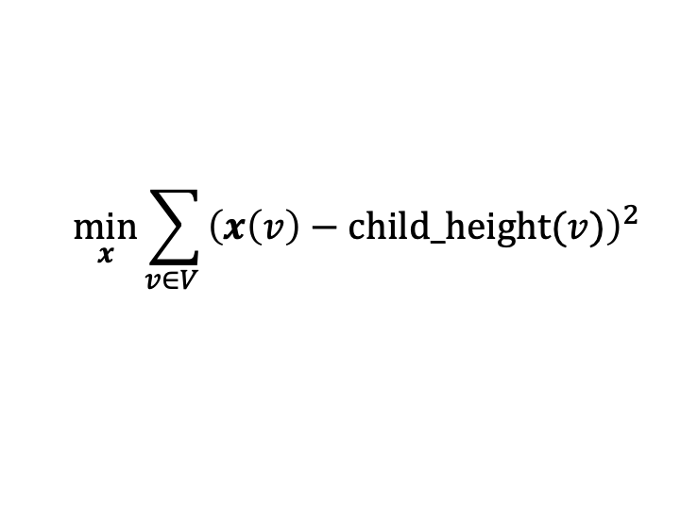
Isotonic Regression
Constraint Graph $G=\left(V,E\right)$
Constraint:
for all $\left(u,v\right)∈E$
$x(u)≤x\left(v\right)$
Age of child
Cost:
Height of mother
$$\min_{x}{\sum_{v∈V }{{\left(x\left(v\right)−\text{child}\text{_}\text{height}(v)\right)}^{2}}}$$

Slide 18
Isotonic Regression
Constraint Graph $G=\left(V,E\right)$
Constraint:
for all $\left(u,v\right)∈E$
$x(u)≤x\left(v\right)$
Age of child
Cost:
Height of mother
$$\min_{x}{\sum_{v∈V }{{\left(x\left(v\right)−\text{child}\text{_}\text{height}(v)\right)}^{2}}}$$
Height of child

Slide 19

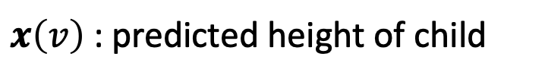
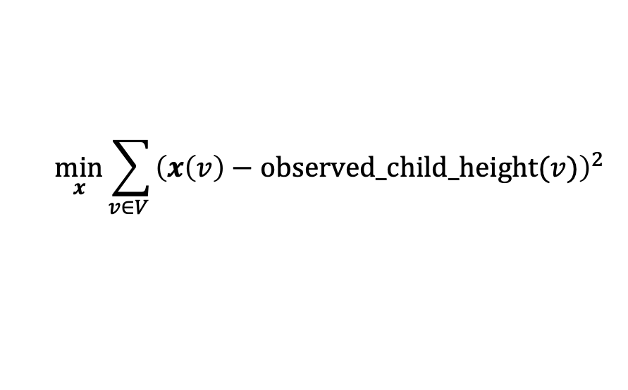
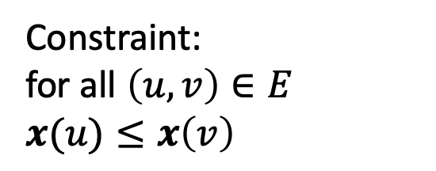

Optimization on Graphs
Graph $G=\left(V,E\right)$
$x∈ℝ^{V}$
Functions & constraints on pairs $x\left(v\right),x(u)$
$x\left(v\right)$ : predicted height of child
$\left(u,v\right)∈E$
Constraint:
for all $\left(u,v\right)∈E$
$x(u)≤x\left(v\right)$
Cost:
$$\min_{x}{\sum_{v∈V }{{\left(x\left(v\right)−\text{observed}\text{_}\text{child}\text{_}\text{height}(v)\right)}^{2}}}$$

Slide 20
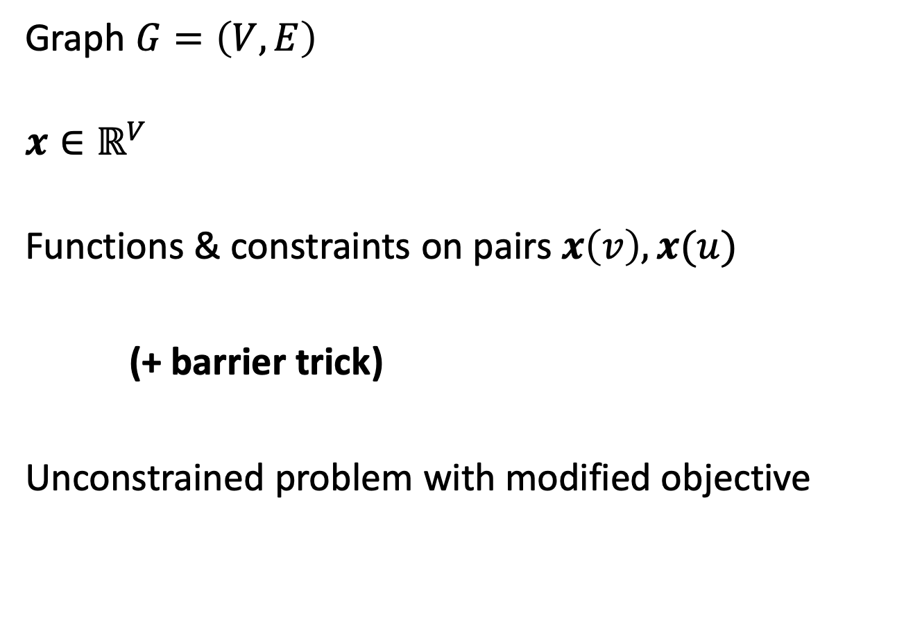
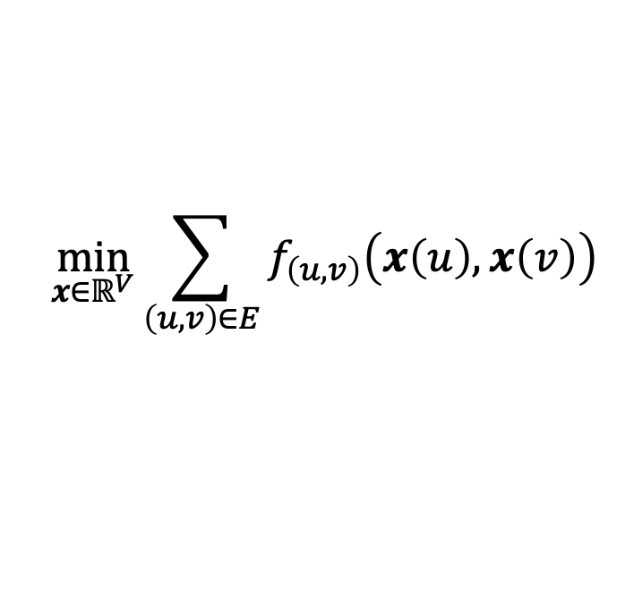
Optimization on Graphs
Graph $G=\left(V,E\right)$
$x∈ℝ^{V}$
Functions & constraints on pairs $x\left(v\right),x(u)$
(+ barrier trick)
Unconstrained problem with modified objective
$\left(u,v\right)∈E$
$$\min_{\begin{aligned}x∈ℝ^{V} \\ \end{aligned}}{\sum_{\left(u,v\right)∈E}{f_{\left(u,v\right)}\left(x\left(u\right),x\left(v\right)\right)}}$$
Notes:
TIME Aug-05 Mon 1
12:05 at end

Slide 21
Optimization on Graphs: Fast Algorithms

Slide 22



Optimization Primer
$$𝒟$$
$\min_{x∈𝒟}{c(x)}$
$$x^{∗}$$

Slide 23






Optimization Primer
$$𝒟$$
$\min_{x∈𝒟}{c(x)}$
Second Order Methods – “Newton Steps”
$$x_{0}$$
$$x_{1}$$
$$x_{2}$$
$$x^{∗}$$
$c\left(x_{\text{0}}+Δ\right)≈c\left(x_{\text{0}}\right)+\frac{dc\left(x_{0}\right)}{dx}Δ+\frac{1}{2}\frac{d^{2}c\left(x_{0}\right)}{dx^{2}}Δ^{2}$
$c\left(x_{0}+Δ\right)$
2nd order
1st order
$$x_{0}$$

Slide 24
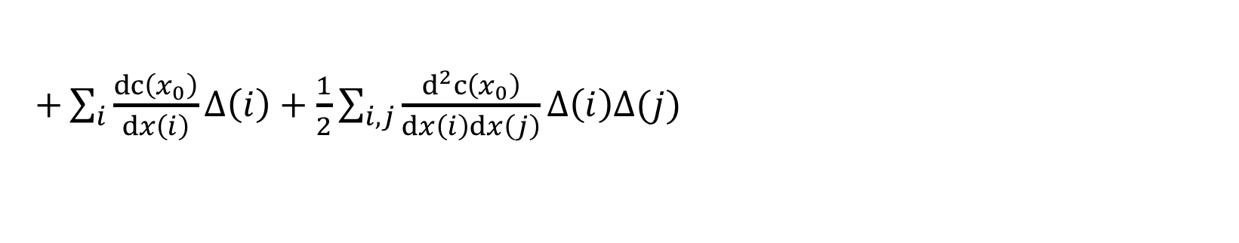

Optimization Primer
$$𝒟$$
$\min_{x∈𝒟}{c(x)}$
Second Order Methods – “Newton Steps”
$$x_{0}$$
$$x_{1}$$
$$x_{2}$$
$$x^{∗}$$
$+\sum_{i}{\frac{dc\left(x_{0}\right)}{dx\left(i\right)}}Δ\left(i\right)+\frac{1}{2}\sum_{i,j}{\frac{d^{2}c\left(x_{0}\right)}{dx\left(i\right)dx\left(j\right)}Δ\left(i\right)Δ(j)}$
$c\left(x_{\text{0}}+Δ\right)≈c\left(x_{\text{0}}\right)$

Slide 25
Optimization Primer
$$𝒟$$
$\min_{x∈𝒟}{c(x)}$
Second Order Methods – “Newton Steps”
$$x_{0}$$
$$x_{1}$$
$$x_{2}$$
$$x^{∗}$$
$c\left(x_{\text{0}}+Δ\right)≈c\left(x_{\text{0}}\right)+∇c\left(x_{0}\right)⋅Δ+$ $\frac{1}{2}Δ⋅∇^{2}c\left(x_{0}\right)Δ$

Slide 26

Optimization Primer
$$𝒟$$
$\min_{x∈𝒟}{c(x)}$
Second Order Methods – “Newton Steps”
$$x_{0}$$
$$x_{1}$$
$$x_{2}$$
$$x^{∗}$$
$c\left(x_{\text{0}}+Δ\right)≈c\left(x_{\text{0}}\right)+g⋅Δ+$ $\frac{1}{2}Δ⋅HΔ$
$HΔ=−g$
$c\left(x_{\text{0}}+Δ\right)≈c\left(x_{\text{0}}\right)+g⋅Δ+$ $\frac{1}{2}Δ⋅HΔ$

Slide 27
Optimization Primer
$$𝒟$$
$\min_{x∈𝒟}{c(x)}$
Second Order Methods – “Newton Steps”
$$x_{0}$$
$$x_{1}$$
$$x_{2}$$
$$x^{∗}$$
$c\left(x_{\text{0}}+Δ\right)≈c\left(x_{\text{0}}\right)+g⋅Δ+$ $\frac{1}{2}Δ⋅HΔ$
$HΔ=−g$
$c\left(x_{\text{0}}+Δ\right)≈c\left(x_{\text{0}}\right)−g⋅H^{−1}g+$ $\frac{1}{2}Δ⋅HΔ$

Slide 28
Optimization Primer
$$𝒟$$
$\min_{x∈𝒟}{c(x)}$
Second Order Methods – “Newton Steps”
$$x_{0}$$
$$x_{1}$$
$$x_{2}$$
$$x^{∗}$$
$c\left(x_{\text{0}}+Δ\right)≈c\left(x_{\text{0}}\right)+g⋅Δ+$ $\frac{1}{2}Δ⋅HΔ$
$HΔ=−g$
$c\left(x_{\text{0}}+Δ\right)≈c\left(x_{\text{0}}\right)−g⋅H^{−1}g+$ $\frac{1}{2}H^{−1}g⋅HH^{−1}g$

Slide 29
Optimization Primer
$$𝒟$$
$\min_{x∈𝒟}{c(x)}$
Second Order Methods – “Newton Steps”
$$x_{0}$$
$$x_{1}$$
$$x_{2}$$
$$x^{∗}$$
$c\left(x_{\text{0}}+Δ\right)≈c\left(x_{\text{0}}\right)+g⋅Δ+$ $\frac{1}{2}Δ⋅HΔ$
$HΔ=−g$
$c\left(x_{\text{0}}+Δ\right)≈c\left(x_{\text{0}}\right)−\frac{1}{2}g⋅H^{−1}g$

Slide 30
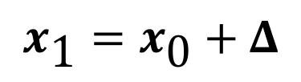
Optimization Primer
$$𝒟$$
$\min_{x∈𝒟}{c(x)}$
Second Order Methods – “Newton Steps”
$$x_{0}$$
$$x_{1}$$
$$x_{2}$$
$$x^{∗}$$
$c\left(x_{\text{0}}+Δ\right)≈c\left(x_{\text{0}}\right)+g⋅Δ+$ $\frac{1}{2}Δ⋅HΔ$
$HΔ=−g$
$$x_{\text{1}}=x_{\text{0}}+Δ$$
A good update step!
Notes:
TIME Aug-05 Mon 1
12:05 at end
TIME Aug-05 Mon 2
10:00 at end

Slide 31
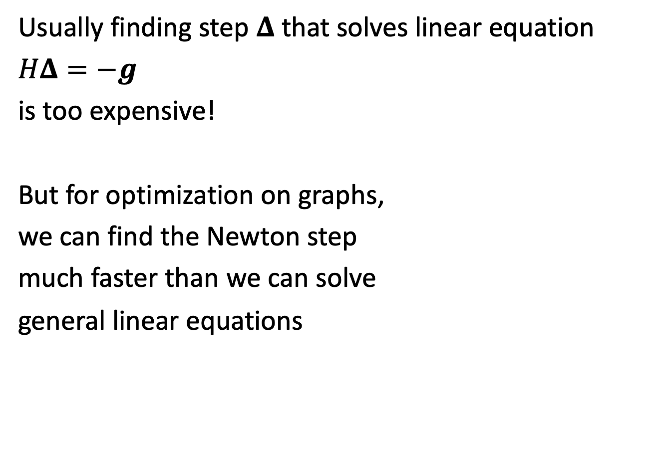
Second Order Methods
Usually finding step $Δ$ that solves linear equation
$HΔ=−g$
is too expensive!
But for optimization on graphs,
we can find the Newton step
much faster than we can solve
general linear equations

Slide 32
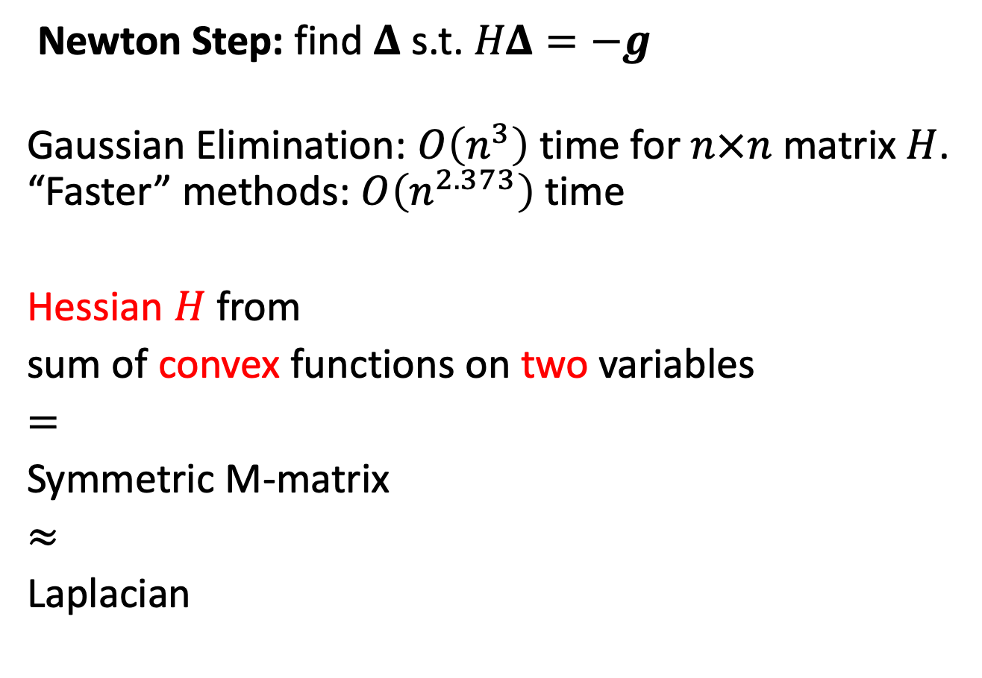

Graphs and Hessian Linear Equations
Newton Step: find $Δ$ s.t. $HΔ=−g$
Gaussian Elimination: $O\left(n^{3}\right)$ time for $n×n$ matrix $H$.
“Faster” methods: $O\left(n^{2.373}\right)$ time
Hessian $H$ from
sum of convex functions on two variables
$=$
Symmetric M-matrix
$≈$
Laplacian
Spielman-Teng ’04: Laplacian linear equations
can be solved
in $\tilde{O}\left(\text{\#}\text{edges}\right)$ time

Slide 33

Graphs and Hessian Linear Equations
Newton Step: find $Δ$ s.t. $HΔ=−g$
Gaussian Elimination: $O\left(n^{3}\right)$ time for $n×n$ matrix $H$.
“Faster” methods: $O\left(n^{2.373}\right)$ time
Hessian $H$ from
sum of convex functions on two variables
$=$
Symmetric M-matrix
$≈$
Laplacian
Daitch-Spielman ’08:
Symmetric M-matrix
linear equations can be solved
in $\tilde{O}\left(\text{\#}\text{edges}\right)$ time

Slide 34
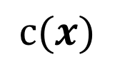
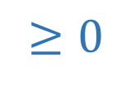


Convex Functions
$$c(x)$$
$c\left(x_{0}\right)+$ $g⋅Δ+\frac{1}{2}Δ⋅HΔ$
$c\left(x_{0}+Δ\right)≈c\left(x_{0}\right)+$ $g⋅Δ$
$$x_{0}$$
$c\left(x_{0}+Δ\right)≈c\left(x_{0}\right)+$ $g⋅Δ+\frac{1}{2}Δ⋅HΔ$
$$≥0$$

Slide 35
Convex Functions
$$c(x)$$
$c\left(x_{0}\right)+$ $g⋅Δ+\frac{1}{2}Δ⋅HΔ$
$c\left(x_{0}+Δ\right)≈c\left(x_{0}\right)+$ $g⋅Δ$
$$x_{0}$$
$c\left(x_{0}+Δ\right)≈c\left(x_{0}\right)+$ $g⋅Δ+\frac{1}{2}Δ⋅HΔ$
No negative eigenvalues!
Notes:
TIME sun 1
Approx 26:00 at end?

Slide 36

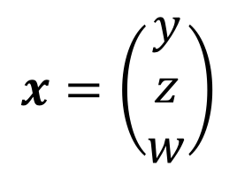






Hessians & Graphs
$$x=\left(\begin{matrix}y \\ z \\ w\end{matrix}\right)$$
Graph-Structured Cost Function
$c\left(x\right)=c_{1}\left(y,z\right)+c_{2}\left(y,w\right)+c_{3}\left(z,w\right)$
$$c_{1}\left(y,z\right)$$
$$z$$
$$y$$
$$c_{3}\left(z,w\right)$$
$$c_{2}\left(y,w\right)$$
$$w$$
$∇^{2}c\left(x\right)=∇^{2}c_{1}\left(y,z\right)+∇^{2}c_{2}\left(z,w\right)+∇^{2}c_{3}\left(w,y\right)$

Slide 37



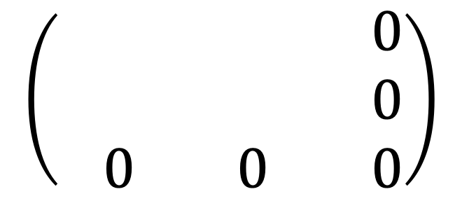


Second Derivatives
$$∇^{2}c\left(x\right)=∇^{2}c_{1}\left(y,z\right)+∇^{2}c_{2}\left(y,w\right)+{∇^{2}c}_{3}\left(z,w\right)$$
$${∇^{2}c}_{1}\left(y,z\right)$$
$$z$$
$$y$$
$${∇^{2}c}_{3}\left(z,w\right)$$
$$∇^{2}c_{2}\left(y,w\right)$$
$$w$$
$$\left(\begin{matrix}−1 & −1 & −0 \\ −1 & 1 & −0 \\ −0 & −0 & −0\end{matrix}\right)$$
2-by-2 PSD
non-negative eigenvalues
If every term looks like
the sum is an M-matrix

Slide 38

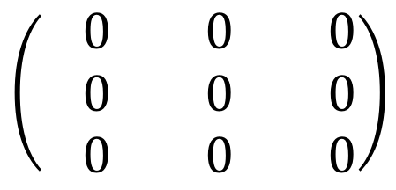

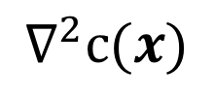


Second Derivatives
$$∇^{2}c\left(x\right)=∇^{2}c_{1}\left(y,z\right)+∇^{2}c_{2}\left(y,w\right)+{∇^{2}c}_{3}\left(z,w\right)$$
$${∇^{2}c}_{1}\left(y,z\right)$$
$$z$$
$$y$$
$${∇^{2}c}_{3}\left(z,w\right)$$
$$∇^{2}c_{2}\left(y,w\right)$$
$$w$$
$$∇^{2}c(x)$$
$$y$$
$$z$$
$$w$$
$$y$$
$$\left(\begin{matrix}−0 & −0 & −0 \\ −0 & −0 & −0 \\ −0 & −0 & −0\end{matrix}\right)$$
$$z$$
$$w$$

Slide 39






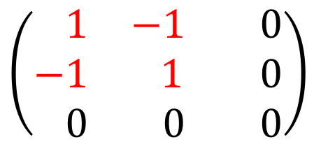


Second Derivatives
$$∇^{2}c\left(x\right)=∇^{2}c_{1}\left(y,z\right)+∇^{2}c_{2}\left(y,w\right)+{∇^{2}c}_{3}\left(z,w\right)$$
$${∇^{2}c}_{1}\left(y,z\right)$$
$$z$$
$$y$$
$${∇^{2}c}_{3}\left(z,w\right)$$
$$∇^{2}c_{2}\left(y,w\right)$$
$$w$$
$$∇^{2}c(x)$$
$$y$$
$$z$$
$$w$$
$$y$$
$$z$$
$$w$$
$$y$$
$$\left(\begin{matrix}−0 & −0 & −0 \\ −0 & −0 & −0 \\ −0 & −0 & −0\end{matrix}\right)$$
$$\left(\begin{matrix}−1 & −1 & −0 \\ −1 & 1 & −0 \\ −0 & −0 & −0\end{matrix}\right)$$
$$z$$
$$w$$

Slide 40
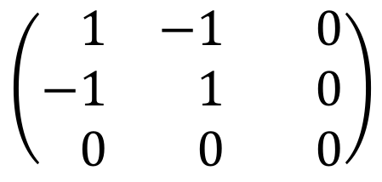
Second Derivatives
$$∇^{2}c\left(x\right)=∇^{2}c_{1}\left(y,z\right)+∇^{2}c_{2}\left(y,w\right)+{∇^{2}c}_{3}\left(z,w\right)$$
$${∇^{2}c}_{1}\left(y,z\right)$$
$$z$$
$$y$$
$${∇^{2}c}_{3}\left(z,w\right)$$
$$∇^{2}c_{2}\left(y,w\right)$$
$$w$$
$$∇^{2}c(x)$$
$$y$$
$$z$$
$$w$$
$$y$$
$$z$$
$$w$$
$$y$$
$$\left(\begin{matrix}−1 & −1 & −0 \\ −1 & −1 & −0 \\ −0 & −0 & −0\end{matrix}\right)$$
$$\left(\begin{matrix}−1 & −1 & −0 \\ −1 & 1 & −0 \\ −0 & −0 & −0\end{matrix}\right)$$
$$z$$
$$w$$

Slide 41

Second Derivatives
$$∇^{2}c\left(x\right)=∇^{2}c_{1}\left(y,z\right)+∇^{2}c_{2}\left(y,w\right)+{∇^{2}c}_{3}\left(z,w\right)$$
$${∇^{2}c}_{1}\left(y,z\right)$$
$$z$$
$$y$$
$${∇^{2}c}_{3}\left(z,w\right)$$
$$∇^{2}c_{2}\left(y,w\right)$$
$$w$$
$$∇^{2}c(x)$$
$$y$$
$$z$$
$$w$$
$$y$$
$$\left(\begin{matrix}−1 & −1 & −0 \\ −1 & −1 & −0 \\ −0 & −0 & −0\end{matrix}\right)$$
$$z$$
$$w$$

Slide 42



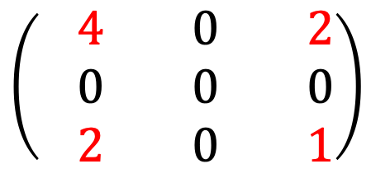

Second Derivatives
$$∇^{2}c\left(x\right)=∇^{2}c_{1}\left(y,z\right)+∇^{2}c_{2}\left(y,w\right)+{∇^{2}c}_{3}\left(z,w\right)$$
$${∇^{2}c}_{1}\left(y,z\right)$$
$$z$$
$$y$$
$${∇^{2}c}_{3}\left(z,w\right)$$
$$∇^{2}c_{2}\left(y,w\right)$$
$$w$$
$$∇^{2}c(x)$$
$$y$$
$$z$$
$$w$$
$$y$$
$$z$$
$$w$$
$$y$$
$$\left(\begin{matrix}−1 & −1 & −0 \\ −1 & −1 & −0 \\ −0 & −0 & −0\end{matrix}\right)$$
$$\left(\begin{matrix}−4 & −0 & −2 \\ −0 & −0 & −0 \\ −2 & −0 & −1\end{matrix}\right)$$
$$z$$
$$w$$

Slide 43



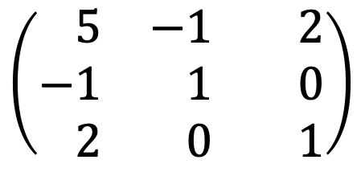
Second Derivatives
$$∇^{2}c\left(x\right)=∇^{2}c_{1}\left(y,z\right)+∇^{2}c_{2}\left(y,w\right)+{∇^{2}c}_{3}\left(z,w\right)$$
$${∇^{2}c}_{1}\left(y,z\right)$$
$$z$$
$$y$$
$${∇^{2}c}_{3}\left(z,w\right)$$
$$∇^{2}c_{2}\left(y,w\right)$$
$$w$$
$$∇^{2}c(x)$$
$$y$$
$$z$$
$$w$$
$$y$$
$$z$$
$$w$$
$$y$$
$$\left(\begin{matrix}−5 & −1 & −2 \\ −1 & −1 & −0 \\ −2 & −0 & −1\end{matrix}\right)$$
$$\left(\begin{matrix}−4 & −0 & −2 \\ −0 & −0 & −0 \\ −2 & −0 & −1\end{matrix}\right)$$
$$z$$
$$w$$

Slide 44


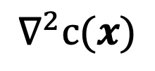




Second Derivatives
$$∇^{2}c\left(x\right)=∇^{2}c_{1}\left(y,z\right)+∇^{2}c_{2}\left(y,w\right)+{∇^{2}c}_{3}\left(z,w\right)$$
$${∇^{2}c}_{1}\left(y,z\right)$$
$$z$$
$$y$$
$${∇^{2}c}_{3}\left(z,w\right)$$
$$∇^{2}c_{2}\left(y,w\right)$$
$$w$$
$$∇^{2}c(x)$$
$$y$$
$$z$$
$$w$$
$$y$$
$$\left(\begin{matrix}−5 & −1 & −2 \\ −1 & −1 & −0 \\ −2 & −0 & −1\end{matrix}\right)$$
$$z$$
$$w$$

Slide 45

Second Derivatives
$$∇^{2}c\left(x\right)=∇^{2}c_{1}\left(y,z\right)+∇^{2}c_{2}\left(y,w\right)+{∇^{2}c}_{3}\left(z,w\right)$$
$${∇^{2}c}_{1}\left(y,z\right)$$
$$z$$
$$y$$
$${∇^{2}c}_{3}\left(z,w\right)$$
$$∇^{2}c_{2}\left(y,w\right)$$
$$w$$
$$∇^{2}c(x)$$
$$y$$
$$z$$
$$w$$
$$y$$
$$\left(\begin{matrix}−5 & −1 & −2 \\ −1 & −1 & −0 \\ −2 & −0 & −1\end{matrix}\right)$$
$$z$$
$$w$$

Slide 46

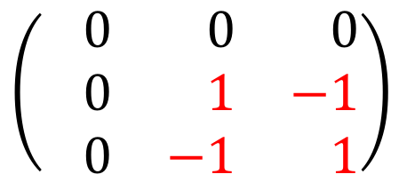
Second Derivatives
$$∇^{2}c\left(x\right)=∇^{2}c_{1}\left(y,z\right)+∇^{2}c_{2}\left(y,w\right)+{∇^{2}c}_{3}\left(z,w\right)$$
$${∇^{2}c}_{1}\left(y,z\right)$$
$$z$$
$$y$$
$${∇^{2}c}_{3}\left(z,w\right)$$
$$∇^{2}c_{2}\left(y,w\right)$$
$$w$$
$$∇^{2}c(x)$$
$$y$$
$$z$$
$$w$$
$$y$$
$$z$$
$$w$$
$$y$$
$$\left(\begin{matrix}−5 & −1 & −2 \\ −1 & −1 & −0 \\ −2 & −0 & −1\end{matrix}\right)$$
$$\left(\begin{matrix}−0 & −0 & −0 \\ −0 & −1 & −1 \\ −0 & −1 & −1\end{matrix}\right)$$
$$z$$
$$w$$

Slide 47
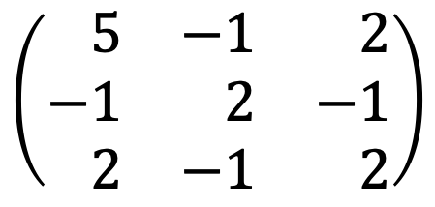
Second Derivatives
$$∇^{2}c\left(x\right)=∇^{2}c_{1}\left(y,z\right)+∇^{2}c_{2}\left(y,w\right)+{∇^{2}c}_{3}\left(z,w\right)$$
$${∇^{2}c}_{1}\left(y,z\right)$$
$$z$$
$$y$$
$${∇^{2}c}_{3}\left(z,w\right)$$
$$∇^{2}c_{2}\left(y,w\right)$$
$$w$$
$$∇^{2}c(x)$$
$$y$$
$$z$$
$$w$$
$$y$$
$$z$$
$$w$$
$$y$$
$$\left(\begin{matrix}−5 & −1 & −2 \\ −1 & −2 & −1 \\ −2 & −1 & −2\end{matrix}\right)$$
$$\left(\begin{matrix}−0 & −0 & −0 \\ −0 & −1 & −1 \\ −0 & −1 & −1\end{matrix}\right)$$
$$z$$
$$w$$

Slide 48
Second Derivatives
$$∇^{2}c\left(x\right)=∇^{2}c_{1}\left(y,z\right)+∇^{2}c_{2}\left(y,w\right)+{∇^{2}c}_{3}\left(z,w\right)$$
$${∇^{2}c}_{1}\left(y,z\right)$$
$$z$$
$$y$$
$${∇^{2}c}_{3}\left(z,w\right)$$
$$∇^{2}c_{2}\left(y,w\right)$$
$$w$$
$$∇^{2}c(x)$$
$$y$$
$$z$$
$$w$$
$$y$$
$$\left(\begin{matrix}−5 & −1 & −2 \\ −1 & −2 & −1 \\ −2 & −1 & −2\end{matrix}\right)$$
$$z$$
$$w$$

Slide 49
Second Derivatives
$$∇^{2}c\left(x\right)=∇^{2}c_{1}\left(y,z\right)+∇^{2}c_{2}\left(y,w\right)+{∇^{2}c}_{3}\left(z,w\right)$$
$${∇^{2}c}_{1}\left(y,z\right)$$
$$z$$
$$y$$
$${∇^{2}c}_{3}\left(z,w\right)$$
$$∇^{2}c_{2}\left(y,w\right)$$
$$w$$
$$\left(\begin{matrix}−1 & −1 & −0 \\ −1 & 1 & −0 \\ −0 & −0 & −0\end{matrix}\right)$$
2-by-2 PSD
non-negative eigenvalues
If every term looks like
the sum is an M-matrix

Slide 50
Second Derivatives
$$∇^{2}c\left(x\right)=∇^{2}c_{1}\left(y,z\right)+∇^{2}c_{2}\left(y,w\right)+{∇^{2}c}_{3}\left(z,w\right)$$
$${∇^{2}c}_{1}\left(y,z\right)$$
$$z$$
$$y$$
$${∇^{2}c}_{3}\left(z,w\right)$$
$$∇^{2}c_{2}\left(y,w\right)$$
$$w$$
$$\left(\begin{matrix}−1 & −1 & −0 \\ −1 & 1 & −0 \\ −0 & −0 & −0\end{matrix}\right)$$
2-by-2 PSD
non-negative eigenvalues
If every term looks like
Newton Step can be computed in nearly linear time!

Slide 51
Optimization on Graphs
Variants of this framework have been used for many optimization problems:
Maximum flow [DS08, CKMST11,KMP12, Mad13, Mad16]
Minimum cost flow [LS14]
Negative weight shortest paths [CMSV16]
Isotonic regression [KRS15]
Regularized Lipschitz learning on graphs [KRSS15]
P-norm flow [KPSW19]

Slide 52
Optimization on Graphs
M-matrix & Laplacian matrix solvers used for many
other problems in TCS
Learning on graphs [ZGL03, ZS04, ZBLWS04]
Graph partitioning [OSV12]
Sampling random spanning trees [KM09,MST15,DKPRS17,DPR17,S18]
Graph sparsification [SS08,LKP12,KPPS17]

Slide 53
Solving M-matrices
Daitch-Spielman ‘08 gave reduction to Laplacian matrices
Spielman-Teng ’04 gave fast Laplacian solver
Since, much work on trying to get a practical solver:
[KMP10, KMP11, KOSZ13, LS13, CKM+14, PS14, LPS16]
We finally succeeded?
Kyng-Sachdeva ’16

Slide 54
Optimization on Graphs:
Toward Practical Algorithms

Slide 55
Julia Package: Laplacians.jl
Graph | Apx Elim | CMG | LAMG | Other
1000x1000 grid | 6.3 | 3.0 | 15
Apx Elim = Approximate Elimination (K & Spielman)
CMG = Combinatorial Multigrid (Koutis)
LAMG = Lean Algebraic Multigrid (Livne & Brandt)

Slide 56
Julia Package: Laplacians.jl
Graph | Apx Elim | CMG | LAMG | Other
1000x1000 grid | 6.3 | 3.0 | 15
100x100x100 grid | 8.7 | 3.4 | 15
Apx Elim = Approximate Elimination (K & Spielman)
CMG = Combinatorial Multigrid (Koutis)
LAMG = Lean Algebraic Multigrid (Livne & Brandt)

Slide 57
Julia Package: Laplacians.jl
Graph | Apx Elim | CMG | LAMG | Other
1000x1000 grid | 6.3 | 3.0 | 15
100x100x100 grid | 8.7 | 3.4 | 15
Rand 4-regular | 17.2 | 12 | 13.7 | 1.7 (CG)
Apx Elim = Approximate Elimination (K & Spielman)
CMG = Combinatorial Multigrid (Koutis)
LAMG = Lean Algebraic Multigrid (Livne & Brandt)
CG = Conjugate Gradient

Slide 58
Julia Package: Laplacians.jl
Graph | Apx Elim | CMG | LAMG | Other
1000x1000 grid | 6.3 | 3.0 | 15
100x100x100 grid | 8.7 | 3.4 | 15
Rand 4-regular | 17.2 | 12 | 13.7 | 1.7 (CG)
Pref attach | 9.5 | 10.8 | 5.1 | 3.2 (ICC)
Apx Elim = Approximate Elimination (K & Spielman)
CMG = Combinatorial Multigrid (Koutis)
LAMG = Lean Algebraic Multigrid (Livne & Brandt)
CG = Conjugate Gradient, ICC = Incomplete Cholesky

Slide 59
Julia Package: Laplacians.jl
Graph | Apx Elim | CMG | LAMG | Other
1000x1000 grid | 6.3 | 3.0 | 15
100x100x100 grid | 8.7 | 3.4 | 15
Rand 4-regular | 17.2 | 12 | 13.7 | 1.7 (CG)
Pref attach | 9.5 | 10.8 | 5.1 | 3.2 (ICC)
Chimera (2500100,11) | 28 | 350 | 74
Apx Elim = Approximate Elimination (K & Spielman)
CMG = Combinatorial Multigrid (Koutis)
LAMG = Lean Algebraic Multigrid (Livne & Brandt)
CG = Conjugate Gradient, ICC = Incomplete Cholesky

Slide 60
Julia Package: Laplacians.jl
Graph | Apx Elim | CMG | LAMG | Other
1000x1000 grid | 6.3 | 3.0 | 15
100x100x100 grid | 8.7 | 3.4 | 15
Rand 4-regular | 17.2 | 12 | 13.7 | 1.7 (CG)
Pref attach | 9.5 | 10.8 | 5.1 | 3.2 (ICC)
Chimera (2500100,11) | 28 | 350 | 74
Min Cost Flow 1 | 5.9 | 4.3 | >60
Min Cost Flow 2 | 6.8 | 23 | 29
Apx Elim = Approximate Elimination (K & Spielman)
CMG = Combinatorial Multigrid (Koutis)
LAMG = Lean Algebraic Multigrid (Livne & Brandt)
CG = Conjugate Gradient, ICC = Incomplete Cholesky

Slide 61
Julia Package: Laplacians.jl
Graph | Apx Elim | CMG | LAMG | Other
1000x1000 grid | 6.3 | 3.0 | 15
100x100x100 grid | 8.7 | 3.4 | 15
Rand 4-regular | 17.2 | 12 | 13.7 | 1.7 (CG)
Pref attach | 9.5 | 10.8 | 5.1 | 3.2 (ICC)
Chimera (2500100,11) | 28 | 350 | 74
Min Cost Flow 1 | 5.9 | 4.3 | >60
Min Cost Flow 2 | 6.8 | 23 | 29
Summary: Approximate Elimination processes between
300k and 500k entries per second, for 8 digit accuracy
Others vary widely

Slide 62
Thanks!
github.com/danspielman/Laplacians.jl/
Slides: rasmuskyng.com/#talks
References
Approximate Gaussian Elimination for Laplacians
(R. Kyng, S. Sachdeva 2016)
Faster Approximate Lossy Generalized Flow via Interior Point Algorithms
(S. Daitch, D. Spielman 2008)
Fast, Provable Algorithms for Isotonic Regression in all Lp norms
(R. Kyng, A.B. Rao, S. Sachdeva 2015)
Nearly-Linear Time Algorithms for Preconditioning and Solving SDD Linear Systems
(D. Spielman, S.-H. Teng 2004)

