Slide 1
How to Solve Problems on Graphs
Using Linear Equations, and
How to Solve Linear Equations Using Graphs
Speaker | Rasmus Kyng | Harvard Theory of Computing

Slide 2
How to Solve Problems on Graphs
Using Linear Equations, and
How to Solve Linear Equations Using Graphs
Optimization on Graphs
Speaker | Rasmus Kyng | Harvard Theory of Computing

Slide 3

Optimization on Graphs
Graph $G=\left(V,E\right)$

Slide 4
Optimization on Graphs
An approach to solving problems

Slide 5
Optimization on Graphs
An approach to solving problems

Slide 6
Optimization on Graphs
Let’s look at an example

Slide 7
Isotonic Regression
Predict child’s height from mother’s height
Model?
Height of child
Height of mother

Slide 8
Isotonic Regression
Predict child’s height from mother’s height
Model? Increasing function?
Height of child
Height of mother

Slide 9
Isotonic Regression
Predict child’s height from mother’s height
Model? Increasing function?
Height of child
Height of mother

Slide 10
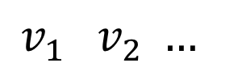
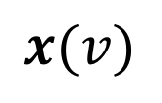

Isotonic Regression
$$x(v)$$
Height of child
$$G=\left(V,E\right)$$
Height of mother
$$v_{1} v_{2} …$$

Slide 11
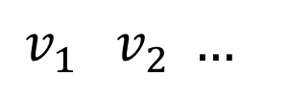
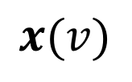
Isotonic Regression
$$x(v)$$
Height of child
$$G=\left(V,E\right)$$
Height of mother
$$v_{1} v_{2} …$$

Slide 12
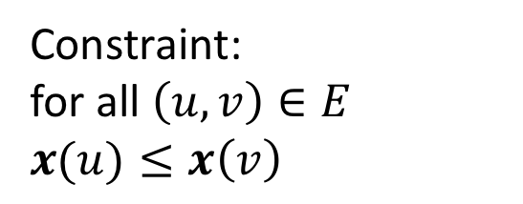

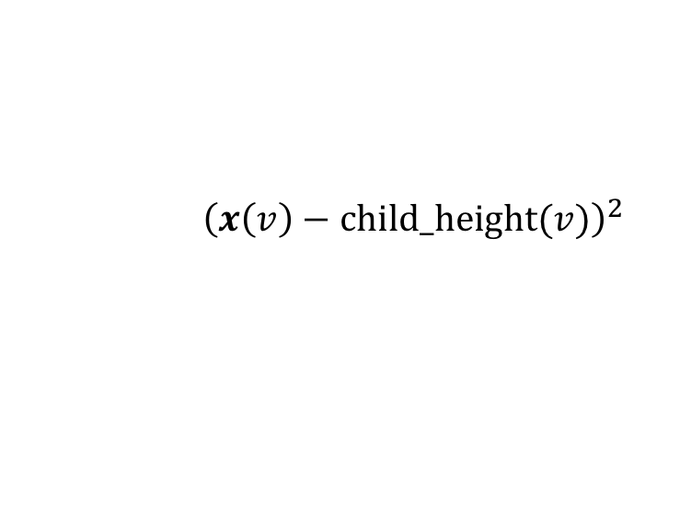
Isotonic Regression
Constraint:
for all $\left(u,v\right)∈E$
$x(u)≤x\left(v\right)$
Cost:
$$\min_{x}{\sum_{v∈V }{{\left(x\left(v\right)−\text{child}\text{_}\text{height}(v)\right)}^{2}}}$$
$$x(v)$$
Height of child
$$G=\left(V,E\right)$$
Height of mother
$$v_{1} v_{2} …$$

Slide 13

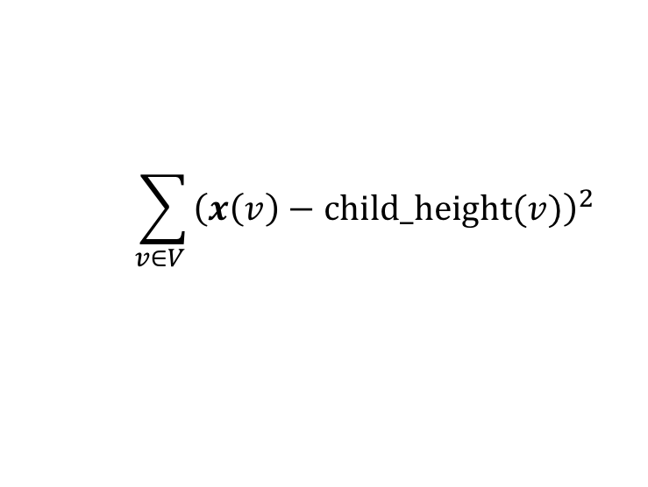
Isotonic Regression
Constraint:
for all $\left(u,v\right)∈E$
$x(u)≤x\left(v\right)$
Cost:
$$\min_{x}{\sum_{v∈V }{{\left(x\left(v\right)−\text{child}\text{_}\text{height}(v)\right)}^{2}}}$$
$$x(v)$$
Height of child
$$G=\left(V,E\right)$$
Height of mother
$$v_{1} v_{2} …$$

Slide 14
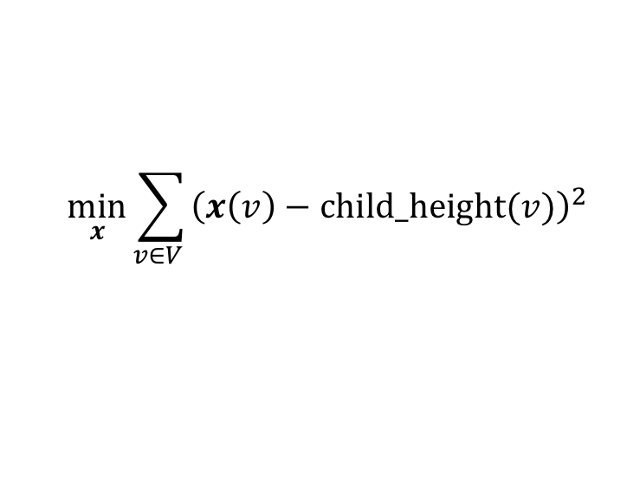
Isotonic Regression
Constraint:
for all $\left(u,v\right)∈E$
$x(u)≤x\left(v\right)$
Cost:
$$\min_{x}{\sum_{v∈V }{{\left(x\left(v\right)−\text{child}\text{_}\text{height}(v)\right)}^{2}}}$$
$$x(v)$$
Height of child
$$G=\left(V,E\right)$$
Height of mother
$$v_{1} v_{2} …$$

Slide 15
Isotonic Regression
Constraint:
for all $\left(u,v\right)∈E$
$x(u)≤x\left(v\right)$
Cost:
$$\min_{x}{\sum_{v∈V }{{\left(x\left(v\right)−\text{child}\text{_}\text{height}(v)\right)}^{2}}}$$
$$x(v)$$
Height of child
$$G=\left(V,E\right)$$
Height of mother
$$v_{1} v_{2} …$$

Slide 16
Isotonic Regression
Constraint:
for all $\left(u,v\right)∈E$
$x(u)≤x\left(v\right)$
Cost:
$$\min_{x}{\sum_{v∈V }{{\left(x\left(v\right)−\text{child}\text{_}\text{height}(v)\right)}^{2}}}$$
$$x(v)$$
Height of child
$$G=\left(V,E\right)$$
Height of mother
$$v_{1} v_{2} …$$

Slide 17

Isotonic Regression
Constraint Graph $G=\left(V,E\right)$
Age of child
Height of mother
Height of mother

Slide 18
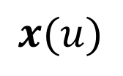
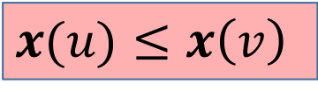

Isotonic Regression
Constraint Graph $G=\left(V,E\right)$
$x\left(v\right)$
$$x(u)$$
Age of child
Height of mother
Height of mother
$x(u)≤x\left(v\right)$
Taller mother AND older child

Slide 19
Isotonic Regression
Constraint:
for all $\left(u,v\right)∈E$
$x(u)≤x\left(v\right)$
Cost:
$$\min_{x}{\sum_{v∈V }{{\left(x\left(v\right)−\text{child}\text{_}\text{height}(v)\right)}^{2}}}$$
$$x(v)$$
Height of child
$$G=\left(V,E\right)$$
Height of mother
$$v_{1} v_{2} …$$

Slide 20

Problem Solving by Optimization
Problem understood through
solutions
costs of solutions
Cost function $c$ : solution $→$ cost
Goal:
$\min_{solutions x}{c(x)}$

Slide 21



Optimization Primer
$$𝒟$$
$\min_{x∈𝒟}{c(x)}$
$$x^{∗}$$

Slide 22



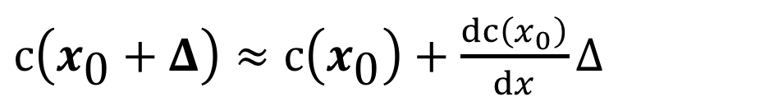
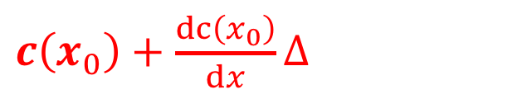



Optimization Primer
$$𝒟$$
$\min_{x∈𝒟}{c(x)}$
First Order Methods – “Gradient Descent”
$$x_{0}$$
$$x_{0}+Δ$$
$$x^{∗}$$
$c\left(x_{\text{0}}+Δ\right)≈c\left(x_{\text{0}}\right)+\frac{dc\left(x_{0}\right)}{dx}Δ$
$c\left(x_{0}+Δ\right)$
$c\left(x_{0}\right)+\frac{dc\left(x_{0}\right)}{dx}Δ$
$$x_{0}$$
$$x_{0}$$

Slide 23

Optimization Primer
$$𝒟$$
$\min_{x∈𝒟}{c(x)}$
First Order Methods – “Gradient Descent”
$$x_{0}$$
$$x_{0}+Δ$$
$$x^{∗}$$
$c\left(x_{\text{0}}+Δ\right)≈c\left(x_{\text{0}}\right)+\sum_{i}{\frac{dc\left(x_{0}\right)}{dx\left(i\right)}}Δ(i)$

Slide 24

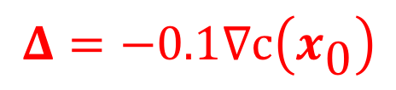
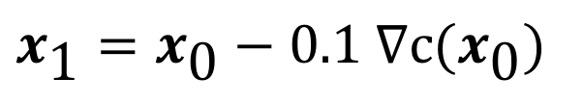
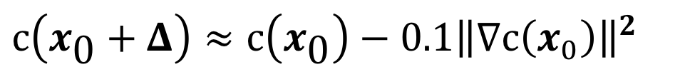
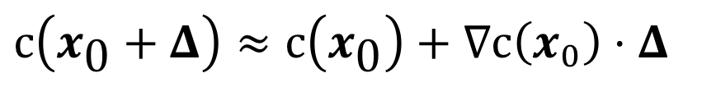

Optimization Primer
$$𝒟$$
$\min_{x∈𝒟}{c(x)}$
First Order Methods – “Gradient Descent”
$$x_{0}$$
$$x_{1}$$
$$x_{2}$$
$$x^{∗}$$
$c\left(x_{\text{0}}+Δ\right)≈c\left(x_{\text{0}}\right)+∇c\left(x_{0}\right)⋅Δ$
$$Δ=−0.1∇c\left(x_{\text{0}}\right)$$
$c\left(x_{\text{0}}+Δ\right)≈c\left(x_{\text{0}}\right)−0.1{\left\|∇c\left(x_{0}\right)\right\|}^{2}$
$x_{\text{1}}=x_{\text{0}}−0.1 ∇c(x_{\text{0}})$
Notes:
TIME sun 1
14:00 at start?

Slide 25



Optimization Primer
$$𝒟$$
$\min_{x∈𝒟}{c(x)}$
Second Order Methods – “Newton Steps”
$$x_{0}$$
$$x_{1}$$
$$x_{2}$$
$$x^{∗}$$
$c\left(x_{\text{0}}+Δ\right)≈c\left(x_{\text{0}}\right)+\frac{dc\left(x_{0}\right)}{dx}Δ+\frac{1}{2}\frac{d^{2}c\left(x_{0}\right)}{dx^{2}}Δ^{2}$
$c\left(x_{0}+Δ\right)$
2nd order
1st order
$$x_{0}$$

Slide 26
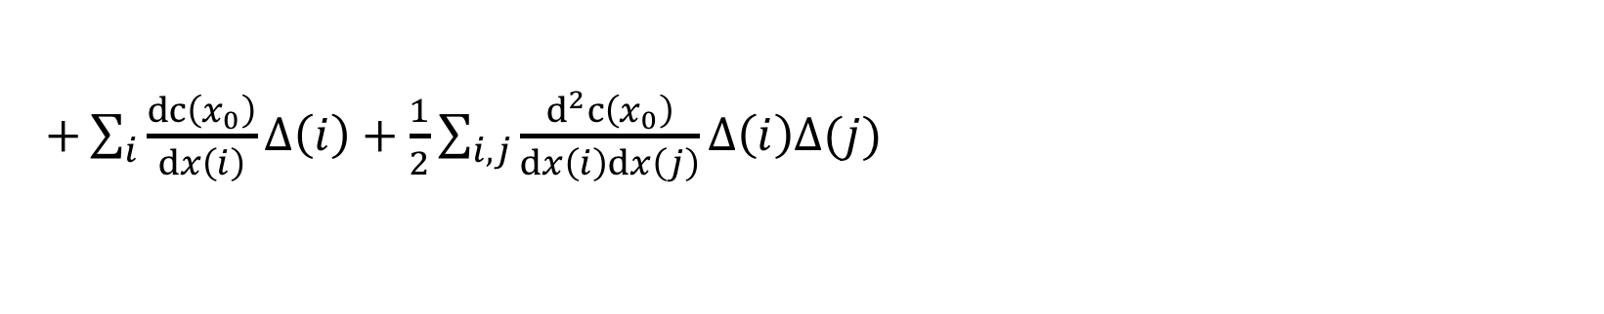

Optimization Primer
$$𝒟$$
$\min_{x∈𝒟}{c(x)}$
Second Order Methods – “Newton Steps”
$$x_{0}$$
$$x_{1}$$
$$x_{2}$$
$$x^{∗}$$
$+\sum_{i}{\frac{dc\left(x_{0}\right)}{dx\left(i\right)}}Δ\left(i\right)+\frac{1}{2}\sum_{i,j}{\frac{d^{2}c\left(x_{0}\right)}{dx\left(i\right)dx\left(j\right)}Δ\left(i\right)Δ(j)}$
$c\left(x_{\text{0}}+Δ\right)≈c\left(x_{\text{0}}\right)$

Slide 27
Optimization Primer
$$𝒟$$
$\min_{x∈𝒟}{c(x)}$
Second Order Methods – “Newton Steps”
$$x_{0}$$
$$x_{1}$$
$$x_{2}$$
$$x^{∗}$$
$c\left(x_{\text{0}}+Δ\right)≈c\left(x_{\text{0}}\right)+∇c\left(x_{0}\right)⋅Δ+$ $\frac{1}{2}Δ⋅∇^{2}c\left(x_{0}\right)Δ$

Slide 28

Optimization Primer
$$𝒟$$
$\min_{x∈𝒟}{c(x)}$
Second Order Methods – “Newton Steps”
$$x_{0}$$
$$x_{1}$$
$$x_{2}$$
$$x^{∗}$$
$c\left(x_{\text{0}}+Δ\right)≈c\left(x_{\text{0}}\right)+g⋅Δ+$ $\frac{1}{2}Δ⋅HΔ$
$HΔ=−g$
$c\left(x_{\text{0}}+Δ\right)≈c\left(x_{\text{0}}\right)+g⋅Δ+$ $\frac{1}{2}Δ⋅HΔ$

Slide 29
Optimization Primer
$$𝒟$$
$\min_{x∈𝒟}{c(x)}$
Second Order Methods – “Newton Steps”
$$x_{0}$$
$$x_{1}$$
$$x_{2}$$
$$x^{∗}$$
$c\left(x_{\text{0}}+Δ\right)≈c\left(x_{\text{0}}\right)+g⋅Δ+$ $\frac{1}{2}Δ⋅HΔ$
$HΔ=−g$
$c\left(x_{\text{0}}+Δ\right)≈c\left(x_{\text{0}}\right)−g⋅H^{−1}g+$ $\frac{1}{2}Δ⋅HΔ$

Slide 30
Optimization Primer
$$𝒟$$
$\min_{x∈𝒟}{c(x)}$
Second Order Methods – “Newton Steps”
$$x_{0}$$
$$x_{1}$$
$$x_{2}$$
$$x^{∗}$$
$c\left(x_{\text{0}}+Δ\right)≈c\left(x_{\text{0}}\right)+g⋅Δ+$ $\frac{1}{2}Δ⋅HΔ$
$HΔ=−g$
$c\left(x_{\text{0}}+Δ\right)≈c\left(x_{\text{0}}\right)−g⋅H^{−1}g+$ $\frac{1}{2}H^{−1}g⋅HH^{−1}g$

Slide 31
Optimization Primer
$$𝒟$$
$\min_{x∈𝒟}{c(x)}$
Second Order Methods – “Newton Steps”
$$x_{0}$$
$$x_{1}$$
$$x_{2}$$
$$x^{∗}$$
$c\left(x_{\text{0}}+Δ\right)≈c\left(x_{\text{0}}\right)+g⋅Δ+$ $\frac{1}{2}Δ⋅HΔ$
$HΔ=−g$
$c\left(x_{\text{0}}+Δ\right)≈c\left(x_{\text{0}}\right)−\frac{1}{2}g⋅H^{−1}g$

Slide 32
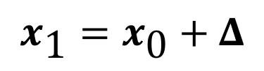
Optimization Primer
$$𝒟$$
$\min_{x∈𝒟}{c(x)}$
Second Order Methods – “Newton Steps”
$$x_{0}$$
$$x_{1}$$
$$x_{2}$$
$$x^{∗}$$
$c\left(x_{\text{0}}+Δ\right)≈c\left(x_{\text{0}}\right)+g⋅Δ+$ $\frac{1}{2}Δ⋅HΔ$
$HΔ=−g$
$$x_{\text{1}}=x_{\text{0}}+Δ$$
A better step!

Slide 33
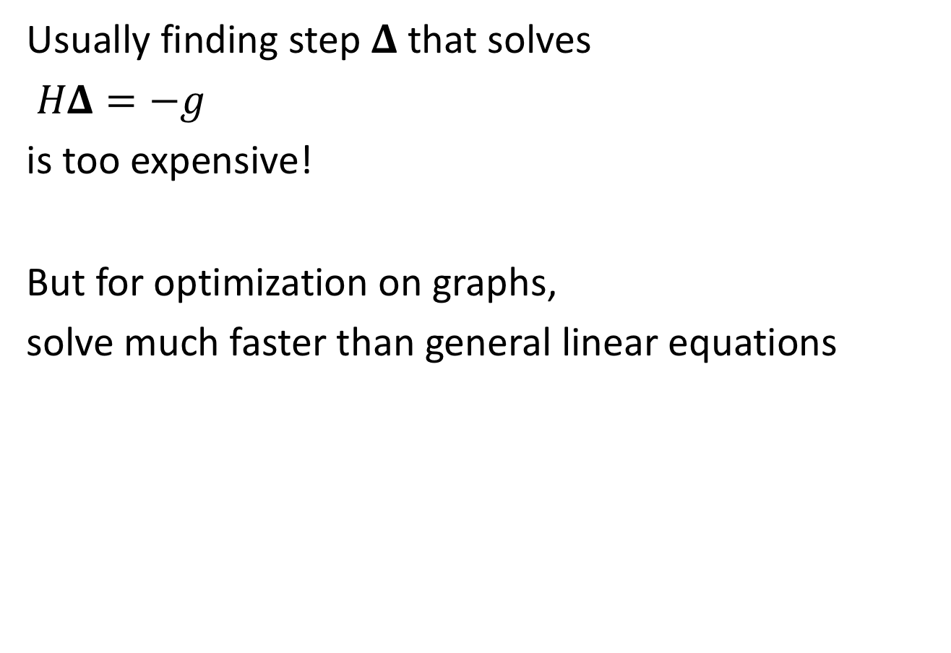
Second Order Methods
Usually finding step $Δ$ that solves
$HΔ=−g$
is too expensive!
But for optimization on graphs,
solve much faster than general linear equations

Slide 34
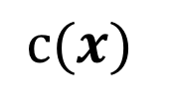
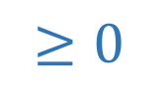


Convex Functions
$$c(x)$$
$c\left(x_{0}\right)+$ $g⋅Δ+\frac{1}{2}Δ⋅HΔ$
$c\left(x_{0}+Δ\right)≈c\left(x_{0}\right)+$ $g⋅Δ$
$$x_{0}$$
$c\left(x_{0}+Δ\right)≈c\left(x_{0}\right)+$ $g⋅Δ+\frac{1}{2}Δ⋅HΔ$
$$≥0$$

Slide 35

Convex Functions
Why convex?
Local minimum
$⟹$ global minimum
$$c(x)$$
$c\left(x_{0}\right)+$ $g⋅Δ+\frac{1}{2}Δ⋅HΔ$
$c\left(x_{0}+Δ\right)≈c\left(x_{0}\right)+$ $g⋅Δ$
$$x_{0}$$
$c\left(x_{0}+Δ\right)≈c\left(x_{0}\right)+$ $g⋅Δ+\frac{1}{2}Δ⋅HΔ$
No negative eigenvalues!
Notes:
TIME sun 1
Approx 26:00 at end?

Slide 36


Optimization on Graphs
Graph $G=\left(V,E\right)$
$x∈ℝ^{V}$
Constraints on pairs $x\left(v\right),x(u)$
for $\left(u,v\right)∈E$

Slide 37
Isotonic Regression
Constraint:
for all $\left(u,v\right)∈E$
$x(u)≤x\left(v\right)$
Cost:
$$\min_{x}{\sum_{v∈V }{{\left(x\left(v\right)−\text{child}\text{_}\text{height}(v)\right)}^{2}}}$$
$$x(v)$$
Height of child
$$G=\left(V,E\right)$$
Height of mother
$$v_{1} v_{2} …$$

Slide 38
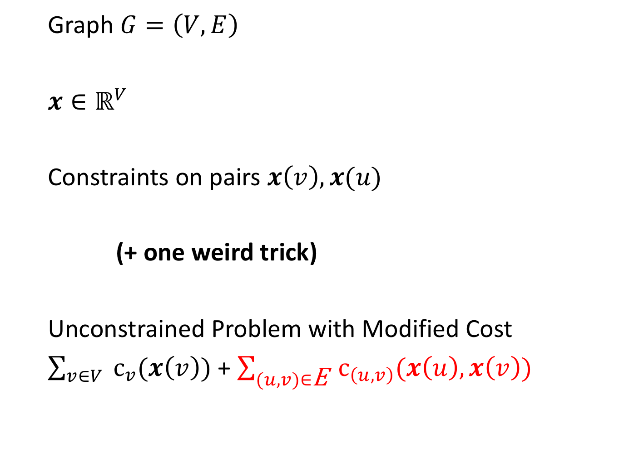
Optimization on Graphs
Graph $G=\left(V,E\right)$
$x∈ℝ^{V}$
Constraints on pairs $x\left(v\right),x(u)$
(+ one weird trick)
Unconstrained Problem with Modified Cost
$\sum_{v∈V }{c_{v}(x\left(v\right))}$ + $\sum_{(u,v)∈\text{E} }{c_{\left(u,v\right)}(x\left(u\right),x\left(v\right))}$
for $\left(u,v\right)∈E$

Slide 39
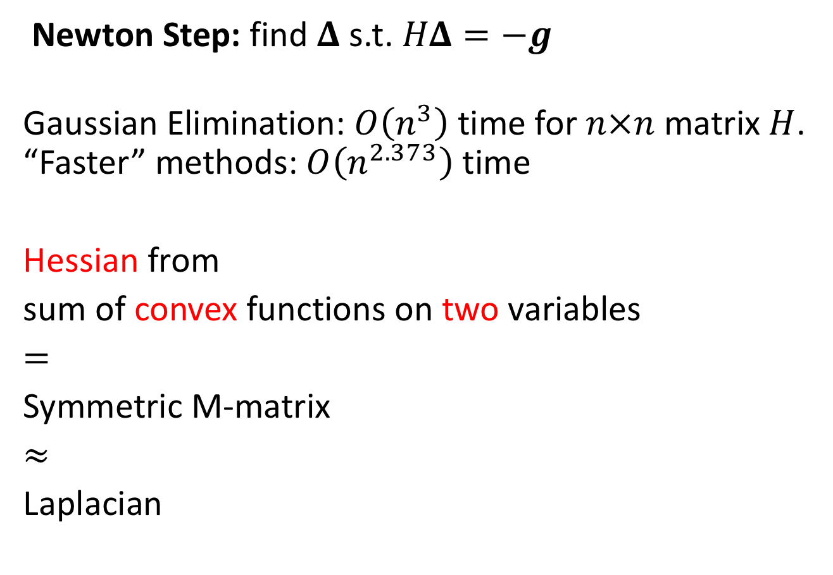

Graphs and Hessian Linear Equations
Newton Step: find $Δ$ s.t. $HΔ=−g$
Gaussian Elimination: $O\left(n^{3}\right)$ time for $n×n$ matrix $H$.
“Faster” methods: $O\left(n^{2.373}\right)$ time
Hessian from
sum of convex functions on two variables
$=$
Symmetric M-matrix
$≈$
Laplacian
Spielman-Teng ’04: Laplacian linear equations
can be solved
in $\tilde{O}\left(\text{\#}\text{edges}\right)$ time

Slide 40
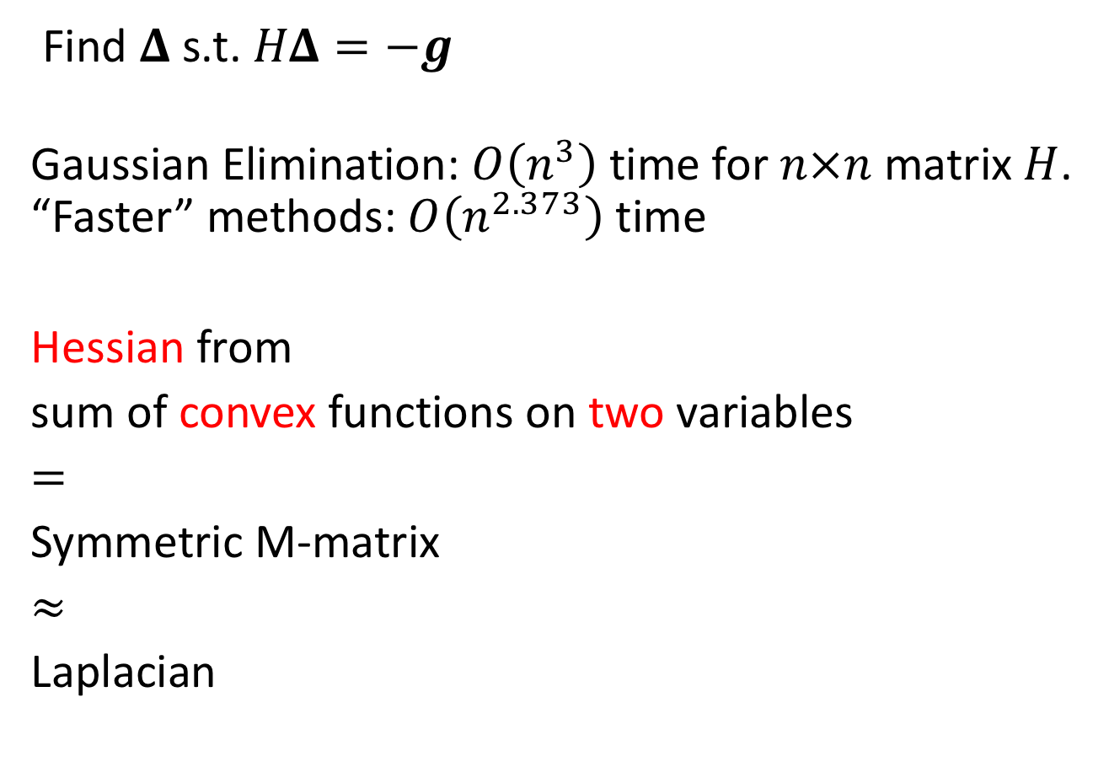

Hessian Linear Equations
Find $Δ$ s.t. $HΔ=−g$
Gaussian Elimination: $O\left(n^{3}\right)$ time for $n×n$ matrix $H$.
“Faster” methods: $O\left(n^{2.373}\right)$ time
Hessian from
sum of convex functions on two variables
$=$
Symmetric M-matrix
$≈$
Laplacian
Daitch-Spielman ’08:
Symmetric M-matrix
linear equations can be solved
in $\tilde{O}\left(\text{\#}\text{edges}\right)$ time

Slide 41

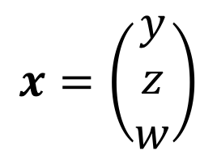






Hessians & Graphs
$$x=\left(\begin{matrix}y \\ z \\ w\end{matrix}\right)$$
Graph-Structured Cost Function
$c\left(x\right)=c_{1}\left(y,z\right)+c_{2}\left(y,w\right)+c_{3}\left(z,w\right)$
$$c_{1}\left(y,z\right)$$
$$z$$
$$y$$
$$c_{3}\left(z,w\right)$$
$$c_{2}\left(y,w\right)$$
$$w$$
$∇^{2}c\left(x\right)=∇^{2}c_{1}\left(y,z\right)+∇^{2}c_{2}\left(z,w\right)+∇^{2}c_{3}\left(w,y\right)$

Slide 42




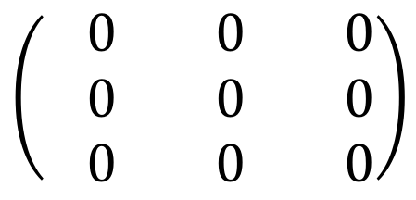


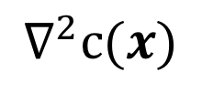



Second Derivatives
$$∇^{2}c\left(x\right)=∇^{2}c_{1}\left(y,z\right)+∇^{2}c_{2}\left(y,w\right)+{∇^{2}c}_{3}\left(z,w\right)$$
$${∇^{2}c}_{1}\left(y,z\right)$$
$$z$$
$$y$$
$${∇^{2}c}_{3}\left(z,w\right)$$
$$∇^{2}c_{2}\left(y,w\right)$$
$$w$$
$$∇^{2}c(x)$$
$$y$$
$$z$$
$$w$$
$$y$$
$$\left(\begin{matrix}−0 & −0 & −0 \\ −0 & −0 & −0 \\ −0 & −0 & −0\end{matrix}\right)$$
$$z$$
$$w$$

Slide 43






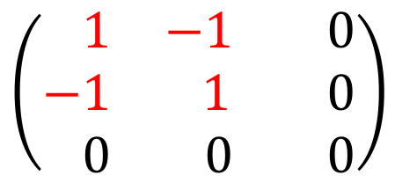


Second Derivatives
$$∇^{2}c\left(x\right)=∇^{2}c_{1}\left(y,z\right)+∇^{2}c_{2}\left(y,w\right)+{∇^{2}c}_{3}\left(z,w\right)$$
$${∇^{2}c}_{1}\left(y,z\right)$$
$$z$$
$$y$$
$${∇^{2}c}_{3}\left(z,w\right)$$
$$∇^{2}c_{2}\left(y,w\right)$$
$$w$$
$$∇^{2}c(x)$$
$$y$$
$$z$$
$$w$$
$$y$$
$$z$$
$$w$$
$$y$$
$$\left(\begin{matrix}−0 & −0 & −0 \\ −0 & −0 & −0 \\ −0 & −0 & −0\end{matrix}\right)$$
$$\left(\begin{matrix}−1 & −1 & −0 \\ −1 & 1 & −0 \\ −0 & −0 & −0\end{matrix}\right)$$
$$z$$
$$w$$

Slide 44
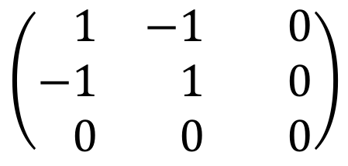
Second Derivatives
$$∇^{2}c\left(x\right)=∇^{2}c_{1}\left(y,z\right)+∇^{2}c_{2}\left(y,w\right)+{∇^{2}c}_{3}\left(z,w\right)$$
$${∇^{2}c}_{1}\left(y,z\right)$$
$$z$$
$$y$$
$${∇^{2}c}_{3}\left(z,w\right)$$
$$∇^{2}c_{2}\left(y,w\right)$$
$$w$$
$$∇^{2}c(x)$$
$$y$$
$$z$$
$$w$$
$$y$$
$$z$$
$$w$$
$$y$$
$$\left(\begin{matrix}−1 & −1 & −0 \\ −1 & −1 & −0 \\ −0 & −0 & −0\end{matrix}\right)$$
$$\left(\begin{matrix}−1 & −1 & −0 \\ −1 & 1 & −0 \\ −0 & −0 & −0\end{matrix}\right)$$
$$z$$
$$w$$

Slide 45

Second Derivatives
$$∇^{2}c\left(x\right)=∇^{2}c_{1}\left(y,z\right)+∇^{2}c_{2}\left(y,w\right)+{∇^{2}c}_{3}\left(z,w\right)$$
$${∇^{2}c}_{1}\left(y,z\right)$$
$$z$$
$$y$$
$${∇^{2}c}_{3}\left(z,w\right)$$
$$∇^{2}c_{2}\left(y,w\right)$$
$$w$$
$$∇^{2}c(x)$$
$$y$$
$$z$$
$$w$$
$$y$$
$$\left(\begin{matrix}−1 & −1 & −0 \\ −1 & −1 & −0 \\ −0 & −0 & −0\end{matrix}\right)$$
$$z$$
$$w$$

Slide 46



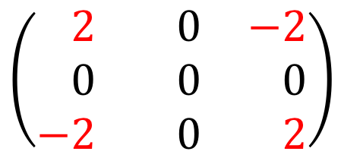

Second Derivatives
$$∇^{2}c\left(x\right)=∇^{2}c_{1}\left(y,z\right)+∇^{2}c_{2}\left(y,w\right)+{∇^{2}c}_{3}\left(z,w\right)$$
$${∇^{2}c}_{1}\left(y,z\right)$$
$$z$$
$$y$$
$${∇^{2}c}_{3}\left(z,w\right)$$
$$∇^{2}c_{2}\left(y,w\right)$$
$$w$$
$$∇^{2}c(x)$$
$$y$$
$$z$$
$$w$$
$$y$$
$$z$$
$$w$$
$$y$$
$$\left(\begin{matrix}−1 & −1 & −0 \\ −1 & −1 & −0 \\ −0 & −0 & −0\end{matrix}\right)$$
$$\left(\begin{matrix}−2 & −0 & −2 \\ −0 & −0 & −0 \\ −2 & −0 & −2\end{matrix}\right)$$
$$z$$
$$w$$

Slide 47
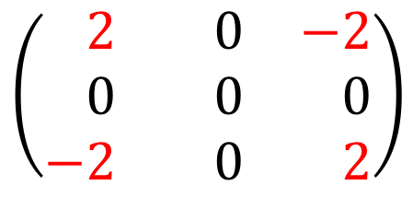



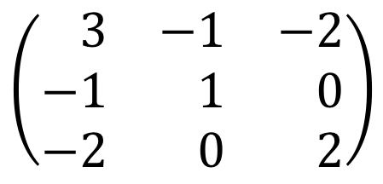
Second Derivatives
$$∇^{2}c\left(x\right)=∇^{2}c_{1}\left(y,z\right)+∇^{2}c_{2}\left(y,w\right)+{∇^{2}c}_{3}\left(z,w\right)$$
$${∇^{2}c}_{1}\left(y,z\right)$$
$$z$$
$$y$$
$${∇^{2}c}_{3}\left(z,w\right)$$
$$∇^{2}c_{2}\left(y,w\right)$$
$$w$$
$$∇^{2}c(x)$$
$$y$$
$$z$$
$$w$$
$$y$$
$$z$$
$$w$$
$$y$$
$$\left(\begin{matrix}−3 & −1 & −2 \\ −1 & −1 & −0 \\ −2 & −0 & −2\end{matrix}\right)$$
$$\left(\begin{matrix}−2 & −0 & −2 \\ −0 & −0 & −0 \\ −2 & −0 & −2\end{matrix}\right)$$
$$z$$
$$w$$

Slide 48
Second Derivatives
$$∇^{2}c\left(x\right)=∇^{2}c_{1}\left(y,z\right)+∇^{2}c_{2}\left(y,w\right)+{∇^{2}c}_{3}\left(z,w\right)$$
$${∇^{2}c}_{1}\left(y,z\right)$$
$$z$$
$$y$$
$${∇^{2}c}_{3}\left(z,w\right)$$
$$∇^{2}c_{2}\left(y,w\right)$$
$$w$$
$$∇^{2}c(x)$$
$$y$$
$$z$$
$$w$$
$$y$$
$$\left(\begin{matrix}−3 & −1 & −2 \\ −1 & −1 & −0 \\ −2 & −0 & −2\end{matrix}\right)$$
$$z$$
$$w$$

Slide 49

Second Derivatives
$$∇^{2}c\left(x\right)=∇^{2}c_{1}\left(y,z\right)+∇^{2}c_{2}\left(y,w\right)+{∇^{2}c}_{3}\left(z,w\right)$$
$${∇^{2}c}_{1}\left(y,z\right)$$
$$z$$
$$y$$
$${∇^{2}c}_{3}\left(z,w\right)$$
$$∇^{2}c_{2}\left(y,w\right)$$
$$w$$
$$∇^{2}c(x)$$
$$y$$
$$z$$
$$w$$
$$y$$
$$\left(\begin{matrix}−3 & −1 & −2 \\ −1 & −1 & −0 \\ −2 & −0 & −2\end{matrix}\right)$$
$$z$$
$$w$$

Slide 50

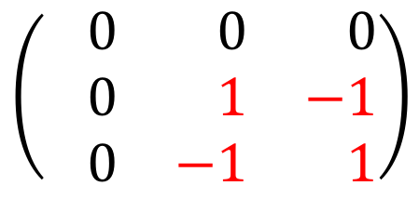
Second Derivatives
$$∇^{2}c\left(x\right)=∇^{2}c_{1}\left(y,z\right)+∇^{2}c_{2}\left(y,w\right)+{∇^{2}c}_{3}\left(z,w\right)$$
$${∇^{2}c}_{1}\left(y,z\right)$$
$$z$$
$$y$$
$${∇^{2}c}_{3}\left(z,w\right)$$
$$∇^{2}c_{2}\left(y,w\right)$$
$$w$$
$$∇^{2}c(x)$$
$$y$$
$$z$$
$$w$$
$$y$$
$$z$$
$$w$$
$$y$$
$$\left(\begin{matrix}−3 & −1 & −2 \\ −1 & −1 & −0 \\ −2 & −0 & −2\end{matrix}\right)$$
$$\left(\begin{matrix}−0 & −0 & −0 \\ −0 & −1 & −1 \\ −0 & −1 & −1\end{matrix}\right)$$
$$z$$
$$w$$

Slide 51
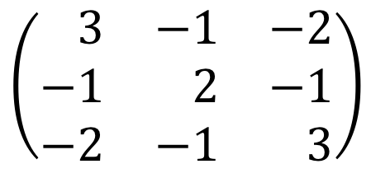
Second Derivatives
$$∇^{2}c\left(x\right)=∇^{2}c_{1}\left(y,z\right)+∇^{2}c_{2}\left(y,w\right)+{∇^{2}c}_{3}\left(z,w\right)$$
$${∇^{2}c}_{1}\left(y,z\right)$$
$$z$$
$$y$$
$${∇^{2}c}_{3}\left(z,w\right)$$
$$∇^{2}c_{2}\left(y,w\right)$$
$$w$$
$$∇^{2}c(x)$$
$$y$$
$$z$$
$$w$$
$$y$$
$$z$$
$$w$$
$$y$$
$$\left(\begin{matrix}−3 & −1 & −2 \\ −1 & −2 & −1 \\ −2 & −1 & −3\end{matrix}\right)$$
$$\left(\begin{matrix}−0 & −0 & −0 \\ −0 & −1 & −1 \\ −0 & −1 & −1\end{matrix}\right)$$
$$z$$
$$w$$

Slide 52
Second Derivatives
$$∇^{2}c\left(x\right)=∇^{2}c_{1}\left(y,z\right)+∇^{2}c_{2}\left(y,w\right)+{∇^{2}c}_{3}\left(z,w\right)$$
$${∇^{2}c}_{1}\left(y,z\right)$$
$$z$$
$$y$$
$${∇^{2}c}_{3}\left(z,w\right)$$
$$∇^{2}c_{2}\left(y,w\right)$$
$$w$$
$$∇^{2}c(x)$$
$$y$$
$$z$$
$$w$$
$$y$$
$$\left(\begin{matrix}−3 & −1 & −2 \\ −1 & −2 & −1 \\ −2 & −1 & −3\end{matrix}\right)$$
$$z$$
$$w$$

Slide 53
Second Derivatives
$$∇^{2}c\left(x\right)=∇^{2}c_{1}\left(y,z\right)+∇^{2}c_{2}\left(y,w\right)+{∇^{2}c}_{3}\left(z,w\right)$$
$${∇^{2}c}_{1}\left(y,z\right)$$
$$z$$
$$y$$
$${∇^{2}c}_{3}\left(z,w\right)$$
$$∇^{2}c_{2}\left(y,w\right)$$
$$w$$
$$∇^{2}c(x)$$
$$y$$
$$z$$
$$w$$
$$y$$
$$\left(\begin{matrix}−3 & −1 & −2 \\ −1 & −2 & −1 \\ −2 & −1 & −3\end{matrix}\right)$$
$$z$$
$$w$$

Slide 54
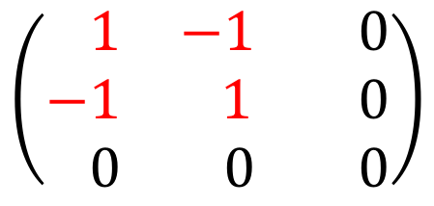
Second Derivatives
$$∇^{2}c\left(x\right)=∇^{2}c_{1}\left(y,z\right)+∇^{2}c_{2}\left(y,w\right)+{∇^{2}c}_{3}\left(z,w\right)$$
$${∇^{2}c}_{1}\left(y,z\right)$$
$$z$$
$$y$$
$${∇^{2}c}_{3}\left(z,w\right)$$
$$∇^{2}c_{2}\left(y,w\right)$$
$$w$$
If every term looks like
then matrix is Laplacian
$$\left(\begin{matrix}−1 & −1 & −0 \\ −1 & 1 & −0 \\ −0 & −0 & −0\end{matrix}\right)$$

Slide 55

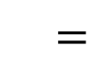

Solving a PSD System
$Ax=b$
Gaussian Elimination
$$A=$$
$$=$$

Slide 56


Solving a PSD System
$Ax=b$
Gaussian Elimination
Find $U$, upper triangular matrix, s.t.
$U^{⊤}U=A$
Then solve
$U^{⊤}y=b$
$U x =y$
Easy to solve in $U^{⊤}$ and $U$
Notes:
TIME sun 1
37:40 at end

Slide 57

Solving a Laplacian System
$Lx=b$
Approximate Gaussian Elimination [KS16]
Find $U$, upper triangular matrix, s.t.
$$U^{⊤}U≈L$$
$U$is sparse.
A few iterative solves to get
approximate solution to $Lx=b$

Slide 58


Gaussian Elimination on Laplacians
What is special about Gaussian Elimination on Laplacians?
The remaining matrix is always Laplacian.
$$L=$$
$$=$$
A new Laplacian!

Slide 59


Sparse Approximation of Laplacians
$$≈$$
[ST04, SS08]
Notes:
TIME sun 3
18:00 at end

Slide 60



Why is Gaussian Elimination Slow?
Solving $Lx=b$ by Gaussian Elimination
can take $Ω\left(n^{3}\right)$ time.
The main issue is fill
$$L=$$
$$v$$

Slide 61
Why is Gaussian Elimination Slow?
Solving $Lx=b$ by Gaussian Elimination
can take $Ω\left(n^{3}\right)$ time.
The main issue is fill
$$L=$$
$$v$$

Slide 62

Why is Gaussian Elimination Slow?
Solving $Lx=b$ by Gaussian Elimination
can take $Ω\left(n^{3}\right)$ time.
The main issue is fill
$$L=$$
New Laplacian
$$v$$
Elimination creates a clique
on the neighbors of $v$

Slide 63

Why is Gaussian Elimination Slow?
Solving $Lx=b$ by Gaussian Elimination
can take $Ω\left(n^{3}\right)$ time.
The main issue is fill
$$L=$$
New Laplacian
$$v$$
$$≈$$
Laplacian cliques can be sparsified!

Slide 64
Gaussian Elimination
Pick a vertex $v$ to eliminate
Add the clique created by eliminating $v$
Repeat until done

Slide 65
Approximate Gaussian Elimination
Pick a vertex $v$ to eliminate
Add the clique created by eliminating $v$
Repeat until done

Slide 66
Approximate Gaussian Elimination
Pick a random vertex $v$ to eliminate
Add the clique created by eliminating $v$
Repeat until done

Slide 67
Approximate Gaussian Elimination
Pick a random vertex $v$ to eliminate
Sample the clique created by eliminating $v$
Repeat until done
Resembles randomized Incomplete Cholesky
Key Proof Idea: Matrix Martingales
Correct in Expectation + Concentration of Measure
Notes:
TIME sun 1
45:30 at end

Slide 68
Optimization on Graphs
Variants of this framework
have been used for many problems:
Maximum flow [DS08, CKMST11,KMP12, Mad13]
Minimum cost flow [LS14]
Negative Weight Shortest Paths [CMSV16]
Isotonic Regression [KRS15]
Regularized Lipschitz Learning on Graphs [KRSS15]

Slide 69
Optimization on Graphs
Laplacian solvers used for many
other problems in TCS
Learning on graphs [ZGL03, ZS04, ZBLWS04]
Graph partitioning [OSV12]
Sampling random spanning trees [KM09,MST15,DKPRS17,DPR17,S18]
Graph sparsification [SS08,LKP12,KPPS17]

Slide 70
Julia Package: Laplacians.jl
Graph | Apx Elim | CMG | LAMG | Other
1000x1000 grid | 6.3 | 3.0 | 15
Apx Elim = Approximate Elimination (K & Spielman)
CMG = Combinatorial Multigrid (Koutis)
LAMG = Lean Algebraic Multigrid (Livne & Brandt)

Slide 71
Julia Package: Laplacians.jl
Graph | Apx Elim | CMG | LAMG | Other
1000x1000 grid | 6.3 | 3.0 | 15
100x100x100 grid | 8.7 | 3.4 | 15
Apx Elim = Approximate Elimination (K & Spielman)
CMG = Combinatorial Multigrid (Koutis)
LAMG = Lean Algebraic Multigrid (Livne & Brandt)

Slide 72
Julia Package: Laplacians.jl
Graph | Apx Elim | CMG | LAMG | Other
1000x1000 grid | 6.3 | 3.0 | 15
100x100x100 grid | 8.7 | 3.4 | 15
Rand 4-regular | 17.2 | 12 | 13.7 | 1.7 (CG)
Apx Elim = Approximate Elimination (K & Spielman)
CMG = Combinatorial Multigrid (Koutis)
LAMG = Lean Algebraic Multigrid (Livne & Brandt)
CG = Conjugate Gradient

Slide 73
Julia Package: Laplacians.jl
Graph | Apx Elim | CMG | LAMG | Other
1000x1000 grid | 6.3 | 3.0 | 15
100x100x100 grid | 8.7 | 3.4 | 15
Rand 4-regular | 17.2 | 12 | 13.7 | 1.7 (CG)
Pref attach | 9.5 | 10.8 | 5.1 | 3.2 (ICC)
Apx Elim = Approximate Elimination (K & Spielman)
CMG = Combinatorial Multigrid (Koutis)
LAMG = Lean Algebraic Multigrid (Livne & Brandt)
CG = Conjugate Gradient, ICC = Incomplete Cholesky

Slide 74
Julia Package: Laplacians.jl
Graph | Apx Elim | CMG | LAMG | Other
1000x1000 grid | 6.3 | 3.0 | 15
100x100x100 grid | 8.7 | 3.4 | 15
Rand 4-regular | 17.2 | 12 | 13.7 | 1.7 (CG)
Pref attach | 9.5 | 10.8 | 5.1 | 3.2 (ICC)
Chimera (2500100,11) | 28 | 350 | 74
Apx Elim = Approximate Elimination (K & Spielman)
CMG = Combinatorial Multigrid (Koutis)
LAMG = Lean Algebraic Multigrid (Livne & Brandt)
CG = Conjugate Gradient, ICC = Incomplete Cholesky

Slide 75
Julia Package: Laplacians.jl
Graph | Apx Elim | CMG | LAMG | Other
1000x1000 grid | 6.3 | 3.0 | 15
100x100x100 grid | 8.7 | 3.4 | 15
Rand 4-regular | 17.2 | 12 | 13.7 | 1.7 (CG)
Pref attach | 9.5 | 10.8 | 5.1 | 3.2 (ICC)
Chimera (2500100,11) | 28 | 350 | 74
Min Cost Flow 1 | 5.9 | 4.3 | >60
Min Cost Flow 2 | 6.8 | 23 | 29
Apx Elim = Approximate Elimination (K & Spielman)
CMG = Combinatorial Multigrid (Koutis)
LAMG = Lean Algebraic Multigrid (Livne & Brandt)
CG = Conjugate Gradient, ICC = Incomplete Cholesky

Slide 76
Julia Package: Laplacians.jl
Graph | Apx Elim | CMG | LAMG | Other
1000x1000 grid | 6.3 | 3.0 | 15
100x100x100 grid | 8.7 | 3.4 | 15
Rand 4-regular | 17.2 | 12 | 13.7 | 1.7 (CG)
Pref attach | 9.5 | 10.8 | 5.1 | 3.2 (ICC)
Chimera (2500100,11) | 28 | 350 | 74
Min Cost Flow 1 | 5.9 | 4.3 | >60
Min Cost Flow 2 | 6.8 | 23 | 29
Summary: Approximate Elimination processes between
300k and 500k entries per second, for 8 digit accuracy
Others vary widely

Slide 77
Thanks!
https://github.com/danspielman/Laplacians.jl/
Approximate Gaussian Elimination for Laplacians
(R. Kyng, S. Sachdeva)
Faster Approximate Lossy Generalized Flow
via Interior Point Algorithms
(S. Daitch, D. Spielman)
Fast, Provable Algorithms for Isotonic Regression
in all Lp norms
(R. Kyng, A.B. Rao, S. Sachdeva)
Nearly-linear time algorithms for graph partitioning,
graph sparsification, and solving linear systems
(S.-H. Teng, D. Spielman)

