Slide 1
A numerical analysis approach to convex optimization
Speaker | Rasmus Kyng | ETH Zurich
Joint works with | D. Adil, R. Peng, S. Sachdeva, D. Wang
 |  | March, 2020

Slide 2
The problem
$A∈ℝ^{m×n}$, $m<n$, $b∈ℝ^{n}$
$\min_{Ax=b}{{\left\|x\right\|}_{p}^{p}}$
$\min_{x}{{\left\|Cx−d\right\|}_{p}^{p}}$

Slide 3
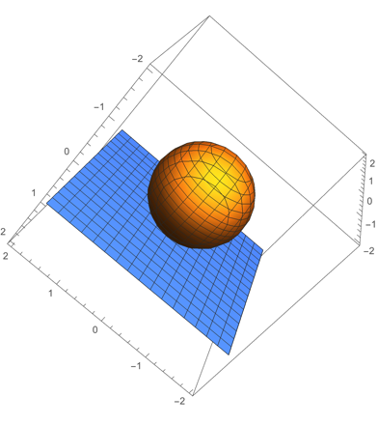
The problem
$A∈ℝ^{m×n}$, $m<n$, $b∈ℝ^{n}$
$\min_{Ax=b}{{\left\|x\right\|}_{p}^{p}}$
$p=2$
linear regression / solving linear equation
$A^{⊤}Ax=A^{⊤}b$

Slide 4
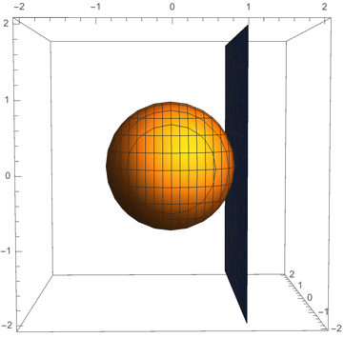
The problem
$A∈ℝ^{m×n}$, $m<n$, $b∈ℝ^{n}$
$\min_{Ax=b}{{\left\|x\right\|}_{p}^{p}}$
$p=2$
linear regression / solving linear equation
$A^{⊤}Ax=A^{⊤}b$

Slide 5
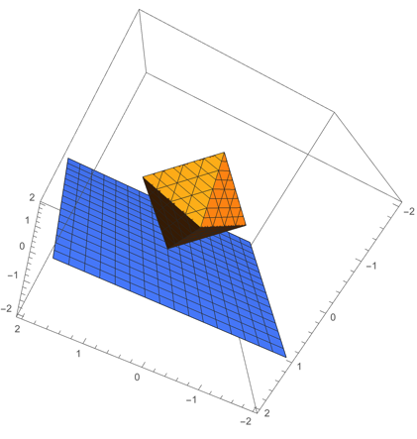
The problem
$A∈ℝ^{m×n}$, $m<n$, $b∈ℝ^{n}$
$\min_{Ax=b}{{\left\|x\right\|}_{p}^{p}}$
$p=1$

Slide 6
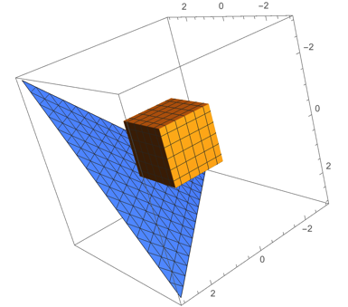
The problem
$A∈ℝ^{m×n}$, $m<n$, $b∈ℝ^{n}$
$\min_{Ax=b}{{\left\|x\right\|}_{p}^{}}$
$p→∞$
Equivalent to general Linear Programming

Slide 7
The problem
$A∈ℝ^{m×n}$, $m<n$, $b∈ℝ^{n}$
$\min_{Ax=b}{{\left\|x\right\|}_{p}^{ }}$
$p→∞$
$\min_{Bf=b}{{\left\|f\right\|}_{∞}^{}}$ is equivalent to Maximum Flow

Slide 8
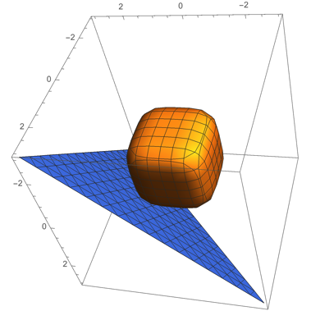
The problem
$A∈ℝ^{m×n}$, $b∈ℝ^{n}$
$\min_{Ax=b}{{\left\|x\right\|}_{p}^{p}}$
$p=4$

Slide 9
Convex optimization, high accuracy
$A∈ℝ^{(0.1⋅n)×n}$, $b∈ℝ^{n}$
slower
running time
faster
running time
$n^{1/2}$ linear eq. solves
$1$ linear eq. solve
Inf-norm regression
2-norm regression
Khachiyan; Karmarkar;
Renegar; Ye; Nesterov & Nemirovski
Chinese mathematicians, 2nd century
Gauss, 19th century

Slide 10
Convex optimization, high accuracy
$A∈ℝ^{(0.1⋅n)×n}$, $b∈ℝ^{n}$
slower
running time
faster
running time
$n^{1/2}$ linear eq. solves
$1$ linear eq. solve
Nesterov & Nemirovski ‘94
p-norm regression
Inf-norm regression
2-norm regression
Chinese mathematicians, 2nd century
Gauss, 19th century

Slide 11
Convex optimization, high accuracy
$A∈ℝ^{(0.1⋅n)×n}$, $b∈ℝ^{n}$
$n^{\frac{\left|\frac{1}{2} − \frac{1}{p}\right|}{1+\left|\frac{1}{2} − \frac{1}{p}\right|}}$ linear eq. solves
slower
running time
faster
running time
$n^{\left|\frac{1}{2} − \frac{1}{p}\right|}$ linear eq. solves
$n^{1/2}$ linear eq. solves
$1$ linear eq. solve
Adil, K., Peng, Sachdeva ‘19
p-norm regression
Bubeck, Cohen, Lee, Li ‘18
p-norm regression
Nesterov & Nemirovski ‘94
p-norm regression
Inf-norm regression
2-norm regression
Chinese mathematicians, 2nd century
Gauss, 19th century

Slide 12
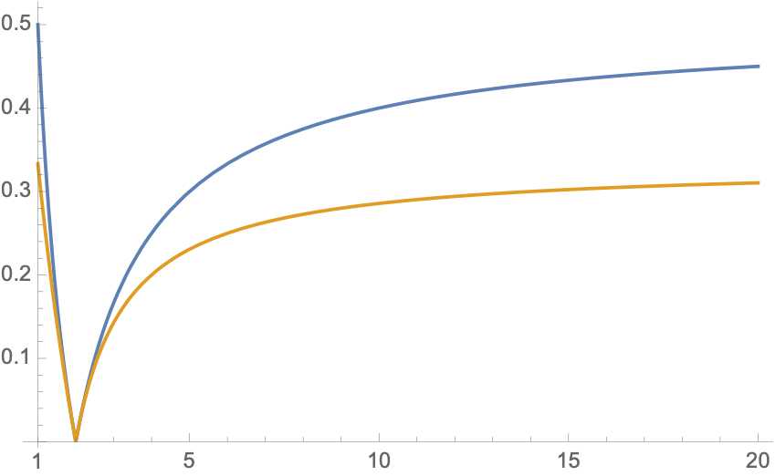
Our result compared to BCLL
$p$-norm regression
$O_{p}(1){ n}^{γ}$ linear eq. solves
$1/2$
BCLL
$1/3$
$γ$
Our result
$p$

Slide 13
Convex optimization, high accuracy
$A∈ℝ^{(0.1⋅n)×n}$, $b∈ℝ^{n}$
$n^{\frac{\left|\frac{1}{2} − \frac{1}{p}\right|}{1+\left|\frac{1}{2} − \frac{1}{p}\right|}}$ linear eq. solves
slower
running time
faster
running time
$n^{\left|\frac{1}{2} − \frac{1}{p}\right|}$ linear eq. solves
$n^{1/2}$ linear eq. solves
$1$ linear eq. solve
Adil, K., Peng, Sachdeva ‘19
p-norm regression
Bubeck, Cohen, Lee, Li ‘18
p-norm regression
Nesterov & Nemirovski ‘94
p-norm regression
Inf-norm regression
2-norm regression
Chinese mathematicians, 2nd century
Gauss, 19th century

Slide 14
Convex optimization, high accuracy
$A∈ℝ^{(0.1⋅n)×n}$, $b∈ℝ^{n}$
slower
running time
faster
running time
$n^{1/3}$ linear eq. solves
$n^{1/2}$ linear eq. solves
$1$ linear eq. solve
Adil, K., Peng, Sachdeva ‘19
p-norm regression
Nesterov & Nemirovski ‘94
p-norm regression
Inf-norm regression
2-norm regression
Chinese mathematicians, 2nd century
Gauss, 19th century
All “smooth” convex problems?!
$n^{1/3}$ linear eq. solves?!

Slide 15
Convex optimization, high accuracy
slower
running time
faster
running time
$$n^{ω+0.5}$$
$$n^{ω}$$
$$n^{2.5}$$
Inverse maintenance:
Karmarkar; Nesterov & Nemirovski; Vaidya; Lee & Sidford
Lee & Sidford ‘15
Inf-norm regression,
w/ inverse maintenance
Caveat: for current $ω≈2.37$
Best running time for $ω=2$is $n^{2.055}$
Jiang, Song, Weinstein, Zhang ‘20
Inf-norm regression
2-norm regression
p-norm regression
w/ inverse maintenance
Adil, K., Peng, Sachdeva ‘19
Inf-norm regression,
w/ inverse maintenance
Cohen, Lee, Song ‘19

Slide 16
Convex optimization, high accuracy
slower
running time
faster
running time
$$n^{ω}$$
2-norm regression
p-norm regression
w/ inverse maintenance
Inf-norm regression,
w/ inverse maintenance

Slide 17
Convex optimization, high accuracy
graph with $n$ vertices
sparse case: $\#\text{edges}=O\left(n\right)$
=> Solve flow lin. eq. in $n$ time
slower
running time
faster
running time
$$n^{ω}$$
$$n^{1.5}$$
$$n^{1.33}$$
$$n^{1}$$
Adil, K., Peng, Sachdeva ‘19
p-norm flow
inf-norm flow
aka maxflow
2-norm flow
2-norm regression
Spielman Teng ‘04
p-norm regression
w/ inverse maintenance
Goldberg-Rao `98
Inf-norm regression,
w/ inverse maintenance
most flows?!
$n^{1.33}$?!

Slide 18
Convex optimization, high accuracy
graph with $n$ vertices
sparse case: $\#\text{edges}=O\left(n\right)$
=> Solve flow lin. eq. in $n$ time
slower
running time
faster
running time
$$n^{ω}$$
$$n^{1.5}$$
$$n^{1.43}$$
$$n^{1}$$
unit capacity
maxflow
Madry ‘13
inf-norm flow
aka maxflow
2-norm flow
2-norm regression
p-norm regression
w/ inverse maintenance
unit capacity
(large) p-norm flow
Inf-norm regression,
w/ inverse maintenance
K., Peng, Sachdeva, Wang ‘19
most flows?!
$n^{1+o(1) }$?!

Slide 19
Convex optimization, high accuracy
graph with $n$ vertices
sparse case: $\#\text{edges}=O\left(n\right)$
=> Solve flow lin. eq. in $n$ time
slower
running time
faster
running time
$$n^{ω}$$
$$n^{1.5}$$
$$n^{1.33}$$
$$n^{1}$$
unit capacity
maxflow
Liu-Sidford ‘2020
inf-norm flow
aka maxflow
2-norm flow
2-norm regression
p-norm regression
w/ inverse maintenance
unit capacity
(large) p-norm flow
Inf-norm regression,
w/ inverse maintenance
K., Peng, Sachdeva, Wang ‘19
most flows?!
$n^{1+o(1) }$?!

Slide 20
Convex optimization
$c:ℝ^{n}→ℝ$ is a convex function
$\min_{Ax=b}{c(x)}$

Slide 21
2nd order methods
Want $δ$ s.t. $c\left(x+δ\right)<c(x)$
Choose $δ$ to minimize u.b.
local
upper bound
(quadratic)
☹
$c\left(x+δ\right)$
local
lower bound
(quadratic)
☹
$$x_{ }$$
$$δ$$
Convergence $log\frac{1}{ε}$
☺

Slide 22
Homotopy: making 2nd order methods global
Solve a sequence of different optimization problems,
ensure starting point near next optimum
$$x_{}^{∗}$$

Slide 23
Homotopy: making 2nd order methods global
Solve a sequence of different optimization problems,
ensure starting point near next optimum
Use locally good apx. around $x_{(0)}$
Find $x_{\left(1\right)}^{∗}$
$$x_{(0)}$$
$$x_{\left(1\right)}^{∗}$$
$$x_{}^{∗}$$

Slide 24
Homotopy: making 2nd order methods global
Solve a sequence of different optimization problems,
ensure starting point near next optimum
Use locally good apx. around $x_{\left(1\right)}^{∗}$
Find $x_{\left(2\right)}^{∗}$
$$x_{\left(1\right)}^{∗}$$
$$x_{\left(2\right)}^{∗}$$
$$x_{}^{∗}$$

Slide 25
Homotopy: making 2nd order methods global
Solve a sequence of different optimization problems,
ensure starting point near next optimum
And so on…
$x_{(t)}^{∗}→x^{∗}$ as $t→∞$
$$x_{\left(1\right)}^{∗}$$
$$x_{\left(2\right)}^{∗}$$
$$x_{}^{∗}$$

Slide 26
Global approximation to $ℓ_{p}$ norms
local
upper bound
(quadratic)
☹
$c\left(x+δ\right)$
local
lower bound
(quadratic)
☹
$$x_{ }$$
$$δ$$
Convergence $log\frac{1}{ε}$
☺

Slide 27
Global approximation to $ℓ_{p}$ norms
Want $δ$ s.t. $c\left(x+δ\right)<c(x)$
Choose $δ$ to minimize u.b.
global
upper bound
(??)
☺
$c\left(x+δ\right)$
global
lower bound
(??)
☺
$$x_{ }$$
$$δ$$
Convergence $log\frac{1}{ε}$
☺

Slide 28
Global approximation to $ℓ_{p}$ norms
Want $δ$ s.t. $c\left(x+δ\right)<c(x)$
Choose $δ$ to minimize u.b.
global
upper bound
(??)
☺
$c\left(x+δ\right)$
global
lower bound
(??)
☺
$$x_{ }$$
$$δ$$
What makes our “envelopes” tractable?

Slide 29
Global approximation to $ℓ_{p}$ norms
Want $δ$ s.t. $c\left(x+δ\right)<c(x)$
Choose $δ$ to minimize u.b.
Constant approximation
solution suffices
global
upper bound
(??)
☺
$c\left(x+δ\right)$
global
lower bound
(??)
☺
$$x_{ }$$
$$δ$$
What makes our “envelopes” tractable?

Slide 30
Global approximation to $ℓ_{p}$ norms
Want $δ$ s.t. $c\left(x+δ\right)<c(x)$
Choose $δ$ to minimize u.b.
global
upper bound
(??)
☺
$c\left(x+δ\right)$
global
lower bound
(??)
☺
$$x_{ }$$
$$δ$$
Why do such “envelopes” exist?
Why can we find constant approx. $δ$ ?

Slide 31
The ingredients of an algorithm
1) “Envelopes” that allow global $log\left(\frac{1}{ε}\right)$ convergence
2) Multiplicative weight method to find step minimizing upper envelope

Slide 32
The envelopes (upper and lower bounds)

Slide 33
Good envelopes?
Scaling behavior
$b_{x}\left(λδ\right)≤\max\left({\left|λ\right|}^{2},{\left|λ\right|}^{p}\right)b_{x}\left(δ\right)$
$c\left(x\right)\text{ +}∇c{\left(x\right)}^{⊤}δ+L⋅b_{x}(δ)$
$c\left(x+δ\right)$
$c\left(x\right)\text{ +}∇c{\left(x\right)}^{⊤}δ+μ⋅b_{x}(δ)$
$$x$$
$$δ$$

Slide 34
Good envelopes?
Scaling behavior
$b_{x}\left(λδ\right)≤\max\left({\left|λ\right|}^{2},{\left|λ\right|}^{p}\right)b_{x}\left(δ\right)$
$\frac{L}{μ}log\frac{1}{ε}$ steps
Implies error $≤ε$ in
Finding $δ$?
Constant approximate min of $∇c{\left(x\right)}^{⊤}δ+L⋅b_{x}(δ)$
via new MWU
$c\left(x\right)\text{ +}∇c{\left(x\right)}^{⊤}δ+L⋅b_{x}(δ)$
$c\left(x+δ\right)$
$c\left(x\right)\text{ +}∇c{\left(x\right)}^{⊤}δ+μ⋅b_{x}(δ)$
$$x$$
$$δ$$

Slide 35
Good envelopes?
Scaling behavior
$b_{x}\left(λδ\right)≤\max\left({\left|λ\right|}^{2},{\left|λ\right|}^{p}\right)b_{x}\left(δ\right)$
$\frac{L}{μ}log\frac{1}{ε}$ steps
Implies error $≤ε$ in
Finding $δ$?
Constant approximate min of $∇c{\left(x\right)}^{⊤}δ+L⋅b_{x}(δ)$
via new MWU
Requires $b_{x}\left(δ\right)=b_{x}\left(−δ\right)$
$c\left(x\right)\text{ +}∇c{\left(x\right)}^{⊤}δ+L⋅b_{x}(δ)$
$c\left(x+δ\right)$
$c\left(x\right)\text{ +}∇c{\left(x\right)}^{⊤}δ+μ⋅b_{x}(δ)$
Goals
$b_{x}\left(λδ\right)≤\max\left({\left|λ\right|}^{2},{\left|λ\right|}^{p}\right)b_{x}\left(δ\right)$
$b_{x}\left(δ\right)=b_{x}\left(−δ\right)$
$\frac{L}{μ}=O_{p}(1)$
$$x$$
$$δ$$

Slide 36
Good envelopes!
${\left\|x\right\|}_{p}^{p}=\sum_{i}{x_{i}^{p}}$
$p=4$
One coordinate:
${(x_{i}+δ_{i})}_{ }^{4}$ $=x_{i}^{4}+4x_{i}^{3}δ_{i}$
$+6x_{i}^{2}δ_{i}^{2}+4x_{i}^{ }δ_{i}^{3}+$ $δ_{i}^{4}$

Slide 37
Good envelopes!
${\left\|x\right\|}_{p}^{p}=\sum_{i}{x_{i}^{p}}$
$p=4$
One coordinate:
${(x_{i}+δ_{i})}_{ }^{4}$ $=x_{i}^{4}+4x_{i}^{3}δ_{i}$
$+6x_{i}^{2}δ_{i}^{2}+4x_{i}^{ }δ_{i}^{3}+$ $δ_{i}^{4}$
linear apx.
$$c\left(x\right)+∇_{x}c{\left(x\right)}^{⊤}δ$$

Slide 38
Good envelopes!
${\left\|x\right\|}_{p}^{p}=\sum_{i}{x_{i}^{p}}$
$p=4$
One coordinate:
${(x_{i}+δ_{i})}_{ }^{4}$ $=x_{i}^{4}+4x_{i}^{3}δ_{i}$
$+6x_{i}^{2}δ_{i}^{2}+4x_{i}^{ }δ_{i}^{3}+$ $δ_{i}^{4}$
linear apx.
$$c\left(x\right)+∇_{x}c{\left(x\right)}^{⊤}δ$$
local
curvature
$\frac{1}{2}δ^{⊤} ∇_{x}^{2}c\left(x\right)δ$

Slide 39
Good envelopes!
${\left\|x\right\|}_{p}^{p}=\sum_{i}{x_{i}^{p}}$
$p=4$
One coordinate:
${(x_{i}+δ_{i})}_{ }^{4}$ $=x_{i}^{4}+4x_{i}^{3}δ_{i}$
$+6x_{i}^{2}δ_{i}^{2}+4x_{i}^{ }δ_{i}^{3}+$ $δ_{i}^{4}$
linear apx.
$$c\left(x\right)+∇_{x}c{\left(x\right)}^{⊤}δ$$
local
curvature
$\frac{1}{2}δ^{⊤} ∇_{x}^{2}c\left(x\right)δ$
"long-range behavior”
Enough to give a global approximation!

Slide 40
Iterative refinement for $ℓ_{p}$-norm regression
linear apx.
"long-range behavior”
$x_{i}^{4}+4x_{i}^{3}δ_{i}+Ω_{p}(1)(x_{i}^{2}δ_{i}^{2}+δ_{i}^{4})$
$≤$
${(x_{i}+δ_{i})}_{ }^{4}$
$≤$
$x_{i}^{4}+4x_{i}^{3}δ_{i}+O_{p}(1)(x_{i}^{2}δ_{i}^{2}+δ_{i}^{4})$
local curvature

Slide 41
Iterative refinement for $ℓ_{p}$-norm regression
$x_{i}^{4}+4x_{i}^{3}δ_{i}+Ω_{p}(1)(x_{i}^{2}δ_{i}^{2}+δ_{i}^{4})$
$≤$
${(x_{i}+δ_{i})}_{ }^{4}$
$≤$
$x_{i}^{4}+4x_{i}^{3}δ_{i}+O_{p}(1)(x_{i}^{2}δ_{i}^{2}+δ_{i}^{4})$
lower bound
$$μ$$
$$b_{x_{i}}\left(δ_{i}\right)=x_{i}^{2}δ_{i}^{2}+δ_{i}^{4}$$
$$L$$
upper bound
Goals
$b_{x}\left(λδ\right)≤\max\left({\left|λ\right|}^{2},{\left|λ\right|}^{p}\right)b_{x}\left(δ\right)$
$b_{x}\left(δ\right)=b_{x}\left(−δ\right)$
$\frac{L}{μ}=O_{p}(1)$
$c\left(x+δ\right)$
$$x$$

Slide 42
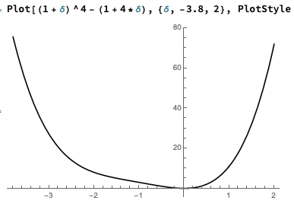
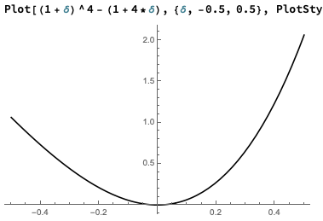
Good envelopes!
Long range:
4th power
Locally
quadratic
$${\left(1+δ\right)}^{4}−\left(1+4δ\right)≈δ^{2}+δ^{4}$$

Slide 43
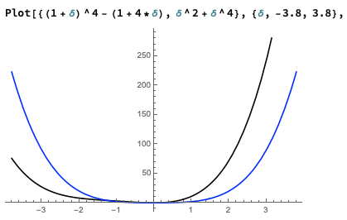
Good envelopes!
$${\left(1+δ\right)}^{4}−\left(1+4δ\right)≈δ^{2}+δ^{4}$$

Slide 44
Iterative refinement with multiplicative weight method
$\min_{Ax=b}{\sum_{i}{x_{i}^{p}}}$
$\left(1−\frac{1}{2^{p}}\right)$ factor progress
step problem
$\min_{Aδ=0}{\sum_{i}{g_{i}^{ }δ_{i}+{h_{i}^{ }δ}_{i}^{2}+δ_{i}^{p}}}$
$O(1)$ approximation
Multiplicative weight method
$2^{p}\log{\frac{1}{ε}}$ steps to converge to $ε$ error

Slide 45
Using multiplicative weights to take a step

Slide 46
Crude solver via multiplicative weights
Want constant accuracy solve of
Via $n^{1/3}$ linear equation solves
Simpler case [Christiano-Kelner-Madry-Spielman-Teng]
Constant accuracy solve of
Via $n^{1/3}$ linear equation solves
$\min_{Aδ=0}{\sum_{i}{g_{i}δ_{i}+{h_{i}δ}_{i}^{2}+δ_{i}^{p}}}$
$\min_{Bf=d}{{\left\|f\right\|}_{∞}}$

Slide 47
Multiplicative weights refresher
$\min_{Bf=d}{{\left\|f\right\|}_{∞}}$ scaled s.t. optimal flow gets ${\left\|f^{∗}\right\|}_{∞}=1$
Oracle
Given probabilities $p_{e}$ s.t. $\sum_{e}{p_{e}}=1$
Return feasible $f$ s.t. $\sum_{e}{p_{e}{|f}_{e}|}≤1+ε$ (good average behavior)
and $∀e.$ ${|f}_{e}|≤ρ$ (ok worst case behavior)
Multiplicative weights
Using $O\left(ρε^{−2}\log{n}\right)$ calls to oracle,
return feasible $\tilde{f}$ s.t. ${\left\|\tilde{f}\right\|}_{∞}≤1+ε$

Slide 48
An $ℓ_{2}$-based oracle
Oracle
Given probabilities $p_{e}$ s.t. $\sum_{e}{p_{e}}=1$
Return feasible $f$ s.t. $\sum_{e}{p_{e}{|f}_{e}|}≤1+ε$ (good average behavior)
and $∀e.$ ${|f}_{e}|≤ρ$ (ok worst case behavior)
$ℓ_{2}$oracle
Let $r_{e}=p_{e}+\frac{ε}{n}$
$\tilde{f}=\underset{Bf=d}{\arg{min}}{\sum{{r_{e}f}_{e}^{2}}}$
then $\sum_{e}{p_{e}}{|\tilde{f}}_{e}|≤1+ε$and $∀e.$ ${|\tilde{f}}_{e}|≤\sqrt{\frac{n}{ε}}$ $(=ρ)$

Slide 49
But when is the oracle bad?
$\min_{Bf=d}{{\left\|f\right\|}_{∞}}$
$k+1$ units flow in
$k$ paths of length $k$
$k+1$ units flow out

Slide 50
But when is the oracle bad?
$\min_{Bf=d}{{\left\|f\right\|}_{∞}}$
$k+1$ units flow in
$f^{∗} : {\left\|⋅\right\|}_{∞}$ minimizer
${\left\|f^{∗}\right\|}_{∞}=1$
$k$ paths of length $k$
1 unit on every edge
$k+1$ units flow out

Slide 51
But when is the oracle bad?
$\min_{Bf=d}{{\left\|f\right\|}_{∞}}$
$k+1$ units flow in
$f^{∗} : {\left\|⋅\right\|}_{∞}$ minimizer
${\left\|f^{∗}\right\|}_{∞}=1$
$k$ paths of length $k$
$\tilde{f}: {\left\|⋅\right\|}_{2}$ minimizer
$\frac{1}{2}$ units per edge
${\left\|\tilde{f}\right\|}_{2}≈k$
$\frac{k}{2}$ units
$k+1$ units flow out
${\left\|\tilde{f}\right\|}_{∞}≈k/2$
$n=Θ\left(k^{2}\right)$
$k=Θ\left(n^{1/2}\right)$

Slide 52
But when is the oracle bad?
$\min_{Bf=d}{{\left\|f\right\|}_{∞}}$
$k+1$ units flow in
$f^{∗} : {\left\|⋅\right\|}_{∞}$ minimizer
${\left\|f^{∗}\right\|}_{∞}=1$
$k$ paths of length $k$
$\tilde{f}: {\left\|⋅\right\|}_{2}$ minimizer
$≈1$ unit per edge
${\left\|\tilde{f}\right\|}_{2}≈1.5k$
$0$ units
$k+1$ units flow out
$${\left\|\tilde{f}\right\|}_{∞}≈1.01$$
Remove the bad edge.
Makes the $ℓ_{2}$ minimizer more like the $ℓ_{∞}$minimizer.

Slide 53
Improved $ℓ_{2}$-based oracle
$ℓ_{2}$-based oracle
then $\sum_{e}{p_{e}}{|\tilde{f}}_{e}|≤1+ε$and $∀e.$ ${|\tilde{f}}_{e}|≤\sqrt{\frac{n}{ε}}$

Slide 54
Improved $ℓ_{2}$-based oracle
$ℓ_{2}$-based oracle with edge deletion
then $\sum_{e}{p_{e}}{|\tilde{f}}_{e}|≤1+ε$and $∀e.$ ${|\tilde{f}}_{e}|≤\sqrt{\frac{n}{ε}}$
$∀e.$ ${|\tilde{f}}_{e}|≤n^{1/3}ε^{−c}$

Slide 55
Improved $ℓ_{2}$-based oracle
This deletion approach was developed in
Christiano-Kelner-Madry-Spielman-Teng ‘11
We need to
replace all combinatorial arguments with geometric ones
establish much better “alignment” of $ℓ_{2}$ minimizer with $ℓ_{p}$minimizer for $p$ near 2
Requires a more delicate reweighting scheme

Slide 56
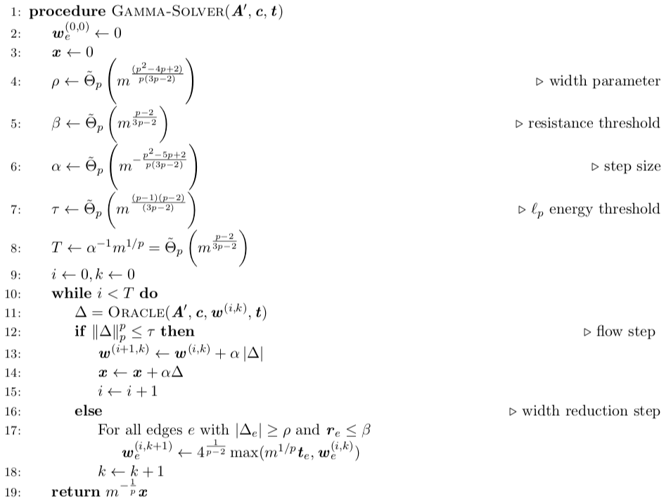
The dirty secrets

Slide 57
Crude solver via multiplicative weights
We solve this to constant accuracy
by a multiplicative weight algorithm
$n^{1/3}$ linear equation solves for large $p$
Believe this will apply to a large class
of convex problems
$\min_{Aδ=0}{∇_{x}c{\left(x\right)}^{⊤}δ+\sum_{i}{x_{i}^{p−2}δ_{i}^{2}+δ_{i}^{p}}}$

Slide 58
Lower bound for $ℓ_{2}$-based oracle
$\min_{Bf=d}{{\left\|f\right\|}_{∞}}$
$k+1$ units flow in
$k$ paths of length $k$
$k−2$ paths of length $k−2$
$k−1$ paths of length $k−1$
$k+1$ units flow out
Folklore (Spielman, Madry)

Slide 59
Lower bound for $ℓ_{2}$-based oracle
$\min_{Bf=d}{{\left\|f\right\|}_{∞}}$
$k+1$ units flow in
$k$ paths of length $k$
$k+1$ units flow out

Slide 60
Lower bound for $ℓ_{2}$-based oracle
$\min_{Bf=d}{{\left\|f\right\|}_{∞}}$
$k+1$ units flow in
$f^{∗} : {\left\|⋅\right\|}_{∞}$ minimizer
$k$ paths of length $k$
1 unit on every edge
${\left\|f^{∗}\right\|}_{∞}=1$
$k+1$ units flow out

Slide 61
Lower bound for $ℓ_{2}$-based oracle
$\min_{Bf=d}{{\left\|f\right\|}_{∞}}$
$k+1$ units flow in
$\tilde{f}: {\left\|⋅\right\|}_{2}$ minimizer
$\frac{1}{2}k$ units
$k$ paths of length $k$
$0$ units
${\left\|\tilde{f}\right\|}_{2}≈k$
$\frac{1}{2}$ units per edge
${\left\|\tilde{f}\right\|}_{∞}≈k/2$
$k+1$ units flow out

Slide 62
Lower bound for $ℓ_{2}$-based oracle
$\min_{Bf=d}{{\left\|f\right\|}_{∞}}$
$k+1$ units flow in
$k$ paths of length $k$
${\left\|\tilde{f}\right\|}_{2}≈k+1$
$≈1$ units per edge
${\left\|\tilde{f}\right\|}_{∞}≈\frac{k−1}{2}$
$k+1$ units flow out

Slide 63
Lower bound for $ℓ_{2}$-based oracle
$\min_{Bf=d}{{\left\|f\right\|}_{∞}}$
$k+1$ units flow in
$k$ paths of length $k$
${\left\|\tilde{f}\right\|}_{2}≈k+2$
$≈1$ units per edge
${\left\|\tilde{f}\right\|}_{∞}≈\frac{k−2}{2}$
$k+1$ units flow out

Slide 64
Lower bound for $ℓ_{2}$-based oracle
$\min_{Bf=d}{{\left\|f\right\|}_{∞}}$
$k+1$ units flow in
$k$ paths of length $k$
${\left\|\tilde{f}\right\|}_{2}≈1.5k$
$≈1$ units per edge
${\left\|\tilde{f}\right\|}_{∞}≈1.01$
$k+1$ units flow out

Slide 65
Lower bound for $ℓ_{2}$-based oracle
$\min_{Bf=d}{{\left\|f\right\|}_{∞}}$
$k+1$ units flow in
$k$ paths of length $k$
${\left\|\tilde{f}\right\|}_{2}≈1.5k$
$≈1$ units per edge
${\left\|\tilde{f}\right\|}_{∞}≈1.01$
$n=Θ\left(k^{3}\right)$
$k+1$ units flow out
$k=Θ\left(n^{1/3}\right)$

Slide 66
Why do we call it “iterative refinement”?

Slide 67
Iterative refinement
$\min_{Ax=b}{\sum_{i}{x_{i}^{p}}}$
$\min_{Aδ=0}{\sum_{i}{g_{i}δ_{i}+{h_{i}δ}_{i}^{2}+δ_{i}^{p}}}$
step problem
$\min_{Aδ=0}{\sum_{i}{g_{i}δ_{i}+{h_{i}δ}_{i}^{2}+δ_{i}^{p}}}$
step problem
A.k.a. iterative refinement

Slide 68
Iterative refinement for linear equations
A.k.a. iterative refinement
$$A^{⊤}Ax=A^{⊤}b$$
$⇔ \min_{Ax=b}{\sum_{i}{x_{i}^{2}}}$
step problem

Slide 69
Iterative refinement
For linear equations,
build the “crude” solver by preconditioning
For our non-linear equations
build the “crude” solver by multiplicative weights
Or we can build a solver by recursive preconditioning
Must be nonlinear, adaptive?

Slide 70
Recap [Adil-K.-Peng-Sachdeva]
Iterative refinement for $ℓ_{p}$-norm regression
$\log{(1/ε)}$ step problems: high accuracy without homotopy
Step problem in $n^{1/3}$ linear equation solves for large $p$
$n^{ω}$+ $n^{2.33}$ running time by inverse maintenance
Believe it will work for larger class (work in progress)

Slide 71
Going much further for flows

Slide 72
Going much further for flows
$\min_{Bf=d}{{\left\|f\right\|}_{p}^{p}}$
Theorem [K.-Peng-Sachdeva-Wang ‘19]
In ${|E|}^{1+o(1)}\log\left(1/ε\right)$ time, find $\left(1+ε\right)$-approximate
$ℓ_{p}$-norm minimizing flow for $p∈\left[ω\left(1\right),\log^{2/3}{(n)}\right]$,
in unit weight graphs.
Not quite maximum flow (that needs $p=\frac{\log{|E|}}{ε}$).
But almost-linear time high accuracy algorithms
for a convex problem are almost unheard of.

Slide 73
Iterative refinement
$\min_{Bf=d}{\sum_{e}{f_{e}^{p}}}$
$\min_{Bδ=0}{\sum_{i}{g_{i}δ_{i}+{h_{i}δ}_{i}^{2}+δ_{i}^{p}}}$
$\left(1+ε\right)$-approx
step problem
$O_{p}(κ\log{(1/ε)})$ steps
$κ$-approximation
$\min_{Bδ=0}{\sum_{i}{g_{i}δ_{i}+{h_{i}δ}_{i}^{2}+δ_{i}^{p}}}$
step problem
A.k.a. iterative refinement

Slide 74
Iterative refinement with multiplicative weight method
$\min_{Bδ=0}{\sum_{i}{g_{i}δ_{i}+{h_{i}δ}_{i}^{2}+δ_{i}^{p}}}$
$\left(1−\frac{1}{2^{p}κ}\right)$ factor progress
step problem
$\min_{Bδ=0}{\sum_{i}{g_{i}^{′}δ_{i}+{h_{i}^{′}δ}_{i}^{2}+δ_{i}^{p}}}$
$O(κ)$ approximation
Multiplicative weight method

Slide 75
Recursive Preconditioning?
$\min_{Bδ=0}{\sum_{i}{g_{i}δ_{i}+{h_{i}δ}_{i}^{2}+δ_{i}^{p}}}$
$\left(1−\frac{1}{2^{p}κ}\right)$ factor progress
step problem
$\min_{Bδ=0}{\sum_{i}{g_{i}^{′}δ_{i}+{h_{i}^{′}δ}_{i}^{2}+δ_{i}^{p}}}$
$O(κ)$ approximation
smaller instance,
$κ$-lossy map
Map solution back
Lose factor $κ$
$\min_{B^{′}δ=0}{\sum_{i}{g_{i}^{′′}δ_{i}+{h_{i}^{′′}δ}_{i}^{2}+δ_{i}^{p}}}$
$O(1)$-approximation
Recurse!
Solved by recursion

Slide 76
Recursive Preconditioning?
$\min_{Bδ=0}{\sum_{i}{g_{i}δ_{i}+{h_{i}δ}_{i}^{2}+δ_{i}^{p}}}$
$\left(1−\frac{1}{2^{p}κ}\right)$ factor progress
step problem
$\min_{Bδ=0}{\sum_{i}{g_{i}^{′}δ_{i}+{h_{i}^{′}δ}_{i}^{2}+δ_{i}^{p}}}$
$O(κ)$ approximation
smaller instance,
$κ$-lossy map
Map solution back
Lose factor $κ$
$\min_{B^{′}δ=0}{\sum_{i}{g_{i}^{′′}δ_{i}+{h_{i}^{′′}δ}_{i}^{2}+δ_{i}^{p}}}$
$O(1)$-approximation
Recurse!
Solved by recursion

Slide 77
The recursion works out
Recursion gives a running time of
$2^{p^{1.5}}{|E|}^{1+O(1/\sqrt{p})}\log\left(1/ε\right)$
to get $ε$-approximate solution.
${|E|}^{1+o(1)}\log\left(1/ε\right)$ time for $p∈\left[ω\left(1\right),\log^{2/3}{(|E|)}\right)$

Slide 78
Smaller instances: ultrasparsification
Based on Spielman-Teng ‘04
Ingredients
Simultaneous $ℓ_{2}$ & $ℓ_{p}$ low stretch tree
New “gradient uniform” expander decomposition
Wang-Saranurak ’19 expander decomposition
+ uniformity of cycle-space projection of gradient
Sampling to sparsify graph while approximately
preserving optimal circulation
Mapping from small-instance solutions to larger instance
$\min_{Bδ=0}{\sum_{i}{g_{i}δ_{i}+{h_{i}δ}_{i}^{2}+δ_{i}^{p}}}$

Slide 79
$ℓ_{2}$ & $ℓ_{p}$ low stretch tree
Stretch of edge $e$ w.r.t. tree $T$
${\text{stretch}}_{T}(e)=\frac{1}{h_{e}}\sum_{{i∈\text{P}\text{ath}}_{T}\left(e\right)}{h_{i}}$

Slide 80
$ℓ_{2}$ & $ℓ_{p}$ low stretch tree
Stretch of edge $e$ w.r.t. tree $T$
${\text{stretch}}_{T}(e)=\frac{1}{h_{e}}\sum_{{i∈\text{P}\text{ath}}_{T}\left(e\right)}{h_{i}}$

Slide 81
$ℓ_{2}$ & $ℓ_{p}$ low stretch tree
Stretch of edge $e$ w.r.t. tree $T$
${\text{stretch}}_{T}(e)=\frac{1}{h_{e}}\sum_{{i∈\text{P}\text{ath}}_{T}\left(e\right)}{h_{i}}$
$ℓ_{2}$ low stretch tree
Tree $T$ where average stretch
across all graph edges is $O(\operatorname{polylog}{n})$
What about $ℓ_{p}$ stretch? Any tree will do for us.

Slide 82
Expanders
A graph $G=(V,E)$ is a $φ$-expander
if for all $S⊂V$ with $\left|S\right|≤|V|/2$
$$\frac{\# \text{edges} \text{leaving} S}{\# \text{edges} \text{incident} \text{on} S}≥φ$$
Expander partitioning of a graph $G=(V,E)$
Partition $V$ into disjoint subsets $V_{1}, V_{2},…, V_{k},$ s.t. each induced subgraph on $V_{i}$ is a $\frac{1}{\log^{10}{n}}$-expander, and
at least half of all edges of $G$ are not cut by the partition.

Slide 83
Expanders
A graph $G=(V,E)$ is a $φ$-expander
if for all $S⊂V$ with $\left|S\right|≤|V|/2$
$$\frac{\# \text{edges} \text{leaving} S}{\# \text{edges} \text{incident} \text{on} S}≥φ$$
Sampling
Degree-based sampling (with edge reweighting)
in a dense expander will produce a sparser graph
where for any $d$,
$$\min_{Bf=d}{\sum_{e}{{rf}_{e}^{2}+f_{e}^{p}}}$$
is approximately preserved.

Slide 84
Expanders
A graph $G=(V,E)$ is a $φ$-expander
if for all $S⊂V$ with $\left|S\right|≤|V|/2$
$$\frac{\# \text{edges} \text{leaving} S}{\# \text{edges} \text{incident} \text{on} S}≥φ$$
Sampling
Degree-based sampling (with edge reweighting)
in a dense expander will produce a sparser graph
where for any $d$,
$$\min_{Bf=d}{\sum_{e}{{rf}_{e}^{2}+f_{e}^{p}}}$$
is approximately preserved.

Slide 85
Expanders
A graph $G=(V,E)$ is a $φ$-expander
if for all $S⊂V$ with $\left|S\right|≤|V|/2$
$$\frac{\# \text{edges} \text{leaving} S}{\# \text{edges} \text{incident} \text{on} S}≥φ$$
Sampling
Degree-based sampling (with edge reweighting)
in a dense expander where gradient vector $g$
has a uniform projection $\tilde{g}$ to the cycle space ($B\tilde{g}=0$)
can also preserve the linear term $\sum_{e}{{g_{e}f}_{e}^{ }}$.
Uniform projection: ${\left\|\tilde{g}\right\|}_{∞}^{2} ≤\frac{\log^{20}{|E|}}{|E|}{\left\|\tilde{g}\right\|}_{2}^{2}$
What are the
flow maps?

Slide 86
Smaller instances: Ultrasparsification
1) Find a low stretch tree to help with $ℓ_{2}$ rerouting

Slide 87
Smaller instances: Ultrasparsification
1) Find a low stretch tree to help with $ℓ_{2}$ rerouting

Slide 88
Smaller instances: Ultrasparsification
1) Find a low stretch tree to help with $ℓ_{2}$ rerouting

Slide 89
Smaller instances: Ultrasparsification
1) Find a low stretch tree to help with $ℓ_{2}$ rerouting
2) Any tree is low stretch for unit weight $ℓ_{∞}$ rerouting!

Slide 90
Smaller instances: Ultrasparsification
1) Find a low stretch tree to help with $ℓ_{2}$ rerouting
2) Any tree is low stretch for unit weight $ℓ_{∞}$ rerouting!
3) Partition tree s.t. each part
a) has small total stretch
b) has small #edges incident

Slide 91
Smaller instances: Ultrasparsification
1) Find a low stretch tree to help with $ℓ_{2}$ rerouting
2) Any tree is low stretch for unit weight $ℓ_{∞}$ rerouting!
3) Partition tree s.t. each part
a) has small total stretch
b) has small #edges incident
4) Find small set of “portals”

Slide 92
Smaller instances: Ultrasparsification
1) Find a low stretch tree to help with $ℓ_{2}$ rerouting
2) Any tree is low stretch for unit weight $ℓ_{∞}$ rerouting!
3) Partition tree s.t. each part
a) has small total stretch
b) has small #edges incident
4) Find small set of “portals”
5) Reroute all off-tree edges to portals

Slide 93
Smaller instances: Ultrasparsification
1) Find a low stretch tree to help with $ℓ_{2}$ rerouting
2) Any tree is low stretch for unit weight $ℓ_{∞}$ rerouting!
3) Partition tree s.t. each part
a) has small total stretch
b) has small #edges incident
4) Find small set of “portals”
5) Reroute all off-tree edges to portals

Slide 94
Smaller instances: Ultrasparsification
1) Find a low stretch tree to help with $ℓ_{2}$ rerouting
2) Any tree is low stretch for unit weight $ℓ_{∞}$ rerouting!
3) Partition tree s.t. each part
a) has small total stretch
b) has small #edges incident
4) Find small set of “portals”
5) Reroute all off-tree edges to portals

Slide 95
Smaller instances: Ultrasparsification
1) Find a low stretch tree to help with $ℓ_{2}$ rerouting
2) Any tree is low stretch for unit weight $ℓ_{∞}$ rerouting!
3) Partition tree s.t. each part
a) has small total stretch
b) has small #edges incident
4) Find small set of “portals”
5) Reroute all off-tree edges to portals

Slide 96
Smaller instances: Ultrasparsification
1) Find a low stretch tree to help with $ℓ_{2}$ rerouting
2) Any tree is low stretch for unit weight $ℓ_{∞}$ rerouting!
3) Partition tree s.t. each part
a) has small total stretch
b) has small #edges incident
4) Find small set of “portals”
5) Reroute all off-tree edges to portals

Slide 97
Smaller instances: Ultrasparsification
1) Find a low stretch tree to help with $ℓ_{2}$ rerouting
2) Any tree is low stretch for unit weight $ℓ_{∞}$ rerouting!
3) Partition tree s.t. each part
a) has small total stretch
b) has small #edges incident
4) Find small set of “portals”
5) Reroute all off-tree edges to portals
6) Expander partition

Slide 98
Smaller instances: Ultrasparsification
1) Find a low stretch tree to help with $ℓ_{2}$ rerouting
2) Any tree is low stretch for unit weight $ℓ_{∞}$ rerouting!
3) Partition tree s.t. each part
a) has small total stretch
b) has small #edges incident
4) Find small set of “portals”
5) Reroute all off-tree edges to portals
6) Expander partition
7) Sample and reweigh internal edges edges to sparsify

Slide 99
Smaller instances: Ultrasparsification
1) Find a low stretch tree to help with $ℓ_{2}$ rerouting
2) Any tree is low stretch for unit weight $ℓ_{∞}$ rerouting!
3) Partition tree s.t. each part
a) has small total stretch
b) has small #edges incident
4) Find small set of “portals”
5) Reroute all off-tree edges to portals
6) Expander partition
7) Sample and reweigh internal edges edges to sparsify

Slide 100
Smaller instances: Ultrasparsification
1) Find a low stretch tree to help with $ℓ_{2}$ rerouting
2) Any tree is low stretch for unit weight $ℓ_{∞}$ rerouting!
3) Partition tree s.t. each part
a) has small total stretch
b) has small #edges incident
4) Find small set of “portals”
5) Reroute all off-tree edges to portals
6) Expander partition
7) Sample and reweigh internal edges edges to sparsify
Repeat

Slide 101
Smaller instances: Ultrasparsification
1) Find a low stretch tree to help with $ℓ_{2}$ rerouting
2) Any tree is low stretch for unit weight $ℓ_{∞}$ rerouting!
3) Partition tree s.t. each part
a) has small total stretch
b) has small #edges incident
4) Find small set of “portals”
5) Reroute all off-tree edges to portals
6) Expander partition
7) Sample and reweigh internal edges edges to sparsify
Repeat

Slide 102
Smaller instances: Ultrasparsification
1) Find a low stretch tree to help with $ℓ_{2}$ rerouting
2) Any tree is low stretch for unit weight $ℓ_{∞}$ rerouting!
3) Partition tree s.t. each part
a) has small total stretch
b) has small #edges incident
4) Find small set of “portals”
5) Reroute all off-tree edges to portals
6) Expander partition
7) Sample and reweigh internal edges edges to sparsify
8) Eliminate vertices with degree 1 or 2, remove self-loops
Repeat

Slide 103
Smaller instances: Ultrasparsification
1) Find a low stretch tree to help with $ℓ_{2}$ rerouting
2) Any tree is low stretch for unit weight $ℓ_{∞}$ rerouting!
3) Partition tree s.t. each part
a) has small total stretch
b) has small #edges incident
4) Find small set of “portals”
5) Reroute all off-tree edges to portals
6) Expander partition
7) Sample and reweigh internal edges edges to sparsify
8) Eliminate vertices with degree 1 or 2, remove self-loops
Repeat

Slide 104
Smaller instances: Ultrasparsification
1) Find a low stretch tree to help with $ℓ_{2}$ rerouting
2) Any tree is low stretch for unit weight $ℓ_{∞}$ rerouting!
3) Partition tree s.t. each part
a) has small total stretch
b) has small #edges incident
4) Find small set of “portals”
5) Reroute all off-tree edges to portals
6) Expander partition
7) Sample and reweigh internal edges edges to sparsify
8) Eliminate vertices with degree 1 or 2, remove self-loops
Repeat

Slide 105
Smaller instances: Ultrasparsification
1) Find a low stretch tree to help with $ℓ_{2}$ rerouting
2) Any tree is low stretch for unit weight $ℓ_{∞}$ rerouting!
3) Partition tree s.t. each part
a) has small total stretch
b) has small #edges incident
4) Find small set of “portals”
5) Reroute all off-tree edges to portals
6) Expander partition
7) Sample and reweigh internal edges edges to sparsify
8) Eliminate vertices with degree 1 or 2, remove self-loops
Repeat

Slide 106
Smaller instances: Ultrasparsification
1) Find a low stretch tree to help with $ℓ_{2}$ rerouting
2) Any tree is low stretch for unit weight $ℓ_{∞}$ rerouting!
3) Partition tree s.t. each part
a) has small total stretch
b) has small #edges incident
4) Find small set of “portals”
5) Reroute all off-tree edges to portals
6) Expander partition
7) Sample and reweigh internal edges edges to sparsify
8) Eliminate vertices with degree 1 or 2, remove self-loops
Repeat

Slide 107
Smaller instances: Ultrasparsification
1) Find a low stretch tree to help with $ℓ_{2}$ rerouting
2) Any tree is low stretch for unit weight $ℓ_{∞}$ rerouting!
3) Partition tree s.t. each part
a) has small total stretch
b) has small #edges incident
4) Find small set of “portals”
5) Reroute all off-tree edges to portals
6) Expander partition
7) Sample and reweigh internal edges edges to sparsify
8) Eliminate vertices with degree 1 or 2, remove self-loops
Repeat

Slide 108
Smaller instances: Ultrasparsification
1) Find a low stretch tree to help with $ℓ_{2}$ rerouting
2) Any tree is low stretch for unit weight $ℓ_{∞}$ rerouting!
3) Partition tree s.t. each part
a) has small total stretch
b) has small #edges incident
4) Find small set of “portals”
5) Reroute all off-tree edges to portals
6) Expander partition
7) Sample and reweigh internal edges edges to sparsify
8) Eliminate vertices with degree 1 or 2, remove self-loops
Repeat

Slide 109
Smaller instances: Ultrasparsification
1) Find a low stretch tree to help with $ℓ_{2}$ rerouting
2) Any tree is low stretch for unit weight $ℓ_{∞}$ rerouting!
3) Partition tree s.t. each part
a) has small total stretch
b) has small #edges incident
4) Find small set of “portals”
5) Reroute all off-tree edges to portals
6) Expander partition
7) Sample and reweigh internal edges edges to sparsify
8) Eliminate vertices with degree 1 or 2, remove self-loops
Repeat

Slide 110
Smaller instances: Ultrasparsification
1) Find a low stretch tree to help with $ℓ_{2}$ rerouting
2) Any tree is low stretch for unit weight $ℓ_{∞}$ rerouting!
3) Partition tree s.t. each part
a) has small total stretch
b) has small #edges incident
4) Find small set of “portals”
5) Reroute all off-tree edges to portals
6) Expander partition
7) Sample and reweigh internal edges edges to sparsify
8) Eliminate vertices with degree 1 or 2, remove self-loops
Repeat
Recurse on new
unit $ℓ_{p}$weight instance.
Handle bias by
non-homogeneous scaling.

Slide 111
Smaller instances: Ultrasparsification
1) Find a low stretch tree to help with $ℓ_{2}$ rerouting
2) Any tree is low stretch for unit weight $ℓ_{∞}$ rerouting!
3) Partition tree s.t. each part
a) has small total stretch
b) has small #edges incident
4) Find small set of “portals”
5) Reroute all off-tree edges to portals
6) Expander partition
7) Sample and reweigh internal edges edges to sparsify
8) Eliminate vertices with degree 1 or 2, remove self-loops
Repeat

Slide 112
Smaller instances: Ultrasparsification
1) Find a low stretch tree to help with $ℓ_{2}$ rerouting
2) Any tree is low stretch for unit weight $ℓ_{∞}$ rerouting!
3) Partition tree s.t. each part
a) has small total stretch
b) has small #edges incident
4) Find small set of “portals”
5) Reroute all off-tree edges to portals
6) Expander partition
7) Sample and reweigh internal edges edges to sparsify
8) Eliminate vertices with degree 1 or 2, remove self-loops
Preserve linear, quadratic,
and pth power simultaneously?
Ensure projection of gradient to partition cycle space is uniform.
Repeat

Slide 113
Smaller instances: Ultrasparsification
1) Find a low stretch tree to help with $ℓ_{2}$ rerouting
2) Any tree is low stretch for unit weight $ℓ_{∞}$ rerouting!
3) Partition tree s.t. each part
a) has small total stretch
b) has small #edges incident
4) Find small set of “portals”
5) Reroute all off-tree edges to portals
6) Expander partition
7) Sample and reweigh internal edges edges to sparsify
8) Eliminate vertices with degree 1 or 2, remove self-loops
Non-linear
gaussian elimination?
It helps that we are dealing with a circulation!
Repeat

Slide 114
Recap
$\min_{Bf=d}{{\left\|f\right\|}_{p}^{p}}$
Theorem [K.-Peng-Sachdeva-Wang ‘19]
In ${|E|}^{1+o(1)}\log\left(1/ε\right)$ time, find $\left(1+ε\right)$-approximate
$ℓ_{p}$-norm minimizing flow for $p∈\left[ω\left(1\right),\log^{2/3}{(n)}\right]$,
in unit weight graphs.
Not quite maximum flow (that needs $p=\frac{\log{|E|}}{ε}$).
But almost-linear time high accuracy algorithms
for a convex problem are almost unheard of.

Slide 115
Application to maximum flow

Slide 116
But when is the oracle bad?
$\min_{Bf=d}{{\left\|f\right\|}_{∞}}$
$k+1$ units flow in
$f^{∗} : {\left\|⋅\right\|}_{∞}$ minimizer
${\left\|f^{∗}\right\|}_{∞}=1$
$k$ paths of length $k$
$\tilde{f}: {\left\|⋅\right\|}_{2}$ minimizer
$\frac{1}{2}$ units per edge
${\left\|\tilde{f}\right\|}_{2}≈k$
$\frac{k}{2}$ units
$k+1$ units flow out
${\left\|\tilde{f}\right\|}_{∞}≈k/2$
$n=Θ\left(k^{2}\right)$
$k=Θ\left(n^{1/2}\right)$

Slide 117
But when is the oracle bad?
$\min_{Bf=d}{{\left\|f\right\|}_{∞}}$
$k+1$ units flow in
$f^{∗} : {\left\|⋅\right\|}_{∞}$ minimizer
${\left\|f^{∗}\right\|}_{∞}=1$
$k$ paths of length $k$
$\tilde{f}: {\left\|⋅\right\|}_{2}$ minimizer
$≈1$ unit per edge
${\left\|\tilde{f}\right\|}_{2}≈1.5k$
$0$ units
$k+1$ units flow out
$${\left\|\tilde{f}\right\|}_{∞}≈1.01$$
Remove the bad edge.
Makes the $ℓ_{2}$ minimizer more like the $ℓ_{∞}$minimizer.

Slide 118
But when is the oracle bad?
$\min_{Bf=d}{{\left\|f\right\|}_{∞}}$
$k+1$ units flow in
$f^{∗} : {\left\|⋅\right\|}_{∞}$ minimizer
${\left\|f^{∗}\right\|}_{∞}=1$
$k$ paths of length $k$
$\tilde{f}: {\left\|⋅\right\|}_{2}$ minimizer
$≈1$ unit per edge
${\left\|\tilde{f}\right\|}_{2}≈1.5k$
$0$ units
$1$ units
$k+1$ units flow out
$${\left\|\tilde{f}\right\|}_{∞}≈1.01$$
Reweigh
Remove the bad edge.
Makes the $ℓ_{2}$ minimizer more like the $ℓ_{∞}$minimizer.

Slide 119
But when is the oracle bad?
$\min_{Bf=d}{{\left\|f\right\|}_{∞}}$
$k+1$ units flow in
$\tilde{f}: {\left\|⋅\right\|}_{2}$ minimizer
${\left\|\tilde{f}\right\|}_{2} ≈1.5k$
$k$ paths of length $k$
$${\left\|\tilde{f}\right\|}_{∞}≈1.01$$
$≈1$ unit per edge
$k+1$ units flow out
Liu-Sidford STOC 2020:
Exact unit capacity maximum flow in $m^{\frac{11}{8} +o(1)}$ time

Slide 120
Open questions
Remove unit weight restriction
Generalize to most convex flow problems?
Maximum flow? (iterative refinement works)
Preconditioning outside graph-land?

Slide 121
Thanks!
My co-authors
Deeksha Adil
Richard Peng
Sushant Sachdeva
Di Wang
UToronto
GaTech
UToronto
GaTech

